Slide 1


Dorset Labour Market Insights
At a national level the labour market has continued to soften with vacancy levels continuing to fall from their historical highs at the end of 2022. Despite this, wage growth has been strong – in reaction to continued high inflation – and for the first time in recent years it broadly reached parity with inflation which is now beginning to slow. Businesses have come under pressure to increase wages, helping employees withstand some of the squeeze on incomes.
The increase in interest rates that have occurred as a reaction to inflationary pressures are having an impact, particularly with evidence that house prices are beginning to fall – although rental levels remain high. This means that household wealth has come under pressure, alongside the squeezes on household income.
  Q3 2023
Image source: BBC October 23
Read full report on Dorset Labour Market and Skills latest insights

Slide 2

The economy
Latest ONS Quarterly Economic figures illustrate the UK economy is growing marginally but has fluctuated from month-to-month. Economic activity has been affected by factors such as industrial action in certain sectors, and public holidays.
Economy avoids recession but remains subdued.
Economic growth as measured by GDP grew by 0.3% in three months to August 23:
- Services output increased by 0.4% following a fall of 0.6% in July.
Production output fell by 0.7% following a fall of 1.1% in July.
Construction output fell by 0.5% after falling by 0.4% in July.
Inflation has fallen from its highs in early 23 (10%+) but remains near 7% with some commentators expecting it to remain stubbornly high.
In its recent World Economic Outlook, the International Monetary Fund (IMF) remains pessimistic about the growth prospects of the UK, particularly when compared to some of other industrialised economies. IMF now forecasts that the UK could have the lowest GDP growth (+0.6% ) in advanced economies in 2024 (although some commentators have highlighted that it previously forecast a recession in the UK in 2023 which did not occur, and that it has consistently taken a pessimistic view of UK growth prospects).
The latest NatWest regional Purchasing Managers Index indicates that business activity fell across all but one (London) of the 12 UK regions. For the South West the main index has been in contraction territory for four successive months. In contrast, the GfK Consumer Confidence Index showed signs of improving consumer sentiment, with the highest index rating since Jan 22. GfK cited a slight easing on personal financial situation due to easing inflation and higher wages.
Image source: House of Commons Library

Slide 3
The labour market (UK)
In their latest Report on Jobs, the Recruitment and Employment Confederation (REC) noted that economic uncertainty and rising costs continued to weigh on hiring decisions. This mostly affected permanent hires (in both public and private sectors), but the rate of decline was the weakest in three months. Improved demand for short-term staff meanwhile helped to drive a modest uptick in temporary posts. Interestingly, it felt there were indications that pay growth was showing signs of softening.
The Bank of England (BoE) reported employment intentions had reduced over the past couple of months and they had eased significantly since the start of the year. However, businesses generally expected to keep staff numbers broadly stable over the coming year. The BoE expected pay settlements to ease gradually over the rest of 2023 and into 2024. Fewer businesses expected to make ‘cost of living’ payments to staff over the coming year than done so last year. Many businesses, especially in consumer services, remained concerned about the possible impact of National Living Wage increases next year.
There were continued signs that recruitment difficulties continued to ease. The easing was still concentrated at the lower end of the skills range, but there were signs that it was becoming more general. Recruitment remained difficult for businesses in sectors with persistent skill shortages, such as IT, engineering, and finance.

Slide 4
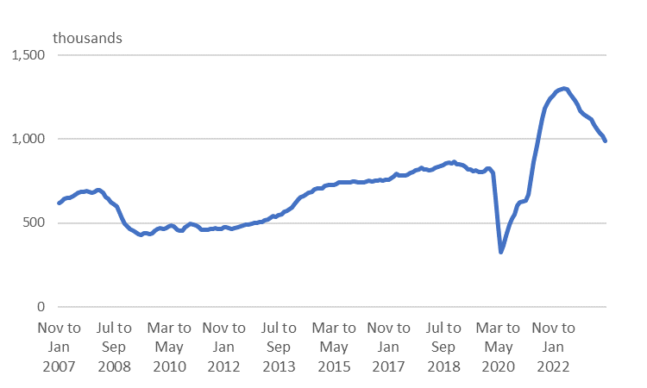
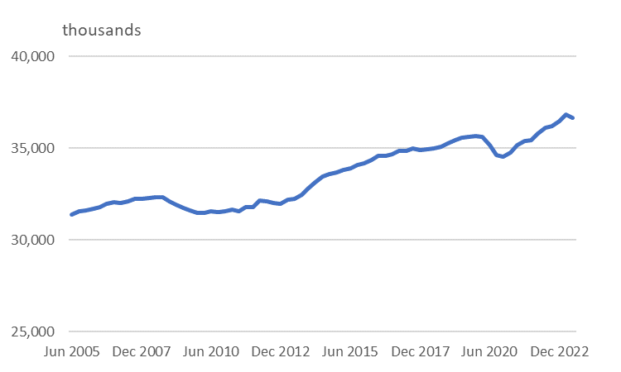
The labour market – UK vacancies & jobs
Vacancies
Nationally, ONS reports an estimated 6% fall in the number of vacancies in the third quarter of 23 on the second quarter of 23**. Total vacancies were down by 268,000 from a year ago, but still c190,000 above pre-pandemic levels.
The industry with the largest fall was accommodation and food services, where vacancies fell by 48,000.
In May to July 23, the number of unemployed people per vacancy was at 1.4, up from 1.2 in Feb to April 23. Although this ratio remains low by historical standards it does show a slight loosening of the labour market as the number of vacancies fell against an increase in unemployment.
In June 2023, UK workforce jobs fell to 36.7m - a fall of 153,000 since March 2023, with a record quarterly fall of 197,000 in self-employment jobs having the largest contribution. Employee jobs offset this slightly, increasing by 68,000 on the quarter.
Jobs*
ONS Vacancies and jobs in the UK, September 2023
*The number of jobs is not the same as the number of people in employment - a person can have more than one job.
**Note. There is some variability in the data across sources - some showing a small increase.

Slide 5

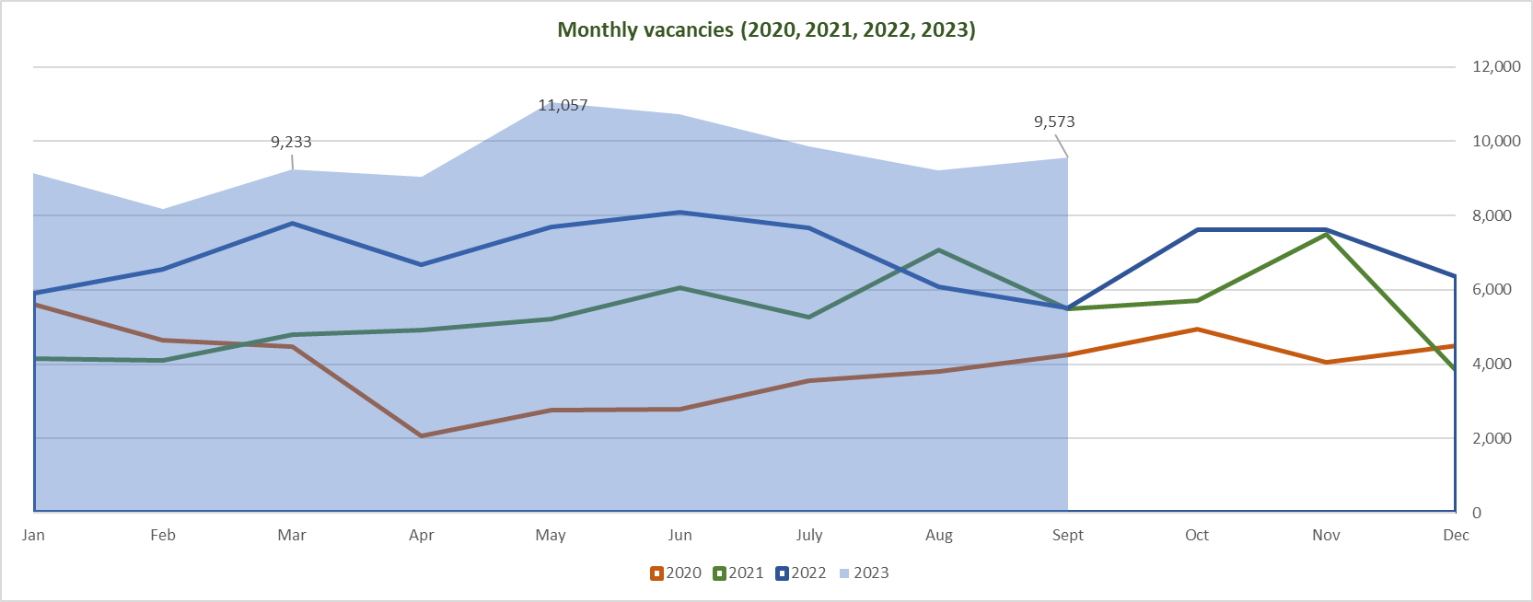
Consistent level of vacancies - Dorset
Vacancies across Dorset have continued to hold up well. Over the 9 months of 2023 there has been average of 9,500 advertised vacancies – significantly higher than in preceding years. The data appears to illustrates continued robust demand for workers across the Dorset LEP areas. In contrast to the national picture of softening demand, vacancies across Dorset have been consistent through the summer and into early autumn.
Lightcast ™ 2023

Slide 6
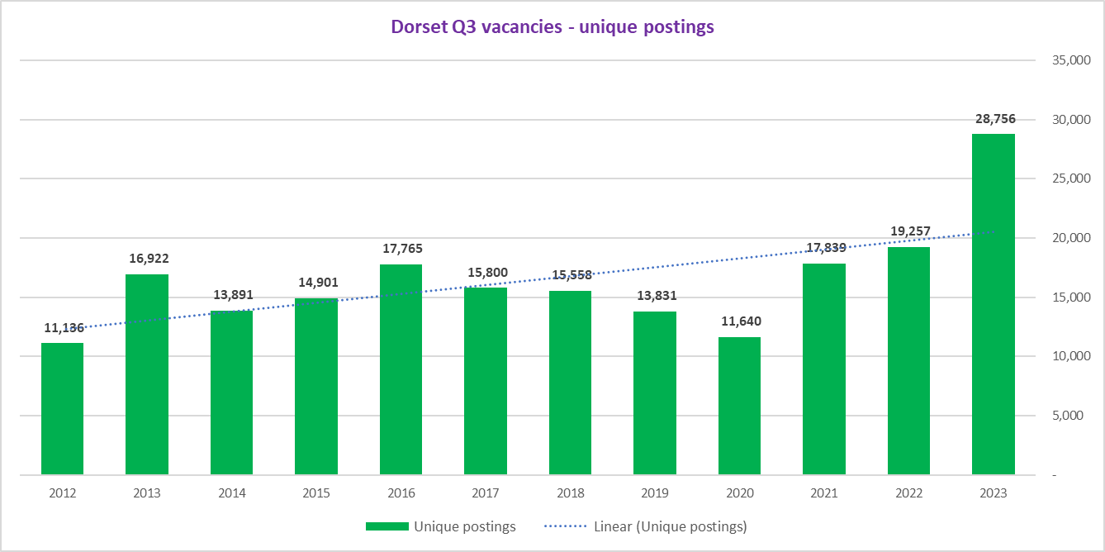
A new record in quarterly demand
The aggregate vacancies advertised through the 3 months July-Sept of 2023 in Dorset hit a new record. This was nearly 50% higher than the same period in 2022. When comparing the two local council areas, vacancy growth was even more pronounced in Dorset where they grew by 69% vs 40% increase in BCP. However, BCP still represents the location of highest vacancies – broadly two-thirds of vacancies across the Dorset LEP area.
Vacancies Jul-Sep 2023
Dorset County – 9,902
BCP – 18,854
Q3 2023 v Q3 2022
(Dorset LEP)
+49%
(England)
+16%
Lightcast ™ 2023
(see Vacancies and Opportunities dashboard)

Slide 7
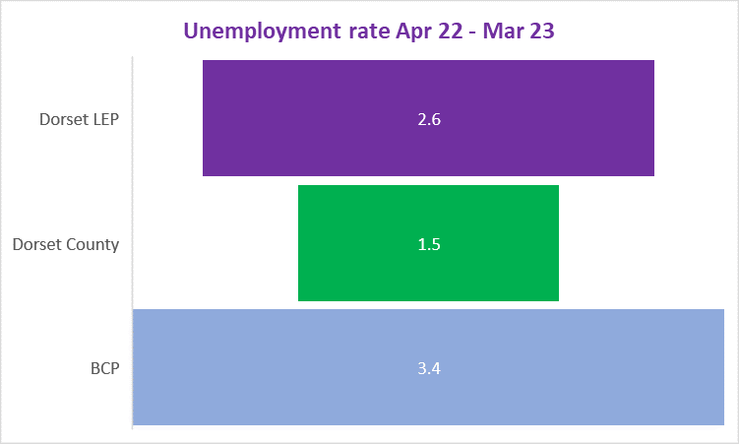
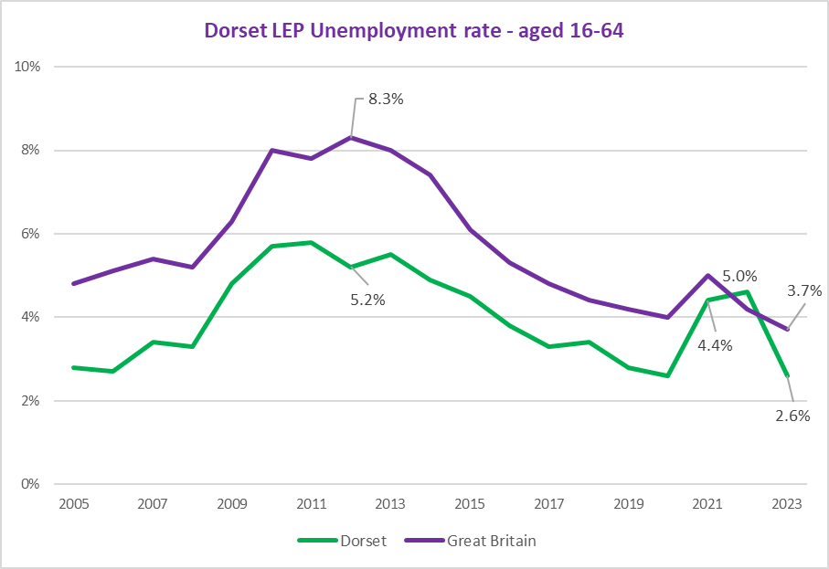
Unemployment remains low
Unemployment rates in Dorset (LEP) have declined continuously since the last quarter of 2021 when they reached 5% and briefly overtook national rates for the first time on record. The latest quarterly data (to March 23) indicates that only 2.6% of working age people in Dorset (LEP) were unemployed and looking for a job.
Moreover, this figure remains very low in Dorset Council dropping to an estimated 1.5%. The number of people out of work remains extremely low within a wider historical context. It is also important to recognise that the unemployment data is slightly lagged, and therefore may begin to reflect more the softening conditions seen elsewhere through the summer.
The ONS has recently changed to the way that it measures unemployment – producing experimental statistics on labour market variables, partly in recognition that previous methods for measuring were no longer fit for purpose. As always, this means care needs to be taken in interpretation of any figures.
ONS Annual Population Survey
(see Vacancies and Opportunities dashboard)

Slide 8


(Un)Employment
Both employment and unemployment rates in Dorset remain more favourable than the national averages (although the confidence intervals associated with the local data are wider).
There were 16,500 more people employed in Dorset (LEP) in 2023 when compared to same period in 2022. Unemployment has continued to fall – and potentially significantly so. The latest data suggesting it is one-third lower in 2023 than the year previously (although again noting the need for care around local data).
Employed
Unemployed
353,700
9,300
Dorset LEP
UK
Dorset LEP
UK
- 6,900 less people unemployed*
(-2pptꜜ)
79.2%
75.4%
(-0.5ppt)
+16,500
more people in employment*
(+3.4ppt)
(+0.3ppt)
3.7%
2.6%
* Figures refer to the period Apr 2022-Mar 2023 in comparison to Apr 2021-Mar 2022 - ONS Annual Population Survey 2023

Slide 9
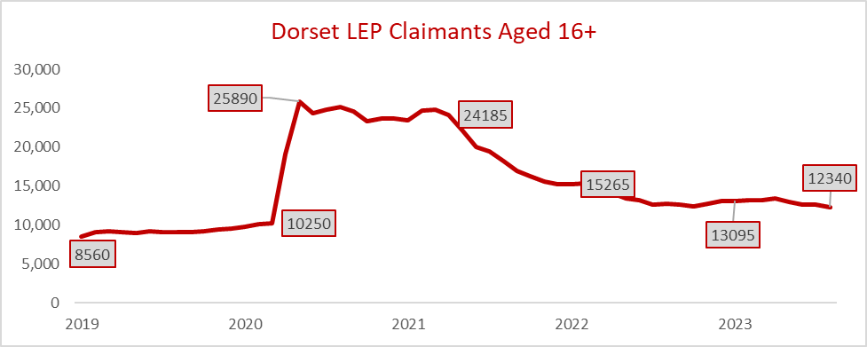

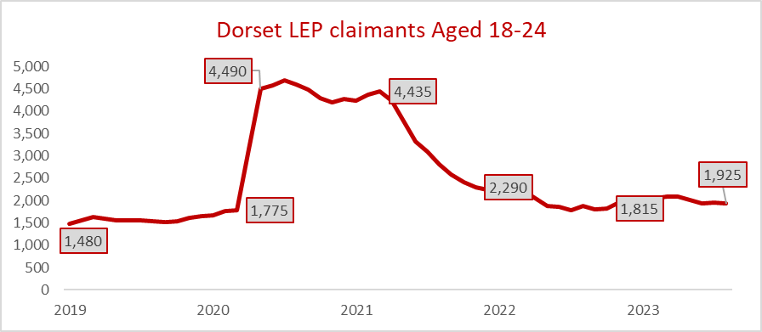

Claimants
With some lag in employment figures, claimant counts over the 3rd quarter of 2023 have broadly remained level in terms of the number of people on out-of-work benefits. This does not show the true extent of unemployment. Unemployment for younger people remains higher than the whole workforce.
Out-of-work benefits
Claimants as a proportion of residents aged 16+
2.6%
Youth unemployment
Claimants as a proportion of residents aged 18-24
3.2%
Source: ONS, Claimant counts

Slide 10

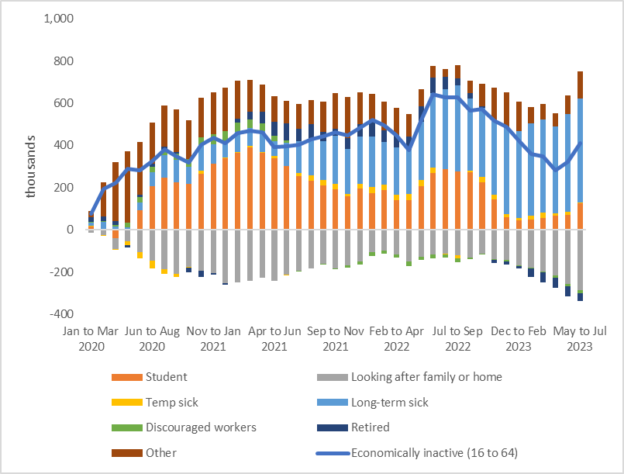
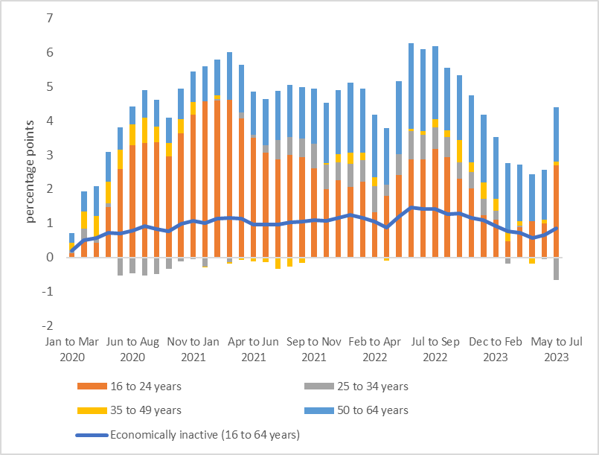
Chart of the quarter 1 – UK economic inactivity
Increases in economic inactivity in the post-pandemic period have been mostly driven by those aged 50 to 64 years, although the latest quarter driven by 16 to 24 years
Those inactive because they were long-term sick also increased to a record high. Conversely, those inactive because they were looking after family or home decreased to a record low
UK inactivity by reason, cumulative change (000s)
– Dec 19-Jul 23
UK inactivity by age, cumulative change (ppts)
– Dec 19-Jul 23
ONS Employment in the UK, Sept 2023

Slide 11

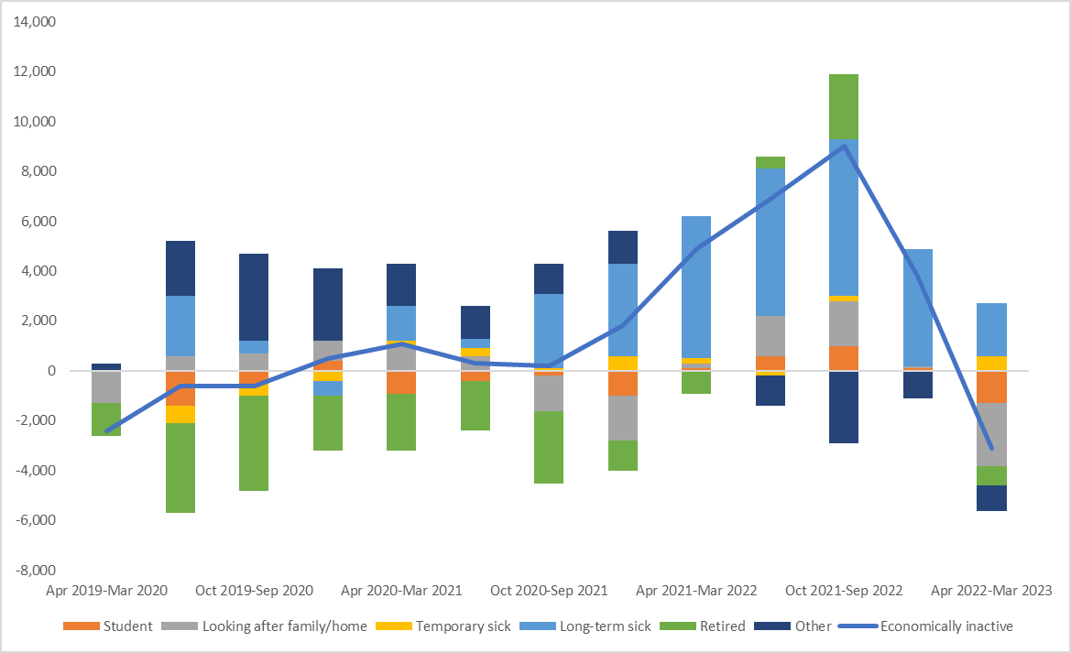
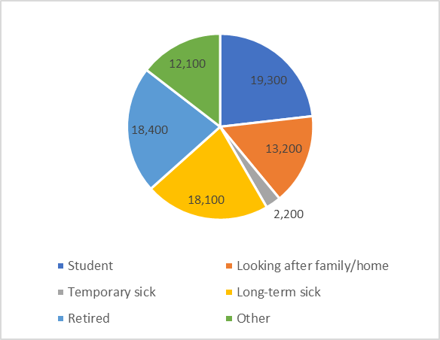
Chart of the quarter 2 – local economic inactivity
Much of the increase in economic inactivity seen across Dorset following the pandemic appears to have largely disappeared in recent quarters – peaking in late 2022
The main factor in the increase had been explained by significant increase in long-term (and to a lesser extent temporary) sickness. This has also significantly reduced in the most recent period.
Dorset (LEP) inactivity by reason, cumulative change (000s)
– Dec 19-Jul 23 (16-64)
Dorset (LEP) inactivity by reason
Mar 23 (16-64)
Economic inactivity
Dorset LEP
83,600/ 18.7%
UK
9.03m /21.7%
ONS: Annual Population Survey

Slide 12
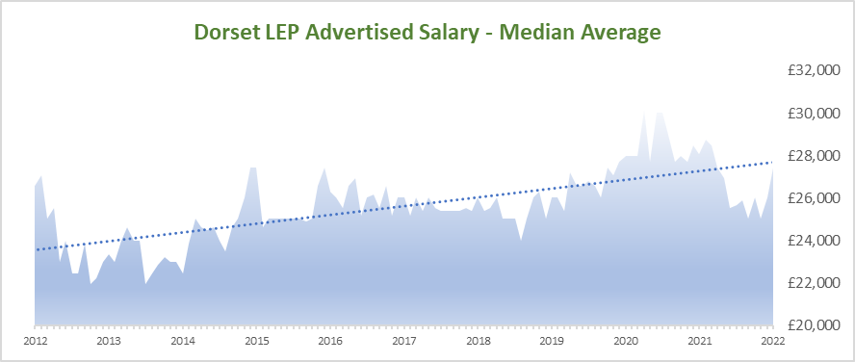
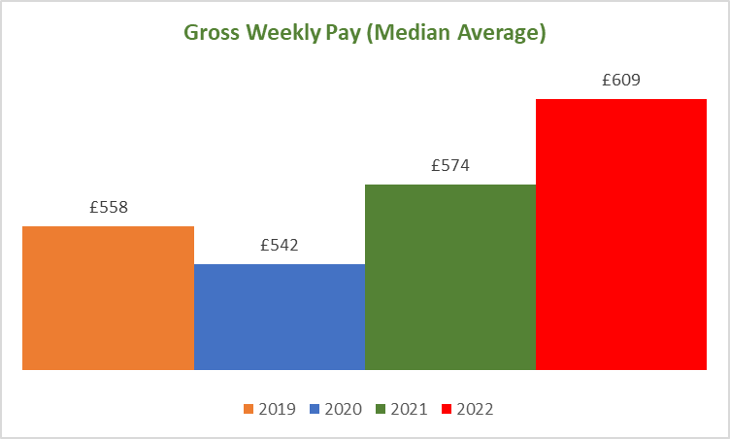
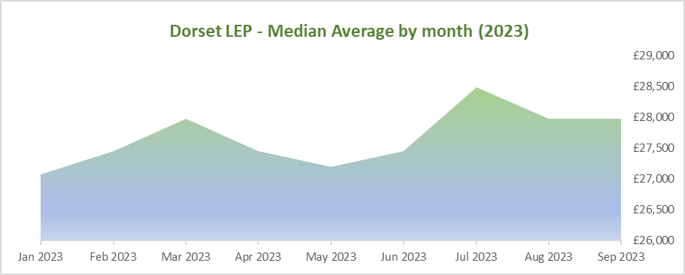
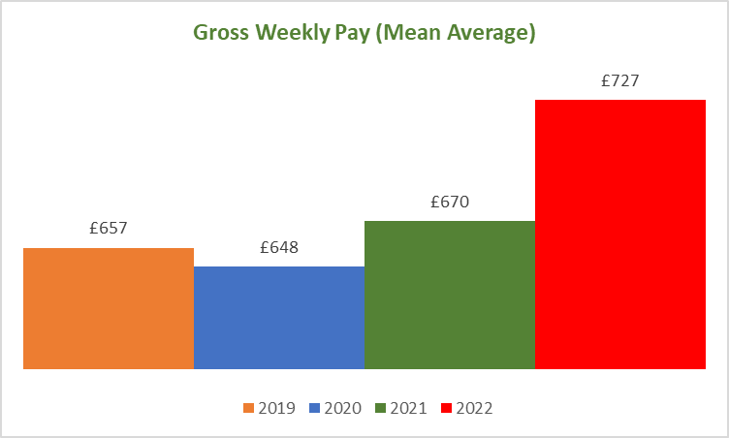
Salaries
With a continued focus on the cost-of-living crisis and the squeeze on incomes it is interesting to understand trends in salaries/wages being offered through advertised vacancies (noting this is a proportion of total jobs). The data suggests that average advertised wages (right-hand charts)have not increased markedly locally – with offered salaries increasing marginally or remaining flat over both the short-term (2023) and longer term (past 10 years). However, ONS data paints a slightly different picture – both locally and nationally – with strong nominal pay growth seen over past 12 months.
Full-Time Workers Pay

Slide 13

Dorset recruitment trends:
Top employers
As is consistently the case, the NHS is by far the largest source of labour demand in Dorset – over 5 times as many as the second largest employer – Dorset Council (excluding recruitment agencies). The NHS and the care sector continues to face significant skills shortages and recruitment difficulties (as shown by average posting duration). Demand has also been high at local Councils, Haven Holidays, JP Morgan Chase, Holt Engineering, Ultra Group and residential care firms. Much recruitment still flows through recruitment agencies.
Strong demand has been shown for some manufacturers and engineering companies, as well as in the hospitality industry – reflecting summer recruitment in this latest data.
Lightcast ™ 2023

Slide 14
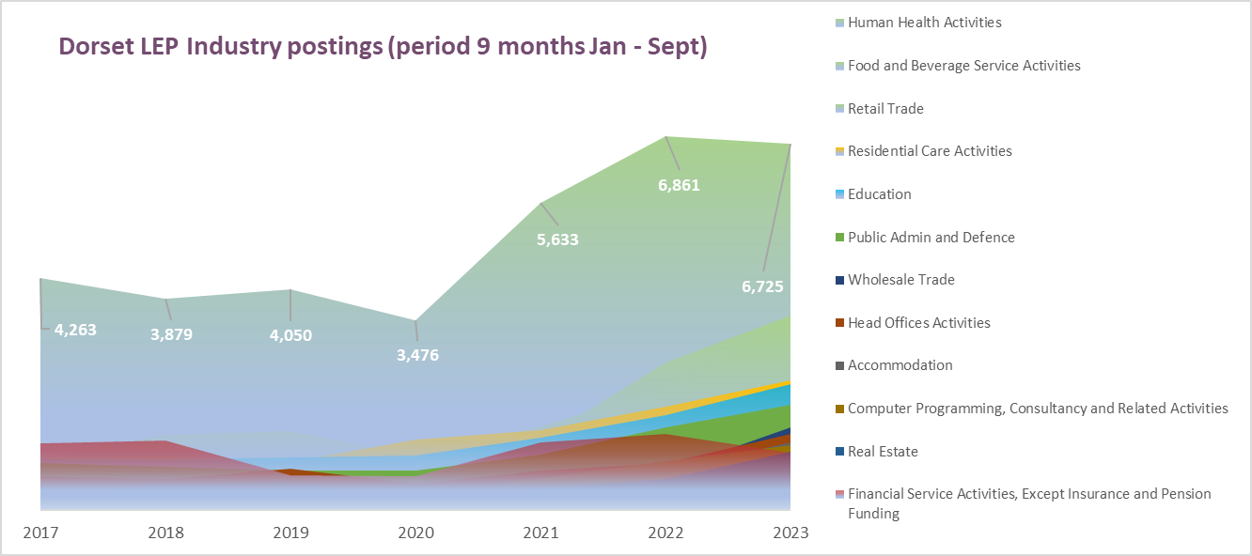
Industry demand trends in Dorset
Looking at the industries with highest number of vacancies in the 9 months to Sept the health care continued to dominate with the most significant unique postings. The next largest sector in terms of labour demand continues to be food and services and retail (with strong increases in advertised postings in 2023 compared to 2022).
Lightcast ™ 2023

Slide 15

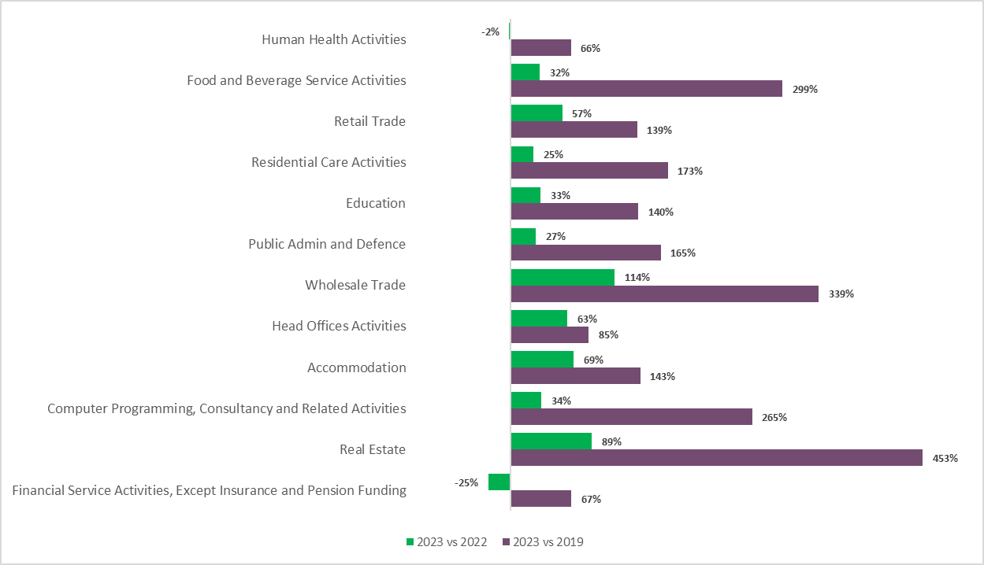
Top 10 industries (2023) - vacancy growth in 2023 to date
Labour demand across all broad industries in Dorset has also grown considerably when compared to pre-pandemic levels (2019).
Most notably, the first 9 months of 2023 have seen vacancies increasing 4.5x and also strong growth in good services and wholesale trade. There was a small fall in the number of advertised vacancies in the human health sector, despite it remaining as the most significant sector in terms of labour demand.
Lightcast ™ 2023

Slide 16
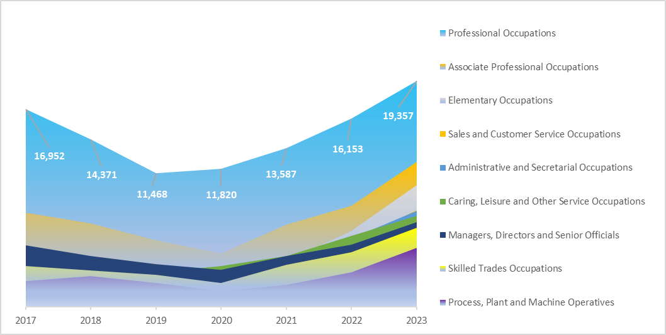
Vacancies by Occupation| 2023 to date
The Standard Occupation Classification (SOC), offers an approximation of jobs on the market that require high, medium or low skills and linked levels of education.
Occupations – long-term developments Jan-Sept
SOC 1-3 Digits | High skilled jobs
1 – Managers 2 – Professionals 3 – Associate Professionals | Generally require a graduate level education
SOC 4-6 Digits | Med-range skilled
4 – Admin 5 – Skilled trades 6 – Caring, leisure, service | Mostly require a Level 3-5 education
SOC 7-9 Digits | Low skilled jobs
7 – Sales 8 – Process, machine operatives 9 – Elementary | Mainly Level 2 qualifications and below
Lightcast ™ 2023
The demand for lower and mid-skilled roles in Dorset have elevated in scale over the past decade, particularly for Elementary and Caring occupations. This is likely a reflection of higher turnover, declining supply and possible changes in the way employers recruit for these roles in recent years.
The openings for high skilled jobs (SOC 1-3) that typically demand university and college graduates in Dorset however remain critical to local growth. With c39,000 vacancies in the first 9 months of 2023 they accounted for c46% of the advertised vacancies, whilst mid-skilled roles made up c27% and lower-skilled for c28% of demand (figures rounded).
SOC 2020 Structure & Descriptions, ONS

Slide 17
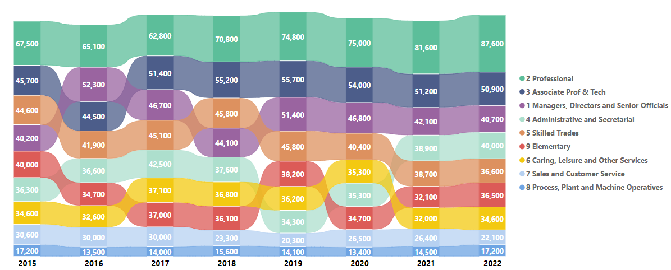
Employment by broad occupation
The existing employment figures illustrate that vacancies demand is not a mirror reflection of actual employment. The largest drops in employment over that period were recorded amongst those employed in low skilled roles (↓14%), mainly explained by a 28% Sales and 18% Skilled Trades declines.
High skilled occupations (SOC 1-3) tended to dominate, accounting for half of all in employment and the occupational grouping that has seen a growth in employment since 2015 (↑17%), largely accounted by the increases in professionals (↑30%) and associate professionals (↑10%) in employment.
Annual Population Survey, Dec 2022

Slide 18
High skilled occupations in Dorset 2023 to date
.
PROFESSIONALS
c19.4k unique job postings
Median advertised salary: c£38k
Top roles: Nurses, Engineers, Teachers & Accountants
Top Sectors: Administrative, Health & Education
Top employers: NHS, JP Morgan, Councils, Dorset Council, Ultra Group, G2 Legal
Top skills: Communications, Management, Teaching, Planning
ASSOCIATE PROFESSIONALS
c12.4 unique job postings
Median advertised salary: c£30k
Top roles: Project Managers, Account Managers, Finance Managers
Top Sectors: Administrative, Health, Retail, Real Estate
Top employers: NHS, JP Morgan, Hays, Councils, BU, Holt Engineering
Top skills: Communications, Customer service, Sales, Detail Orientation
MANAGERS
c7.2k jobs unique job postings
Median advertised salary: c£32k
Top roles: Business Development Mngrs, Store Managers
Top Sectors: Administrative, Health, Retail, Trade & Finance
Top employers: NHS, Tesco, JP Morgan, Hays, Councils, Haven Holidays, Agincare, Holt
Top skills: Management, Communications, Customer Services
Lightcast ™ 2023

Slide 19
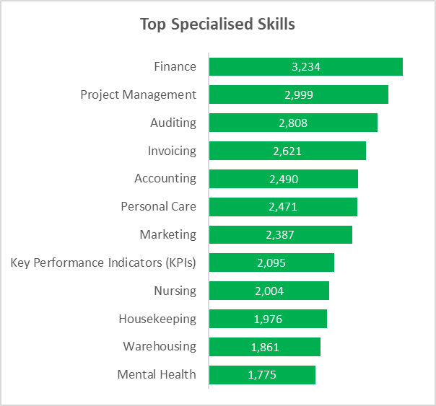
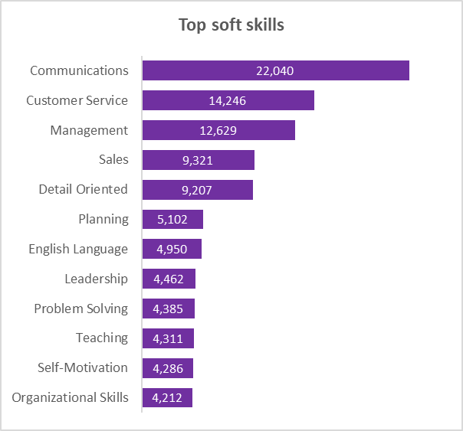
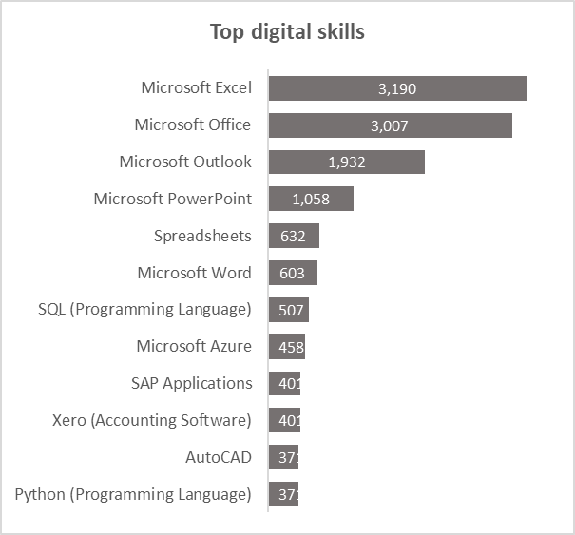
Skills
Employers most frequently requested soft skills were in communication, customer service, management, sales, and detail-orientation, alongside personal attributes such as enthusiasm and self-motivation. Specialised skills often cited in job postings include finance, and project management. This continues longer-term trends.
Many of these were less prevalent in candidate profiles (i.e. CVs) when compared to the volume of references in job postings (recognising that skill sets may not be accurately described in candidate profiles).
Top sought after skills (job postings) – Dorset LEP area Jan 23 – Sept 23
Lightcast ™ 2023

Slide 20

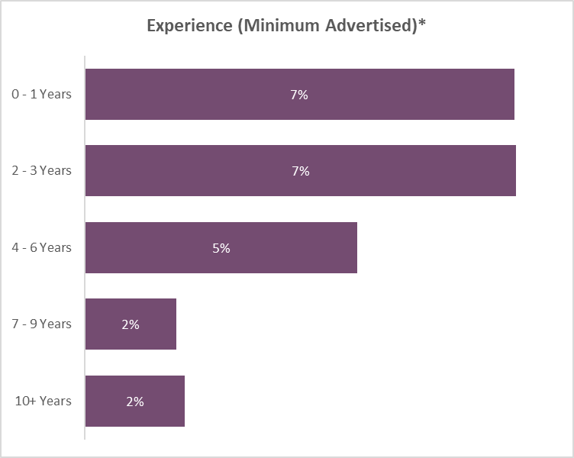
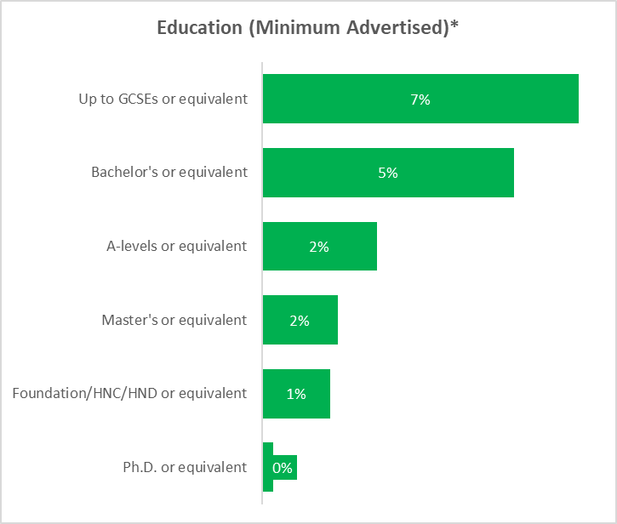
Education & Experience | 2023 to date
Only 18% of advertised jobs specified educational requirements. Where specified, over half of the jobs (57%) required degrees.
Only 23% of advertised jobs specified experience requirements in terms of number of years. Where specified, two-thirds of the advertised jobs required less than 3 years of experience.
Lightcast ™ 2023
*Figures to be taken with caution due to large number of missing data points.

Slide 21

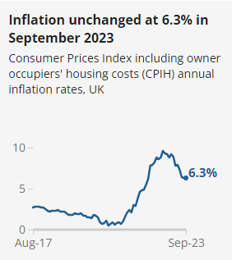
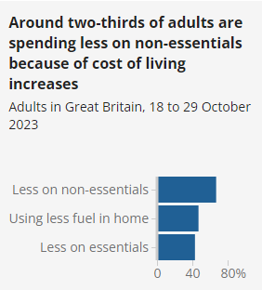
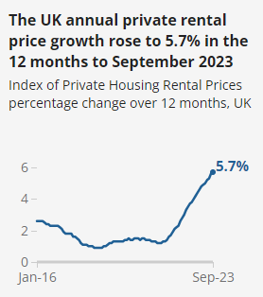
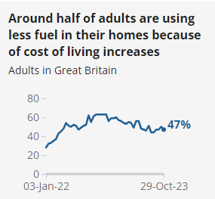
Cost of Living
The latest ONS insight into social trends and public opinion Around a half (49%) of adults reported that their cost of living had increased compared with a month previously. However, this had decreased (from 80%) during a similar period one year ago – indicating a slight easing of inflationary pressure.
Among those currently paying rent or a mortgage, 4 in 10 (40%) reported that their rent or mortgage payments had gone up in the past six months.
ONS - 2023

Slide 22

Working Futures Corner
The Institute for Employment Research has produced its latest projections for the size and shape of the employment and labour market in the UK and local areas up to 2035.
The megatrends expected to shape the future of work include:
Brexit & Covid 19
Increased adoption of technology
Major demographic changes
Major environmental changes
In the immediate future up to 2027
Decline in overall employment due to automation is expected in the Primary sector (Agriculture, Electricity and Water) and Manufacturing, while moderate growth in employment is projected in Construction, Trade, Accommodation, Transport, Business and Public Administration.
Significant employment growth is expected for:
• Higher level occupations, including managers, most professional occupations and many associate professional and technical roles;
• Caring, leisure and other service occupations;
• Net job losses are projected for administrative and secretarial occupations, skilled trade occupations, and process, plant and machine operatives;
• Elementary occupations will experience mixed fortunes, with some modest growth in jobs where tasks are not so easily subject to automation, but job losses in other areas.
Detailed local projections for new and replacement demand are also available for Dorset - link.

Slide 23

Policy impact
The Resolution Foundation recently released a policy paper that focuses on how to embed a skills strategy within an economic strategy. The report focuses on a set of sectors – financial and business services, the creative and cultural sectors, life sciences and clean technologies and artificial intelligence (all important within the Dorset context).
It finds that wages tend to be higher and wage-experience trajectories steeper for workers at every level of educational qualification in these strategic sectors. Therefore, supporting these sectors to grow will provide wage-benefits to individuals. However, there are signals that the current skill mix of workers may not be adequate. The clearest indicator that demand exceeds supply for skills is the high wage premium associated with higher levels of education. Without a sustained upgrading of the education and skills of workers, these strategic sectors may struggle to sustain growth.

Slide 24
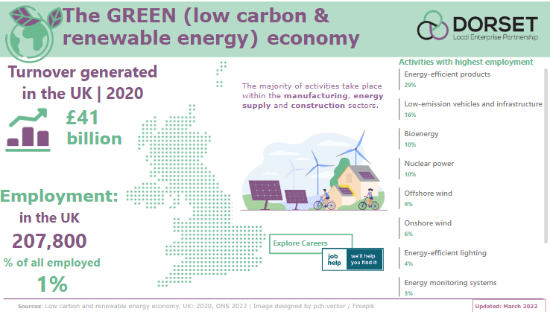
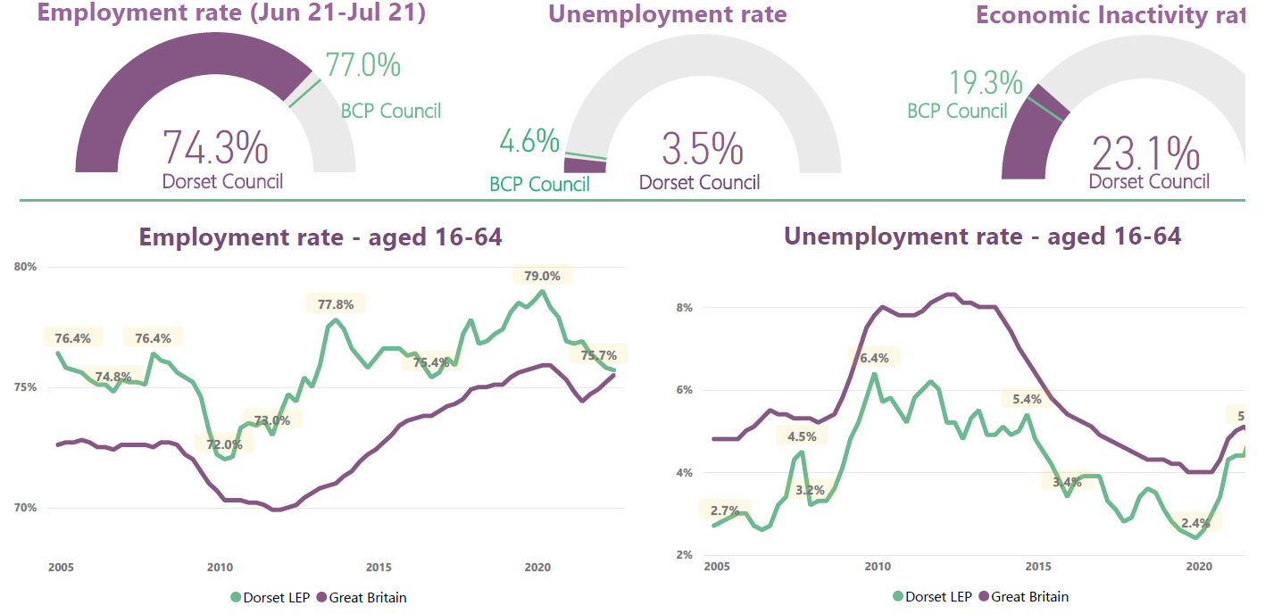
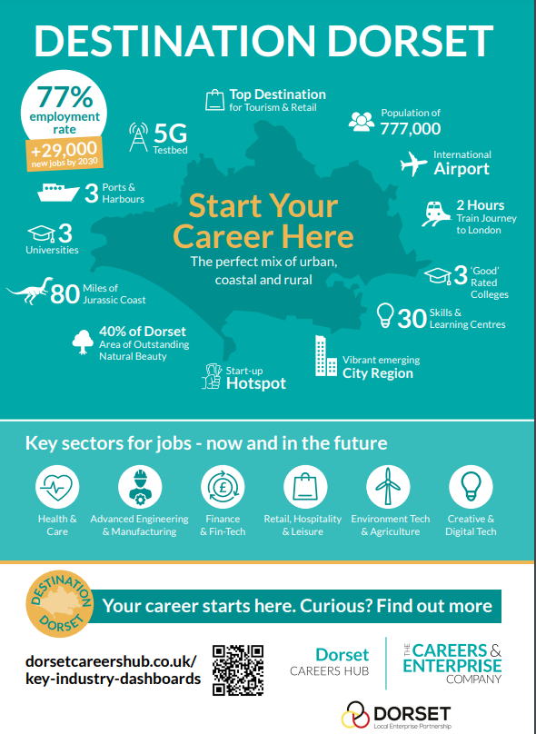
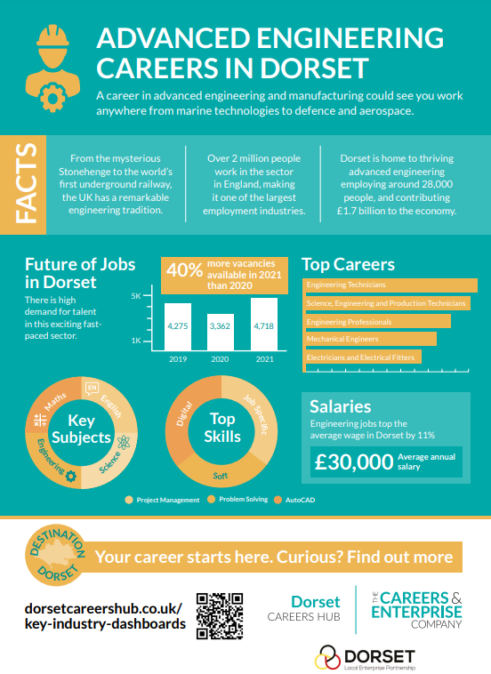
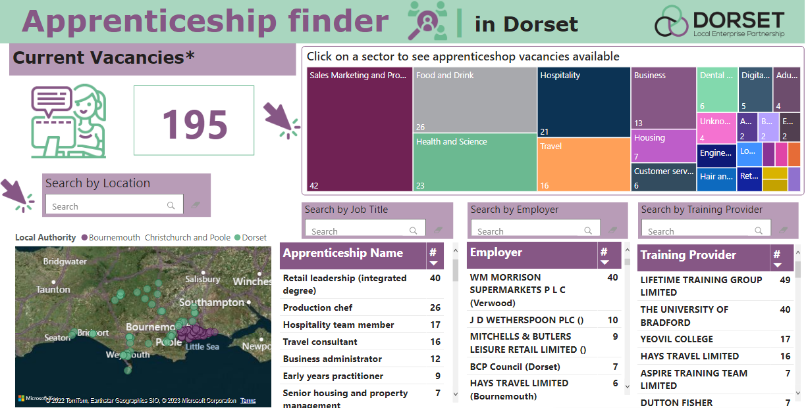
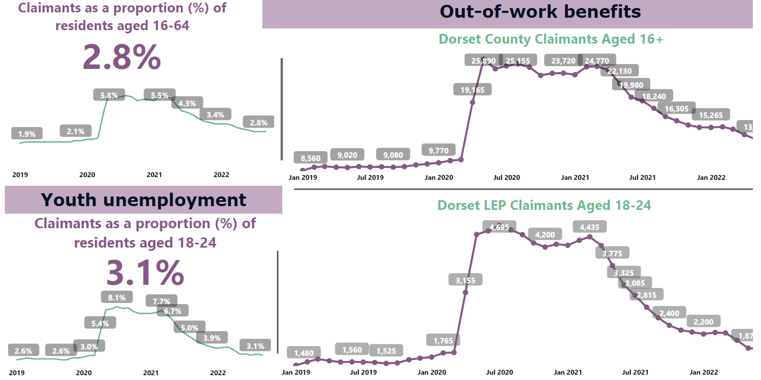
Visit dorsetlep.co.uk/labour-market-and-skills-research
to explore latest insights and our interactive dashboards
Email DorsetLEP@bournemouth.ac.uk to subscribe for updates
Key industry dashboards
Employment Insights
Key Industry Posters
Apprenticeships finder
Vacancy Insights

