Slide 1
PART 1 | LANDSCAPE
Last data refresh:
17/06/2022
Notes:
Living in Dorset
No alt text provided
textbox
No alt text provided
image
No alt text provided
image
No alt text provided
textbox
No alt text provided
textbox
No alt text provided
textbox
No alt text provided
textbox
No alt text provided
textbox
No alt text provided
textbox
No alt text provided
textbox
No alt text provided
textbox
No alt text provided
textbox
No alt text provided
textbox
No alt text provided
textbox
No alt text provided
textbox
No alt text provided
textbox
No alt text provided
actionButton
No alt text provided
actionButton
No alt text provided
actionButton
No alt text provided
actionButton
No alt text provided
actionButton
No alt text provided
actionButton
No alt text provided
actionButton
No alt text provided
actionButton
No alt text provided
actionButton
No alt text provided
actionButton
No alt text provided
actionButton
No alt text provided
actionButton
No alt text provided
actionButton
No alt text provided
Go to Part 2
No alt text provided
actionButton
No alt text provided
textbox
No alt text provided
actionButton
No alt text provided
textbox
No alt text provided

Slide 2
Population
Notes:
Living in Dorset
No alt text provided
textbox
No alt text provided
textbox
No alt text provided
textbox
No alt text provided
image
No alt text provided
basicShape
No alt text provided
basicShape
No alt text provided
image
No alt text provided
Population Projections
No alt text provided
# Population (2020)
No alt text provided
Working age population
No alt text provided
Labour Force
No alt text provided
Age profile
No alt text provided
#
No alt text provided
actionButton
No alt text provided

Slide 3
Employment
Notes:
Living in Dorset
No alt text provided
textbox
No alt text provided
textbox
No alt text provided
textbox
No alt text provided
image
No alt text provided
basicShape
No alt text provided
textbox
No alt text provided
image
No alt text provided
# Employed (2021)
No alt text provided
Employment rate (aged 16-64)
No alt text provided
Unemployment rate (aged 16-64)
No alt text provided
slicer
No alt text provided
# Unemployed (2021)
No alt text provided
Employed # (aged 16-64)
No alt text provided
Unemployed # (aged 16-64)
No alt text provided
actionButton
No alt text provided

Slide 4
Claimants
Notes:
Living in Dorset
No alt text provided
textbox
No alt text provided
textbox
No alt text provided
textbox
No alt text provided
image
No alt text provided
basicShape
No alt text provided
textbox
No alt text provided
basicShape
No alt text provided
image
No alt text provided
% of residents aged 16-64
No alt text provided
image
No alt text provided
(%) of residents aged 18-24
No alt text provided
basicShape
No alt text provided
Claimant Count Age 16+
No alt text provided
Claimants Aged 18-24
No alt text provided
actionButton
No alt text provided

Slide 5
Sector Employment
Notes:
Living in Dorset
No alt text provided
textbox
No alt text provided
textbox
No alt text provided
textbox
No alt text provided
image
No alt text provided
basicShape
No alt text provided
image
No alt text provided
ribbonChart
No alt text provided
clusteredBarChart
No alt text provided
basicShape
No alt text provided
Average wages
No alt text provided
basicShape
No alt text provided
actionButton
No alt text provided

Slide 6
Sector Development
Notes:
Living in Dorset
No alt text provided
textbox
No alt text provided
textbox
No alt text provided
textbox
No alt text provided
image
No alt text provided
basicShape
No alt text provided
image
No alt text provided
2015 - 2021 Change
No alt text provided
basicShape
No alt text provided
ribbonChart
No alt text provided
actionButton
No alt text provided

Slide 7
Occupations Employment
Notes:
Living in Dorset
No alt text provided
textbox
No alt text provided
textbox
No alt text provided
textbox
No alt text provided
image
No alt text provided
basicShape
No alt text provided
basicShape
No alt text provided
image
No alt text provided
% Employed by occupation (2021)
No alt text provided
Employment (2021)
No alt text provided
basicShape
No alt text provided
Average wages
No alt text provided
basicShape
No alt text provided
Average annual openings
No alt text provided
Automation Index
No alt text provided
basicShape
No alt text provided
actionButton
No alt text provided

Slide 8
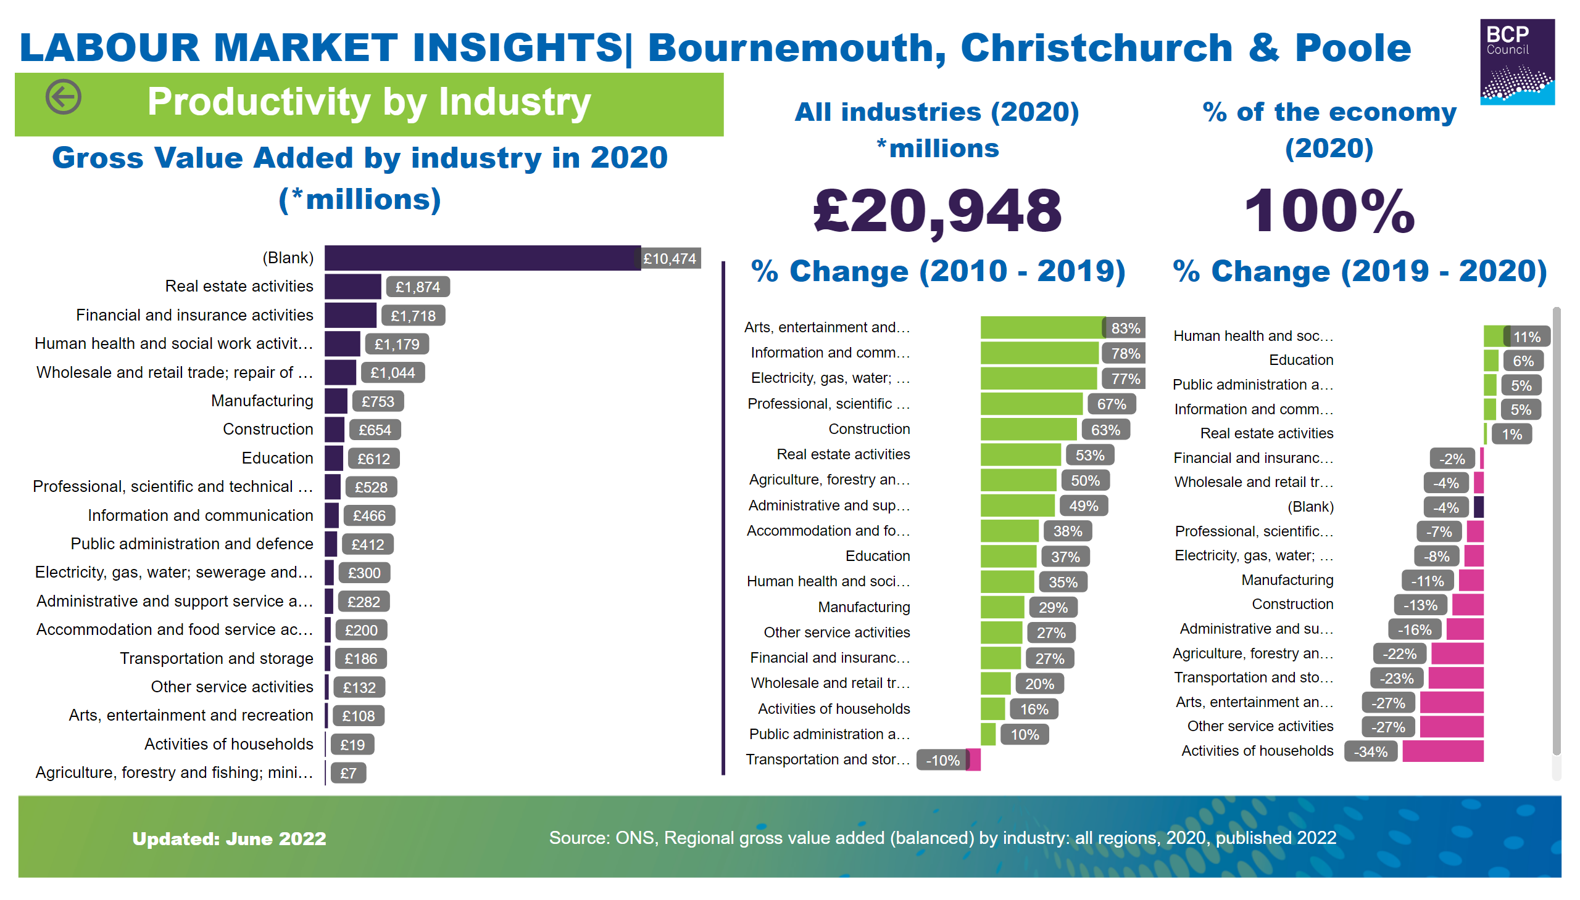
Sector Productivity
Notes:
Living in Dorset
No alt text provided
textbox
No alt text provided
textbox
No alt text provided
textbox
No alt text provided
image
No alt text provided
basicShape
No alt text provided
image
No alt text provided
actionButton
No alt text provided
Gross Value Added by industry in 2020 (*millions)
No alt text provided
All industries (2020) *millions
No alt text provided
% Change (2019 - 2020)
No alt text provided
% Change (2010 - 2019)
No alt text provided
% of the economy (2020)
No alt text provided

Slide 9
Occupations Development
Notes:
Living in Dorset
No alt text provided
textbox
No alt text provided
textbox
No alt text provided
textbox
No alt text provided
image
No alt text provided
basicShape
No alt text provided
image
No alt text provided
basicShape
No alt text provided
ribbonChart
No alt text provided
2015 - 2021 Change
No alt text provided
actionButton
No alt text provided

Slide 10
Enterprise
Notes:
Living in Dorset
No alt text provided
textbox
No alt text provided
textbox
No alt text provided
textbox
No alt text provided
image
No alt text provided
basicShape
No alt text provided
image
No alt text provided
# Enterprises*
No alt text provided
# Enterprises* (2021)
No alt text provided
Enterprise size - UK
No alt text provided
Enterprise size - BCP
No alt text provided
# Micro (0-9)
No alt text provided
# Small (10-49)
No alt text provided
# Medium (50-249)
No alt text provided
#Large (250+)
No alt text provided
basicShape
No alt text provided
actionButton
No alt text provided

Slide 11
Business Demography
Notes:
Living in Dorset
No alt text provided
textbox
No alt text provided
textbox
No alt text provided
textbox
No alt text provided
image
No alt text provided
basicShape
No alt text provided
image
No alt text provided
Business birth rate
No alt text provided
# Active Enterprises*
No alt text provided
# Business births*
No alt text provided
Business death rate
No alt text provided
# Business deaths*
No alt text provided
Business survival (BCP)
No alt text provided
Business survival (UK)
No alt text provided
basicShape
No alt text provided
actionButton
No alt text provided

Slide 12
Productivity
Notes:
Living in Dorset
No alt text provided
textbox
No alt text provided
textbox
No alt text provided
textbox
No alt text provided
image
No alt text provided
basicShape
No alt text provided
textbox
No alt text provided
image
No alt text provided
GVA (per hour worked) - difference from UK
No alt text provided
Gross Domestic Product | GDP (2019)
No alt text provided
basicShape
No alt text provided
GVA Time Series
No alt text provided
GVA Difference Time Series
No alt text provided
GDP Time Series
No alt text provided
Gross Value Added (GVA) per hour worked
No alt text provided
Reference areas
No alt text provided
slicer
No alt text provided
Output gap (per annum)
No alt text provided
actionButton
No alt text provided

Slide 13
Earnings
Notes:
Living in Dorset
No alt text provided
textbox
No alt text provided
textbox
No alt text provided
textbox
No alt text provided
image
No alt text provided
basicShape
No alt text provided
image
No alt text provided
Median gross weekly wage - full-time workers (Residents)
No alt text provided
Weekly wages by area - 2021*
No alt text provided
Median gross weekly wage - full-time workers (Workplace)
No alt text provided
basicShape
No alt text provided
Weekly wages by sex
No alt text provided
actionButton
No alt text provided

Slide 14
Low paid jobs
Notes:
Living in Dorset
No alt text provided
textbox
No alt text provided
textbox
No alt text provided
textbox
No alt text provided
image
No alt text provided
basicShape
No alt text provided
image
No alt text provided
# Jobs below the living wage by area
No alt text provided
# BCP jobs paid below the living wage (2021)
No alt text provided
basicShape
No alt text provided
% BCP jobs
No alt text provided
% England jobs
No alt text provided
% Jobs below the living wage by area
No alt text provided
Jobs below the living wage (2019-2021)
No alt text provided
actionButton
No alt text provided
basicShape
No alt text provided

Slide 15
Deprivation
Notes:
Living in Dorset
No alt text provided
textbox
No alt text provided
Index of Multiple Deprivation Rank
No alt text provided
textbox
No alt text provided
textbox
No alt text provided
image
No alt text provided
Domains of Deprivation - % of BCP neighbourhoods among the top 10% of deprivation nationally
No alt text provided
basicShape
No alt text provided
image
No alt text provided
basicShape
No alt text provided
image
No alt text provided
Number of neighbourhoods
No alt text provided
actionButton
No alt text provided

Slide 16
Children in Poverty
Notes:
Living in Dorset
No alt text provided
textbox
No alt text provided
textbox
No alt text provided
textbox
No alt text provided
image
No alt text provided
# Children living in low income families
No alt text provided
basicShape
No alt text provided
image
No alt text provided
Children (aged 0-19) living in families in Relative low income (2021)
No alt text provided
% Children (aged 0-19) living in families in Relative low income (2021)
No alt text provided
basicShape
No alt text provided
basicShape
No alt text provided
# Children living in Relative low income families by area
No alt text provided
% Children living in Relative low income families by area (2021)*
No alt text provided
actionButton
No alt text provided

Slide 17
PART 2 | DEMAND
Notes:
Living in Dorset
No alt text provided
textbox
No alt text provided
image
No alt text provided
image
No alt text provided
textbox
No alt text provided
textbox
No alt text provided
textbox
No alt text provided
textbox
No alt text provided
textbox
No alt text provided
textbox
No alt text provided
textbox
No alt text provided
textbox
No alt text provided
textbox
No alt text provided
textbox
No alt text provided
textbox
No alt text provided
textbox
No alt text provided
actionButton
No alt text provided
actionButton
No alt text provided
actionButton
No alt text provided
actionButton
No alt text provided
actionButton
No alt text provided
actionButton
No alt text provided
actionButton
No alt text provided
actionButton
No alt text provided
actionButton
No alt text provided
actionButton
No alt text provided
actionButton
No alt text provided
Go to Part 3
No alt text provided
actionButton
No alt text provided
textbox
No alt text provided
actionButton
No alt text provided
actionButton
No alt text provided
textbox
No alt text provided
actionButton
No alt text provided

Slide 18
Vacancies
Notes:
Living in Dorset
No alt text provided
Total Vacancies 2021
No alt text provided
basicShape
No alt text provided
textbox
No alt text provided
2021 v 2020 (BCP)
No alt text provided
(UK)
No alt text provided
textbox
No alt text provided
Annual Vacancies
No alt text provided
textbox
No alt text provided
basicShape
No alt text provided
basicShape
No alt text provided
image
No alt text provided
image
No alt text provided
Monthly Vacancies (2020-2022)
No alt text provided
image
No alt text provided
actionButton
No alt text provided

Slide 19
Area Vacancies
Notes:
Living in Dorset
No alt text provided
textbox
No alt text provided
textbox
No alt text provided
textbox
No alt text provided
image
No alt text provided
Annual Vacancies
No alt text provided
image
No alt text provided
basicShape
No alt text provided
actionButton
No alt text provided

Slide 20
Top Employers & Jobs
Notes:
Living in Dorset
No alt text provided
textbox
No alt text provided
textbox
No alt text provided
textbox
No alt text provided
image
No alt text provided
tableEx
No alt text provided
Top jobs in demand
No alt text provided
basicShape
No alt text provided
image
No alt text provided
actionButton
No alt text provided

Slide 21
Industry Group
Notes:
Living in Dorset
No alt text provided
textbox
No alt text provided
textbox
No alt text provided
textbox
No alt text provided
image
No alt text provided
ribbonChart
No alt text provided
basicShape
No alt text provided
basicShape
No alt text provided
image
No alt text provided
actionButton
No alt text provided

Slide 22
Industries
Notes:
Living in Dorset
No alt text provided
textbox
No alt text provided
textbox
No alt text provided
textbox
No alt text provided
image
No alt text provided
basicShape
No alt text provided
basicShape
No alt text provided
image
No alt text provided
ribbonChart
No alt text provided
actionButton
No alt text provided

Slide 23
Jobs by Industry
Notes:
Living in Dorset
No alt text provided
textbox
No alt text provided
textbox
No alt text provided
textbox
No alt text provided
image
No alt text provided
basicShape
No alt text provided
image
No alt text provided
# Top 10 Occupations 2021
No alt text provided
tableEx
No alt text provided
actionButton
No alt text provided

Slide 24
Occupations
Notes:
Living in Dorset
No alt text provided
textbox
No alt text provided
textbox
No alt text provided
textbox
No alt text provided
image
No alt text provided
basicShape
No alt text provided
basicShape
No alt text provided
image
No alt text provided
ribbonChart
No alt text provided
actionButton
No alt text provided

Slide 25
Jobs by Occupations
Notes:
Living in Dorset
No alt text provided
textbox
No alt text provided
textbox
No alt text provided
textbox
No alt text provided
image
No alt text provided
basicShape
No alt text provided
basicShape
No alt text provided
image
No alt text provided
# Top 10 Occupations 2021
No alt text provided
tableEx
No alt text provided
actionButton
No alt text provided

Slide 26
Qualifications & Experience
Notes:
Living in Dorset
No alt text provided
textbox
No alt text provided
textbox
No alt text provided
textbox
No alt text provided
image
No alt text provided
image
No alt text provided
basicShape
No alt text provided
actionButton
No alt text provided
Subject Areas in Greatest Demand*
No alt text provided
Experience Requirements*
No alt text provided
Education (Minimum Advertised)*
No alt text provided

Slide 27
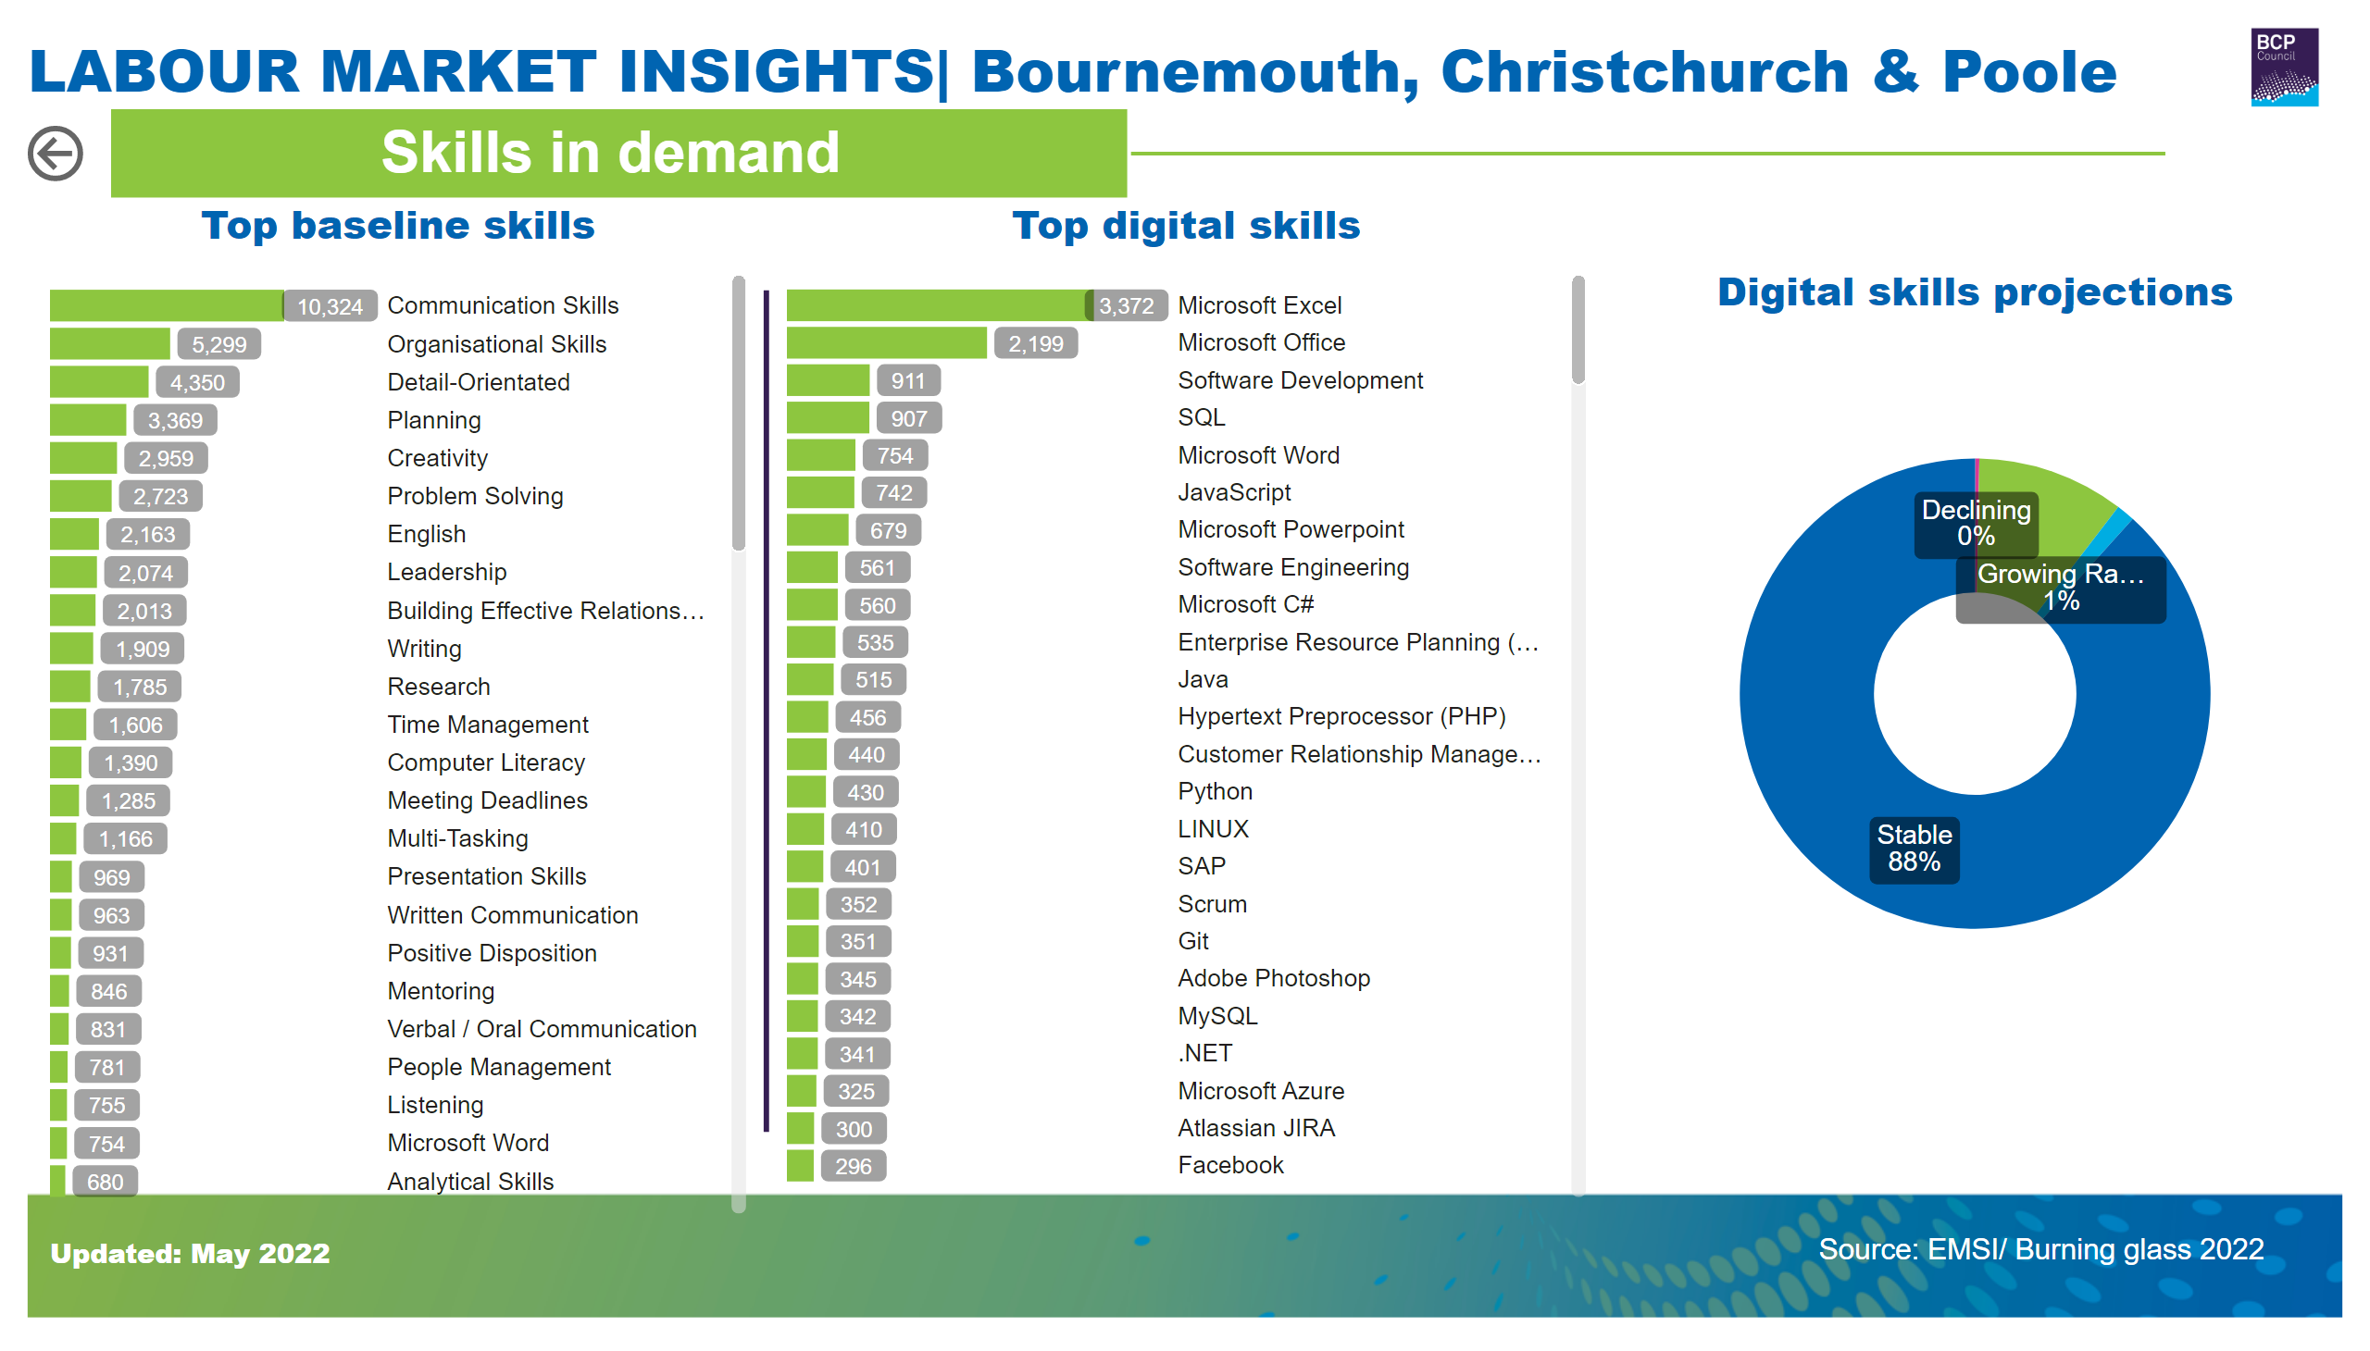
Skills in Demand
Notes:
Living in Dorset
No alt text provided
textbox
No alt text provided
textbox
No alt text provided
textbox
No alt text provided
image
No alt text provided
image
No alt text provided
basicShape
No alt text provided
actionButton
No alt text provided
Top baseline skills
No alt text provided
Top digital skills
No alt text provided
Digital skills projections
No alt text provided
basicShape
No alt text provided

Slide 28
Staff Proficiency & Utilisation
Notes:
Living in Dorset
No alt text provided
textbox
No alt text provided
Staff not fully proficient - England
No alt text provided
textbox
No alt text provided
textbox
No alt text provided
image
No alt text provided
England
No alt text provided
textbox
No alt text provided
basicShape
No alt text provided
image
No alt text provided
Staff not fully proficient - Bournemouth
No alt text provided
Staff not fully proficient - Poole
No alt text provided
basicShape
No alt text provided
Bournemouth
No alt text provided
Poole
No alt text provided
actionButton
No alt text provided

Slide 29
Labour & Skill Shortages
Notes:
Living in Dorset
No alt text provided
textbox
No alt text provided
% of all vacancies that are hard-to-fill (Bournemouth & Poole)
No alt text provided
textbox
No alt text provided
textbox
No alt text provided
image
No alt text provided
% of all vacancies that are hard-to-fill
No alt text provided
basicShape
No alt text provided
image
No alt text provided
basicShape
No alt text provided
Employers with 1+ skill shortage vacancies (Bournemouth & Poole)**
No alt text provided
Employers with 1+ skill shortage vacancies
No alt text provided
basicShape
No alt text provided
Employers with 1+ hard-to-fill vacancies (Bournemouth & Poole)*
No alt text provided
Employers with 1+ hard-to-fill vacancies
No alt text provided
actionButton
No alt text provided

Slide 30
Recruitment Concerns
Notes:
Living in Dorset
No alt text provided
textbox
No alt text provided
Employers reporting 1+ skills gaps in their existing workforce
No alt text provided
textbox
No alt text provided
textbox
No alt text provided
image
No alt text provided
basicShape
No alt text provided
Skills Gaps Reported
No alt text provided
Recruitment Concerns
No alt text provided
Employers planning to digitise / automate
No alt text provided
Employers to need more staff with digital, technical and complex analytical skills
No alt text provided
Employers projecting their skills needs will change
No alt text provided
textbox
No alt text provided
basicShape
No alt text provided
image
No alt text provided
basicShape
No alt text provided
actionButton
No alt text provided

Slide 31
Top Skills Supply & Demand
Notes:
Living in Dorset
No alt text provided
textbox
No alt text provided
textbox
No alt text provided
textbox
No alt text provided
image
No alt text provided
image
No alt text provided
basicShape
No alt text provided
actionButton
No alt text provided
Top specialised skills
No alt text provided
basicShape
No alt text provided
Top specialised skills
No alt text provided

Slide 32
PART 3 | SUPPLY
Notes:
Living in Dorset
No alt text provided
textbox
No alt text provided
image
No alt text provided
image
No alt text provided
textbox
No alt text provided
textbox
No alt text provided
textbox
No alt text provided
textbox
No alt text provided
textbox
No alt text provided
textbox
No alt text provided
textbox
No alt text provided
textbox
No alt text provided
textbox
No alt text provided
textbox
No alt text provided
textbox
No alt text provided
textbox
No alt text provided
textbox
No alt text provided
actionButton
No alt text provided
actionButton
No alt text provided
actionButton
No alt text provided
actionButton
No alt text provided
actionButton
No alt text provided
actionButton
No alt text provided
actionButton
No alt text provided
actionButton
No alt text provided
actionButton
No alt text provided
actionButton
No alt text provided
actionButton
No alt text provided
actionButton
No alt text provided
actionButton
No alt text provided
actionButton
No alt text provided
textbox
No alt text provided
actionButton
No alt text provided

Slide 33
Education Levels
Notes:
Living in Dorset
No alt text provided
textbox
No alt text provided
textbox
No alt text provided
textbox
No alt text provided
image
No alt text provided
basicShape
No alt text provided
basicShape
No alt text provided
image
No alt text provided
Qualifications
No alt text provided
Proportion of people aged 16-64 educated to NVQ Level 4+
No alt text provided

Slide 34
Education Levels by area
Notes:
Living in Dorset
No alt text provided
textbox
No alt text provided
textbox
No alt text provided
textbox
No alt text provided
image
No alt text provided
basicShape
No alt text provided
basicShape
No alt text provided
image
No alt text provided
Qualifications
No alt text provided

Slide 35
Adult FE and Skills
Notes:
Living in Dorset
No alt text provided
textbox
No alt text provided
textbox
No alt text provided
textbox
No alt text provided
image
No alt text provided
basicShape
No alt text provided
basicShape
No alt text provided
image
No alt text provided
lineChart
No alt text provided

Slide 36
FES_Subjects
Notes:
Living in Dorset
No alt text provided
textbox
No alt text provided
textbox
No alt text provided
textbox
No alt text provided
image
No alt text provided
basicShape
No alt text provided
basicShape
No alt text provided
image
No alt text provided
Qualifications
No alt text provided

Slide 37
Apprenticeship Participation
Notes:
Living in Dorset
No alt text provided
basicShape
No alt text provided
textbox
No alt text provided
textbox
No alt text provided
textbox
No alt text provided
image
No alt text provided
image
No alt text provided
actionButton
No alt text provided
Apprenticeship Participation
No alt text provided
Participation by Age Group
No alt text provided
Apprenticeship Participation
No alt text provided
# Apprenticeships (2020/21)
No alt text provided
basicShape
No alt text provided

Slide 38
Apprenticeship Starts
Notes:
Living in Dorset
No alt text provided
basicShape
No alt text provided
textbox
No alt text provided
textbox
No alt text provided
textbox
No alt text provided
image
No alt text provided
image
No alt text provided
actionButton
No alt text provided
Apprenticeship Starts
No alt text provided
Starts by Age Group
No alt text provided
Apprenticeship Participation
No alt text provided
Starts by Level
No alt text provided
Apprenticeship Participation
No alt text provided
basicShape
No alt text provided
# Apprenticeship Starts (2020/21)
No alt text provided

Slide 39
Apprenticeship Achievements
Notes:
Living in Dorset
No alt text provided
basicShape
No alt text provided
textbox
No alt text provided
textbox
No alt text provided
textbox
No alt text provided
image
No alt text provided
image
No alt text provided
actionButton
No alt text provided
Starts by Age Group
No alt text provided
Apprenticeship Participation
No alt text provided
Apprenticeship Achievements
No alt text provided
Achievements by Level
No alt text provided
Apprenticeship Participation
No alt text provided
basicShape
No alt text provided
# Apprenticeship Achievements (2020/21)
No alt text provided

Slide 40
Apprenticeship Achievements by Subject
Notes:
Living in Dorset
No alt text provided
basicShape
No alt text provided
textbox
No alt text provided
textbox
No alt text provided
textbox
No alt text provided
image
No alt text provided
image
No alt text provided
actionButton
No alt text provided
Apprenticeship Participation
No alt text provided

Slide 41
HE Qualifiers
Notes:
Living in Dorset
No alt text provided
textbox
No alt text provided
textbox
No alt text provided
textbox
No alt text provided
image
No alt text provided
basicShape
No alt text provided
basicShape
No alt text provided
image
No alt text provided
Qualifications
No alt text provided
# HE Qualifiers (2020/21)
No alt text provided
actionButton
No alt text provided
# HE Enrolments (2020/21)
No alt text provided

Slide 42
Key Stage 4
Notes:
Living in Dorset
No alt text provided
basicShape
No alt text provided
textbox
No alt text provided
textbox
No alt text provided
textbox
No alt text provided
image
No alt text provided
image
No alt text provided
actionButton
No alt text provided
Overall
No alt text provided
# KS4 Cohort BCP (2019/20)
No alt text provided
Sustained education, employment & apprenticeships
No alt text provided
textbox
No alt text provided
Sustained education
No alt text provided
textbox
No alt text provided
textbox
No alt text provided
textbox
No alt text provided
Sustained apprenticeships
No alt text provided
Sustained employment
No alt text provided
textbox
No alt text provided
textbox
No alt text provided
textbox
No alt text provided
textbox
No alt text provided
Education
No alt text provided
Apprenticeship
No alt text provided
Employment
No alt text provided

Slide 43
Key Stage 5
Notes:
Living in Dorset
No alt text provided
basicShape
No alt text provided
textbox
No alt text provided
textbox
No alt text provided
textbox
No alt text provided
image
No alt text provided
image
No alt text provided
actionButton
No alt text provided
Destinations by disadvantaged status
No alt text provided
# KS5 Cohort BCP (2019/20)
No alt text provided
Sustained education, employment & apprenticeships
No alt text provided
textbox
No alt text provided
Sustained education
No alt text provided
textbox
No alt text provided
textbox
No alt text provided
textbox
No alt text provided
Sustained apprenticeships
No alt text provided
Sustained employment
No alt text provided
textbox
No alt text provided
textbox
No alt text provided
textbox
No alt text provided
textbox
No alt text provided
Destinations by area
No alt text provided

Slide 44
Adult FE & Skills
Notes:
Living in Dorset
No alt text provided
basicShape
No alt text provided
textbox
No alt text provided
textbox
No alt text provided
textbox
No alt text provided
image
No alt text provided
image
No alt text provided
actionButton
No alt text provided
# Learners BCP (2018/19)
No alt text provided
Sustained positive destination
No alt text provided
textbox
No alt text provided
Sustained education
No alt text provided
textbox
No alt text provided
textbox
No alt text provided
textbox
No alt text provided
Destination not sustained
No alt text provided
Sustained employment
No alt text provided
textbox
No alt text provided
textbox
No alt text provided
textbox
No alt text provided
textbox
No alt text provided
Destinations by subject area
No alt text provided
Destinations
No alt text provided

Slide 45
Apprenticeships Destinations
Notes:
Living in Dorset
No alt text provided
basicShape
No alt text provided
textbox
No alt text provided
textbox
No alt text provided
textbox
No alt text provided
image
No alt text provided
image
No alt text provided
actionButton
No alt text provided
# Apprenticeships BCP (2018/19)
No alt text provided
Sustained positive destination
No alt text provided
Sustained education
No alt text provided
textbox
No alt text provided
textbox
No alt text provided
Destination not sustained
No alt text provided
Sustained employment
No alt text provided
textbox
No alt text provided
textbox
No alt text provided
Destinations by subject area
No alt text provided
Destinations by level
No alt text provided

Slide 46
Graduate Outcomes
Notes:
Living in Dorset
No alt text provided
basicShape
No alt text provided
textbox
No alt text provided
textbox
No alt text provided
textbox
No alt text provided
image
No alt text provided
image
No alt text provided
actionButton
No alt text provided
In employment or further study
No alt text provided
Unemployed
No alt text provided
textbox
No alt text provided
textbox
No alt text provided
textbox
No alt text provided
Outcomes by subject area
No alt text provided
Outcomes by provider
No alt text provided
textbox
No alt text provided

