Slide 1
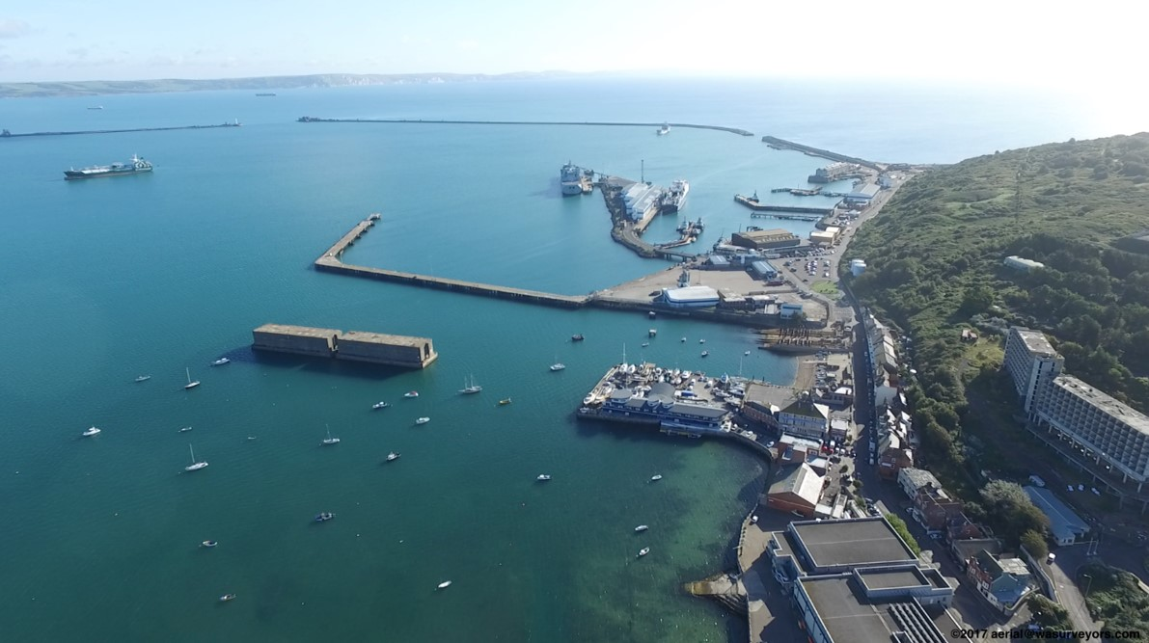
High Potential Opportunity
Sustainable Aquaculture
Developing and deploying technologies in Dorset
Portland Harbour

Slide 2
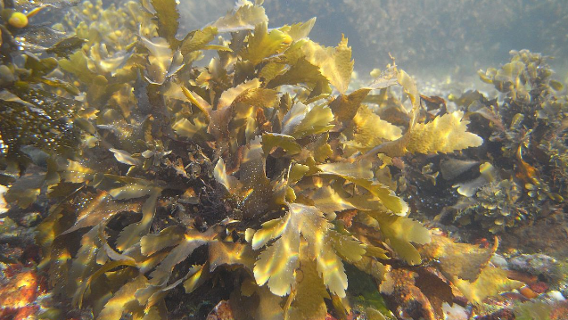
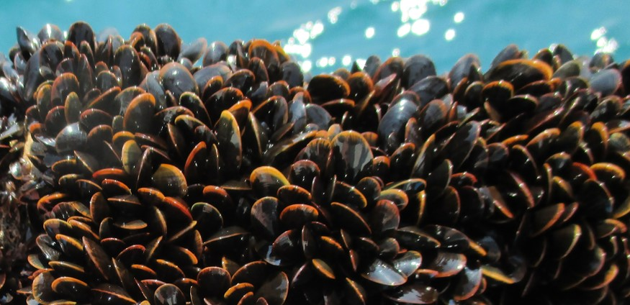
Executive Summary:
An opportunity to enter the UK aquaculture market to meet growing national and global demand for fish, shellfish and aquatic plants by developing and deploying technologies...
The UK domestic aquaculture industry is:
the 8th largest producer of finfish from marine and coastal aquaculture in the world…
worth an estimated £1.4 billion…
expected to grow faster than the UK economy over the next 10 years…
creating huge opportunities to increase farming of other fish or shellfish, beyond salmon...
Growth opportunities exist in a sustainable UK aquaculture supply chain by developing and deploying a diverse range of technologies (sensors, automation, engineering) for life support (nutritional feed, health and welfare), farming and processing fish for sale.
The UK - A springboard for you to exploit the global £139 billion aquaculture market opportunity.
Source: https://ec.europa.eu/jrc/en/news/how-much-fish-do-we-consume-first-global-seafood-consumption-footprint-published; https://www.seafish.org/article/uk-seafood-industry-overview; https://www.seafoodsource.com/features/technavio-report-global-aquaculture-markets-growth-accelerating-through-2022

Slide 3
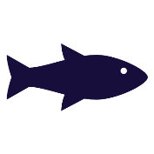
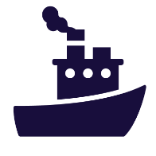
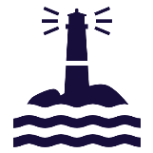
Executive Summary:
…using the unique natural assets, a sustainable environment and the local infrastructure found in Dorset to support the growth of your business
Work alongside the Centre for Environment, Fisheries and Aquaculture Science (Cefas) - extensive experience of the regulation of aquaculture systems and deploying innovative, cutting edge technologies alongside cost-effective data sources
Take advantage of Marine Service companies (e.g. Quest Marine and Carlin Boat Charters) who will help businesses with cranage, diving expertise, tug boats, dredging and experience of aquaculture farming
Dorset – a
Commercial Advantage to Investors
Consider great locations in Poole and Portland Harbours providing sheltered bases for operations in small, specifically designed sea areas with infrastructure and space for the construction of more hatcheries and aquaculture facilities on land
Access an integrated Supply Chain with a skilled engineering, marine and scientific workforce, at competitive costs
Expect a ready supply of high-calibre science, technology and labour with industry centred training programmes in Higher Education Institutions and Centres of Scientific Excellence
Use support from local partners, and national government through the Seafood 2040 Strategic Framework
Find the perfect setting for aquaculture companies and technology providers to flourish in a rich coastline

Slide 4
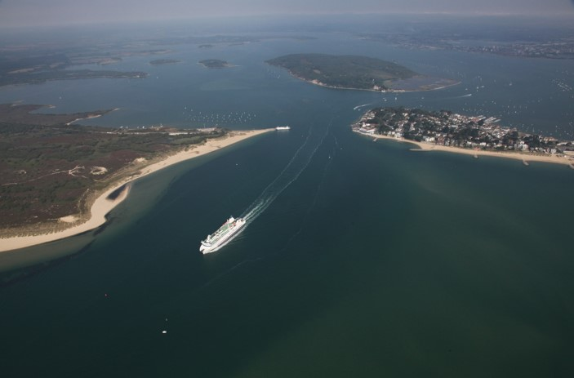
Access a clear pipeline of opportunity in developing and deploying technology supported by Government and Industry commitments
Click the icons below to find out more about the key opportunities for your business
Entrance to Poole harbour
NATIONAL AND GLOBAL DEMAND FOR SEAFOOD
SUSTAINABLE AQUACULTURE
TECHNOLOGY DEVELOPMENT & DEPLOYMENT

Slide 5
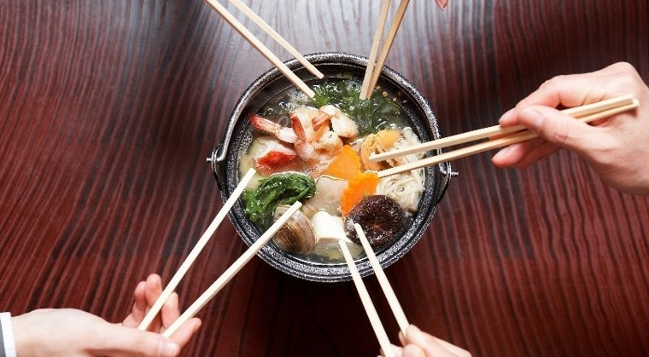
Help meet the national and global demand for fish, shellfish and aquatic plants from Dorset
DEMAND
Global seafood consumption has more than doubled in the past 50 years, putting stress on the sustainability of fishing.
Demand:
Aquaculture:
£173 billion
Global aquaculture market by 2022
Seafood purchases in Great Britain are estimated to be worth £6.61bn while aquaculture represents only 17% of this supply. An opportunity exists to meet this demand through growth in sustainable aquaculture.
is projected to be the prime source of seafood by 2030, as global demand grows and wild capture fisheries approach their maximum take.
when practiced responsibly, can help provide livelihoods and feed a global population that will reach nine billion by 2050.
offers business growth by improved logistics systems, improvements in sustainable practices and diversification of species.
SUSTAINABLE AQUACULTURE
With the current UK aquaculture market generating revenues of £1.4 billion
Globally, the average annual increase in fish consumption (3.2%) has outpaced population growth (1.6%).
TECHNOLOGY & INNOVATION
2018
2022
Source: https://thefishsite.com/; https://www.seafoodsource.com

Slide 6
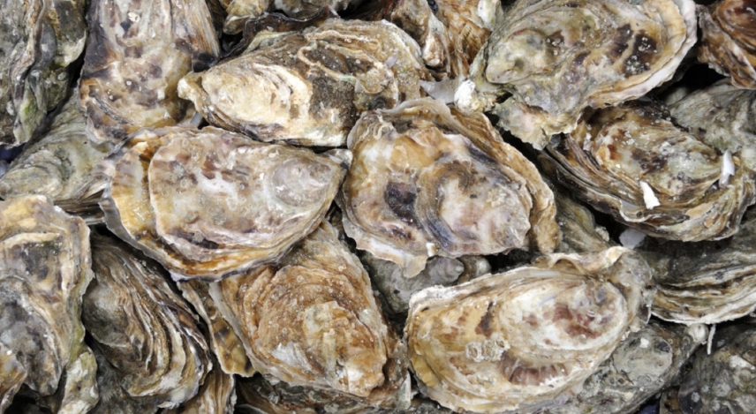
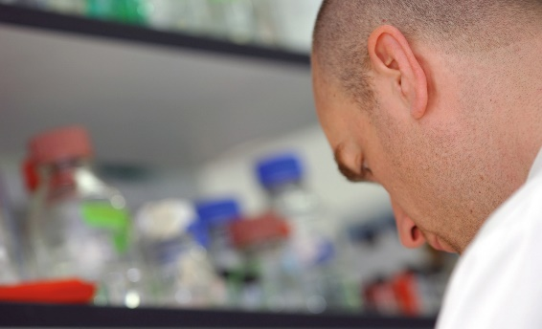
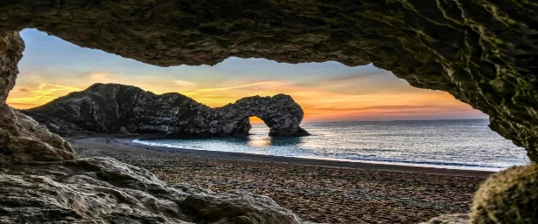
Contribute to an environmental, economic and socially sustainable aquaculture supply chain
DEMAND
Opportunities exist in Dorset for truly sustainable aquaculture systems that have:
Minimal Environmental Impacts – No significant disruption to the ecosystem, or loss of biodiversity or substantial pollution impacts.
Economic Value – No significant disruption to the ecosystem, or cause for loss of biodiversity or substantial pollution impacts.
Social Contribution –Contribute to community well-being and are socially responsible.
Seafood 2040 Strategic Framework
The result of shared enterprise from stakeholders across the English seafood supply chain that sets out a vision for an industry that is sustainable and truly thriving – a success story built on collaboration, innovation and best practice (please click here)
SUSTAINABLE AQUACULTURE
Recommendations include:
Aquaculture growth strategy;
Potential for priority aquaculture zones;
Protection of shellfish waters; and
Review and simplification of legislation and regulation.
TECHNOLOGY & INNOVATION
Sources: Cefas, Seafood 2040

Slide 7
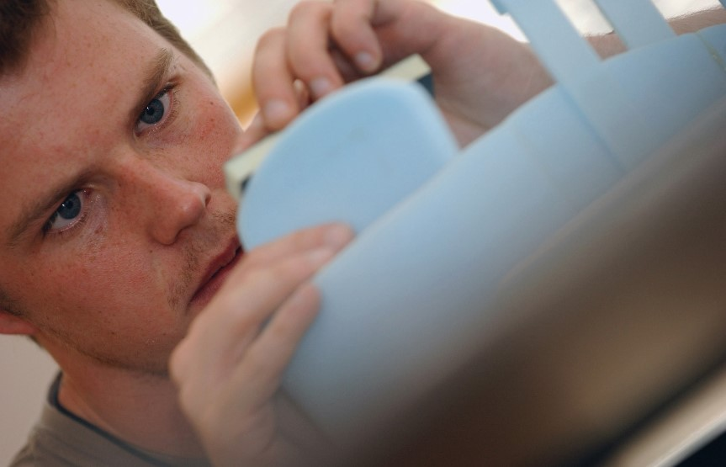
Capitalise on world class science, a progressive supply chain and dynamic business environment
Sustainable land and sea - based aquaculture systems represent opportunities for the aquaculture sector.
Examples include:
On Land: Recirculating Aquaculture Systems (RAS) to create suitable conditions for aquaculture using indoor tanks, pumps, aerators and filters; Aquaponics systems using hydroponics (growing plants without soil) provide opportunities to strengthen sustainable aquaculture, organic crop production and reduce water consumption.
In the Sea: Developing technology and alternative methods of combating diseases that minimise environmental impacts; along with shellfish farming equipment designed to perform in extreme environments.
Growth opportunities exist in sustainable aquaculture supply chains by developing and deploying a diverse range of technologies (sensors, automation, engineering) for breeding, life support (nutritional feed, health and welfare), farming to processing fish for sale.
DEMAND
Digital technologies disrupting aquaculture that provide investment opportunities include:
3D Printing | hybrid aquaponic systems
Robotics | examine and repair nets/cages remotely
Drones | monitor/inspect offshore fish farms
Sensors | monitor oxygen levels, water temperature, heart rate and metabolism
Artificial Intelligence | improve decision-making
AR / VR | analyse mortalities, health status and environmental parameters.
Blockchain | Verify sustainability across the supply chain
SUSTAINABLE AQUACULTURE
Work with the existing Agri-Tech and marine engineering cluster in the South-West to develop technologies for sustainable aquaculture
TECHNOLOGY & INNOVATION
Sources: https://ag.alltech.com/en/blog/8-digital-technologies-disrupting-aquaculture

Slide 8
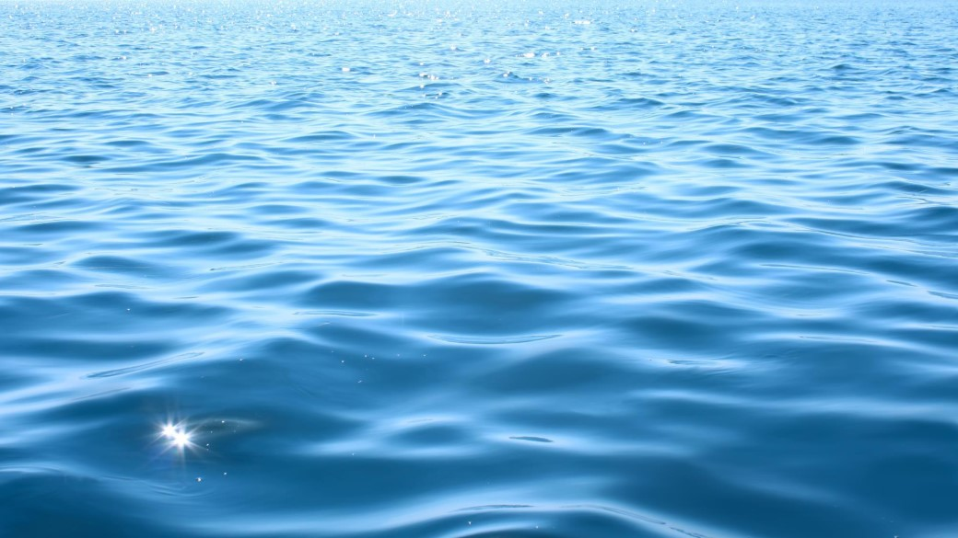
A compelling case of strengths that makes Dorset the natural choice for a successful business:
SUPPLY CHAIN
SKILLS & RESEARCH
SUPPORT PROFILE
INDUSTRY NETWORKS
DORSET
The location for sustainable aquaculture

Slide 9
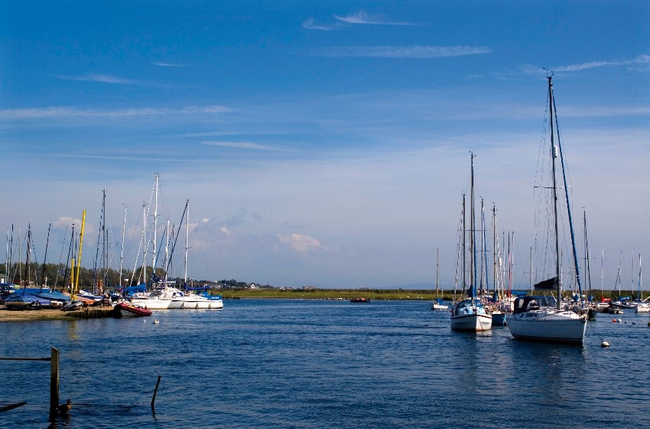
A highly-consolidated supply chain, offering you an easy fit
Click any of the options to the right to find out more about Dorset’s aquaculture capabilities and cluster that you can become a part of.
Dorset Logistics Network
A Natural Fit
Cluster
Christchurch harbour

Slide 10
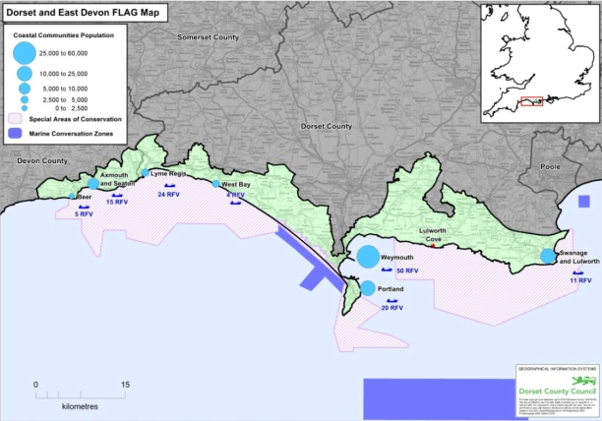
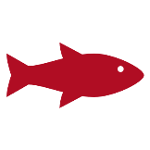
The natural right choice for your aquaculture investment…
Dorset has unique natural assets, a sustainable environment and the local infrastructure in place to support the growth of the local aquaculture sector and your business.
The coastline has created the perfect setting for aquaculture companies and technology providers to flourish. This includes:
Cefas are undertaking a full scale mapping exercise to identify potential sites to develop aquaculture projects for Dorset and East Devon Fisheries Local Action Group (FLAG). The FLAG area runs from Swanage to Beer and includes:
2
Marine Conservation Zones
3
Marine Special Areas of Conservation
1
Marine Protected Area
1
Special Protection Area
Shallow and sheltered harbours and land based development opportunities for hatcheries and recirculation systems;
Onshore areas with potential for development of processing facilities etc;
Excellent water quality and growth conditions – for shellfish especially;
Warm coastal sea water temperatures and less aggressive tidal flows than found in competitor sites – fostering opportunities to produce a wide variety of fish, shellfish, molluscs and plants; and
A vibrant tourist industry with demand for local fresh fish and renowned fish restaurants in location.
Poole and Portland harbours provide sheltered bases for operations in the open ocean (small, specifically designed sea areas) and have infrastructure and space for the construction of more hatcheries and aquaculture facilities on-land.
In-land areas and on-shore facilities within both ports are also available and ready to be developed as well as facilities at other notable locations such as Kingston Maurward College.

Slide 11
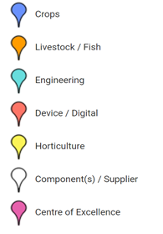
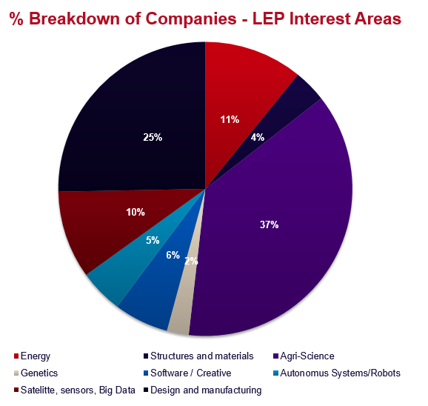
With access to the South-West Agri-Tech Cluster to collaborate…
World-Class technology supporting efficiency and innovation in celebrated West Country livestock farming, fishing and food industries.
The South West is England’s largest rural region with rich, diverse natural resources, a strong and growing network of over 200 innovative Agri‑Tech companies, working with industry leading academics and R&D institutions.
The area attracts many major employers including Arla Foods UK, Danone, Mole Valley Farms, Mullers, Thatchers Cider, and Yeo Valley Farms Production. Complementary sector strengths include Aerospace, Automotive, Marine, Nuclear, Space, ITech and Pharmaceuticals.
Dorset

Slide 12
And a fully integrated logistics network
Dorset allows for seamless access and rapid freight distribution between air, land and sea.
DIRECT ACCESS TO LOCATIONS WORLDWIDE
Bournemouth Airport is receiving major investment for key infrastructure developments, and offers domestic and international flights to major cities within the UK, Europe and worldwide.
CONNECTING YOU TO CUSTOMERS AND SUPPLIERS BY ROAD…
Dorset’s road network which is receiving heavy investment is well connected and allows for direct access to the South West region and beyond.
WITH VALUABLE GLOBAL SUPPLY CHAIN AND DEPLOYMENT SUPPORT
Dorset has 3 strategically located ports (Poole, Weymouth and Portland) which provide valuable supply chain and deployment support for aquaculture projects.
30
3
Ports for Cargo Handling
Global Destinations
Exeter and Southampton Airports also offer more than 50 international destinations, attracting a large number of passengers from the wider South West region.
… AND RAIL
The Rail Network connects Dorset to the rest of the UK, London Waterloo being within 3.5 hours travelling time.
Southampton, Portsmouth and Plymouth Ports are also strategically located to support marine and aquaculture projects in the South West region.

Slide 13
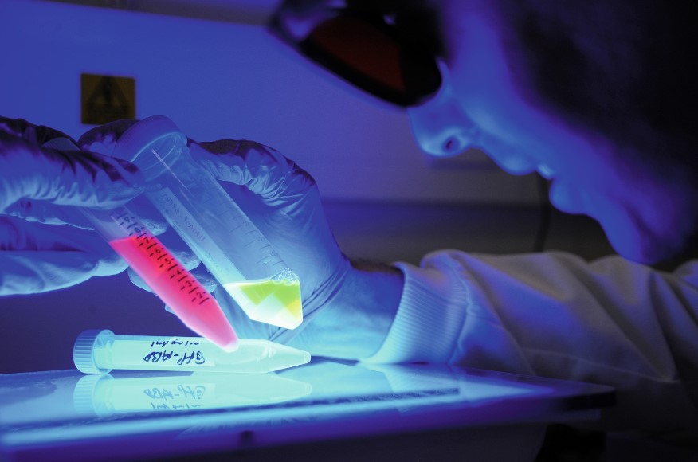
Access world-class research and skills you need to succeed
Dorset is perfectly positioned to ensure you have access to the skills you need, now and for the future.
Cutting edge marine and aquaculture programmes in Dorset and the wider South West are also addressing key industry issues including sustainability, technology, training, supply chains and production.
Click the icons to the right to find out more about how our people and institutions can support your technology business.
Skills
World Class Research

Slide 14
A pipeline of talent for the skills and capabilities needed…
With industry centred training programmes in Higher Education Institutions, you can expect a ready supply of high-calibre labour.
The graduate pool is strengthened by aquaculture specific courses and world-class research centres
Exeter, Plymouth, Portsmouth, and Southampton universities + Sparsholt College offer degree courses linked to the needs of the aquaculture and wider marine sector.
University
of
Exeter
Partner of the Sustainable Aquaculture Futures Centre (with Cefas), employing combined strengths to develop scientific research for societal benefit.
20,000 students, member of the Russell Group - 98% of its research is rated as international quality
Non-degree level courses are also available including diplomas in Fisheries Management, and Fish husbandry at Bridgwater College.
University of Plymouth
School of Biological and Marine Sciences offering courses including MSc Sustainable Aquaculture Systems
23,000 students, 2,900 staff and £100 million network of business support facilities
Kingston Maurward College offers a Foundation Degree in Marine Ecology and Conservation, a City and Guilds Technical Certificate Level 2 (GCSE grade) course (fish health and biology, game and course angling, freshwater sport and fishery management) and a Level 3 (A Level equivalent) will follow next year.
Bournemouth University
Department of Life & Environmental Sciences offering courses in Marine Ecology and Conservation + Marine and Freshwater Management – with links to Kingston Maurward College
19,000 students and one of the top 200 young universities in the world
The region also has world-leading marine and maritime education and research institutions in a number of fields. The Southern England Region has three of the UK’s four marine research and development centres at the University of Southampton, University of Portsmouth and the University of Plymouth.
Sparsholt College
Recognised worldwide for expertise in providing education in aquaculture and fisheries studies
6,500 students and one of the leading providers of university level courses for the land and environment

Slide 15
Complemented by access to world-class science...
Providing you with cutting edge research and innovation in environmental impact and aquatic animal health
Cefas
Lowestoft and Weymouth
Recognised leader in aquaculture science. Cefas has extensive experience of the regulation of all aquaculture systems and deploy innovative, cutting edge technologies alongside complementary and cost-effective data sources.
Cefas has links with a diverse range of stakeholders and creates significant opportunities to partner in research and development of new technologies and processes. For example, regulatory testing and modelling for risk is done at the Weymouth Laboratory.
The Cefas regulatory toolbox ensures aquaculture supply chain companies have all the information required to set up successfully, through a single portal.
Sustainable Aquaculture Futures
Exeter University and Cefas
Draws upon research strengths to undertake interdisciplinary activity associated with:
Aquatic disease – diagnosis, therapeutics and mitigation
Anti-microbial resistance
Genomes and host pathogen interactions
Aquatic disease modelling and epidemiology
Environment and animal health
Aquatic food safety
The Marine Innovation Centre
Plymouth University
Organises workshops, networking events and face-to-face meetings to help businesses unlock the value of R&D, solve technical challenges, improve products and processes and capitalise on new market opportunities.
Institute of Marine Sciences
Portsmouth University
An internationally known marine station providing high quality marine research and teaching. They have developed the sites, facilities, equipment and the expertise that leading businesses want.
This includes the Aquatic Research Centre that houses a state-of-the-art aquarium and sea-water system, and the Shallow water research and testing platform in Langstone harbour.

Slide 16
And conservation practice in Dorset to succeed in aquaculture
Providing you with cutting edge research and data into conservation in Dorset
Game and Wildlife Conservation Trust
Salmon & Trout Research Centre in East Stoke, Dorset.
Monitoring Atlantic salmon numbers in the River Frome since 1973, creating one of the most comprehensive records of salmon movement in England and Wales.
Working in collaboration with teams throughout Europe to study the global decline in salmon numbers.
Trout studies aim to understand the ramifications of stocking in order to ascertain what methods are most favourable to the natural wild stock. In addition, research is undertaken to evaluate habitat restoration programmes on selected river catchments.
Blue Marine Foundation
In Lyme Bay, Dorset, BLUE has established a model of sustainable fishing hailed as a ‘world first’ by bringing together fishermen with marine authorities and scientists to shape conservation measures to protect their fishery. The model combines science and tech to inform best practice management and improve traceability of catch size and location.
Investment in chiller units has improved quality and was hailed as ‘the best thing to happen in this port in 100 years’.
Fishermen receive higher prices with the Reserve Seafood Label created through a partnership with the Seafish Responsible Fishing Scheme (RFS) to build sustainable, traceable and high quality credentials. Habitats and stocks are also recovering. The Lyme Bay model is now being rolled out around the UK coast and in the Mediterranean.
Southern IFCA
Inshore Fisheries and Conservation Authorities lead, champion and manage a sustainable marine environment and inshore fisheries, by successfully securing the right balance between social, environmental and economic benefits to ensure healthy seas, sustainable fisheries and a viable industry.
Southern IFCA covers the inshore waters of Hampshire, Dorset and the Isle of Wight out to 6 nautical miles; working both on land and at sea to balance sustainable fisheries with a sustainable environment.
The District contains a diverse range of habitats and species within European Marine Sites and Marine Conservation Zones and IFCA evidence collection ranges from impact surveys to habitat mapping and underwater video footage.

Slide 17
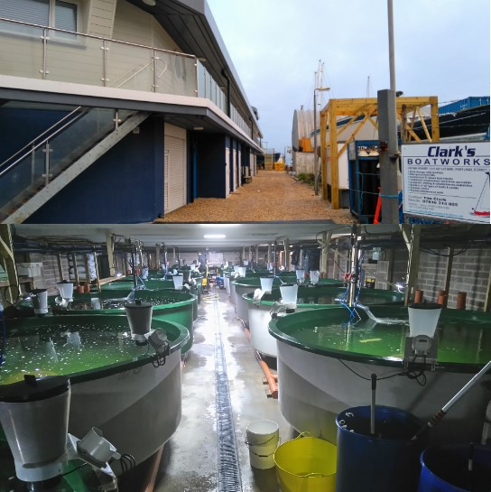
All backed with competitive
locations, incentives and support
Click on an icon to see how locating your business here will offer you speed, support, and competitive advantage
Local Support
Locations to Support Your Growth
UK Government
Support

Slide 18
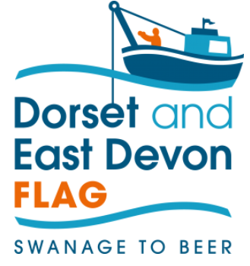
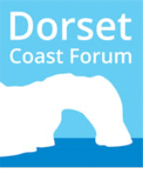
Partnerships supporting aquaculture industry’s needs...
Dorset LEP offers tailored soft landing packages for new investors including relocation support, commercial property searches (introduction to land and real estate agents), local economic intelligence provision and introductions to local sector networking groups. http://dorsetlep.co.uk/
A wide range of funding and finance options for your investment are available. https://www.dorsetchamber.co.uk/business-support/finance-funding/
The Dorset & East Devon FLAG launched in March 2017 was awarded £800,000 to deliver community-led Local Development in the area’s fisheries, aquaculture and seafood sectors between Swanage and Beer. Their strategy includes strengthening the aquaculture sector in Dorset, improving infrastructure and equipment to enable safe, sustainable working ports and harbours, and enabling innovation to increase the value of catch and products.
https://www.dorsetcoast.com/projects/flag/
The Dorset Coast Forum is a strategic coastal partnership, which looks at the long term issues facing the Dorset coast and its inshore waters. The forum enables investors to discuss issues, gain access to the latest data and information, access support for the design and delivery of innovative projects, and network with key industry stakeholders.
https://www.dorsetcoast.com
Cefas’ exceptional breadth of science and technology capability means they can offer investors a comprehensive range of services including research, advice and consultancy; laboratory services and analysis; modelling; surveys; and technology services.
https://www.cefas.co.uk/
Sources: Dorset LEP, CEFAS, Dorset Coast Forum

Slide 19
Coupled with great locations to drive your business growth,
make Dorset an easy choice for your investment…
Portland Port
Portland Port Land Estate is home to a diverse range of maritime businesses attracted by the proximity of the land to the berths and anchorages of the harbour.
It is a safe and unique location within the English Channel providing excellent all-round protection with its superb natural shelter and break water. The Harbour is within easy access of the main shipping lanes 24 hours a day 7 days a week.
Portland Port already host tenants with fishery related interests but offers more opportunities for land-based aquaculture subject to obtaining the necessary consents.
Portland gives excellent sea water quality and temperature for land-based fish farms, to provide excellent fish growth of marketable quality.
Of particular interest is an area land circa. 5000m² which has in the past had planning permission for a fish farm (Ref WP/14/01033/OUT and WP/16/00150/RES).
Poole Harbour
A large natural harbour, the largest in Europe and second largest in the world, with the town of Poole on its shores.
Under the current Poole Fishery Order 1985 there are 31 defined leased beds in the area of seabed that the Southern IFCA leases from the Crown Estate. 3 of these beds are not currently sub-leased and lie dormant.
The remaining leased beds are sub-leased from the Southern IFCA to nine stakeholders /companies with the consent of the Commissioners of Crown Lands to sub-lease under the provisions of the Southern IFCA lease from the Crown.
The main species currently farmed on these leased beds are mussels and pacific oysters; however in the past native oysters, clams and cockles have been farmed or cultivated.
Designated as world heritage site: July 22, 1999.
Other areas identified as opportunities for investment by the FLAG project include:
Lulworth
specific to the Lulworth Cove area with a potential opportunity for aquaculture to exist
Lyme Bay
fertile waters with great potential for large offshore shellfish culture in this area, trials could take place for different species and Sea trout could be cultivated in this area
Entrance to Poole harbour

Slide 20
With support needed to ensure a seamless investor process
Visit Programmes
Property Options
YOUR TECHNOLOGY
BUSINESS
Financial Advice
Specialist Advice (tax, skills, visas & migration)
Government Departments
Access to Academia
UK Suppliers and Partners
(UK & Overseas))
Professional Support
Regulation
Market Information
Read on to see how this combines with local government to provide you with world class support services.
Real companies. Real experience. Real value.

Slide 21
Access to networks that can help influence, and connect you to suppliers and customers
The UK has a vibrant industry network offering support and advice for companies operating in the UK aquaculture sector.
Click one of the options to the left to find out more about our industry bodies and to see why leading companies choose to locate in Dorset.
Industry Bodies
Companies Choosing Dorset

Slide 22
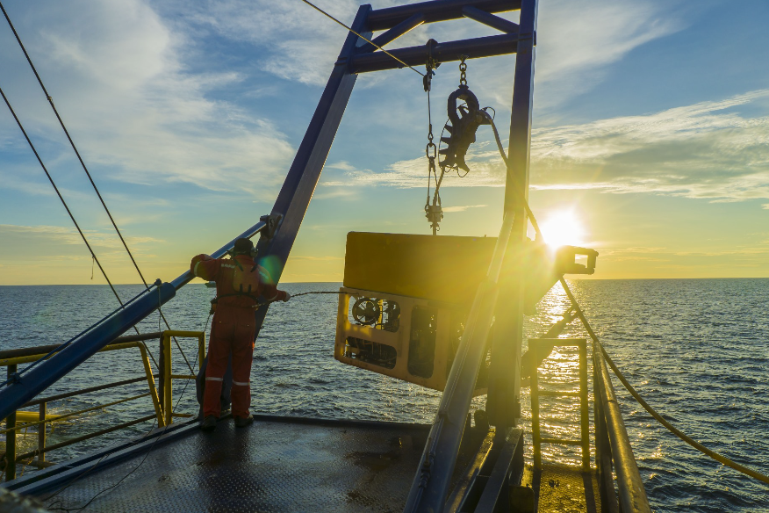
The UK’s industry bodies enable quick and easy access to suppliers, partners and customers
For comprehensive support and advice, click any of the industry bodies below.
Cefas
Seafish
Aquaculture Research Collaborative Hub UK
Dorset and East Devon FLAG
Fisheries Society of the British Isles
The Natural Environment Research Council
Dorset Coast Forum
Institute of Fisheries Management
South West Agritech
Southern Inshore Fisheries and Conservation Authority
Aquaculture Stewardship Council
UK Marine Industries Alliance

Slide 23
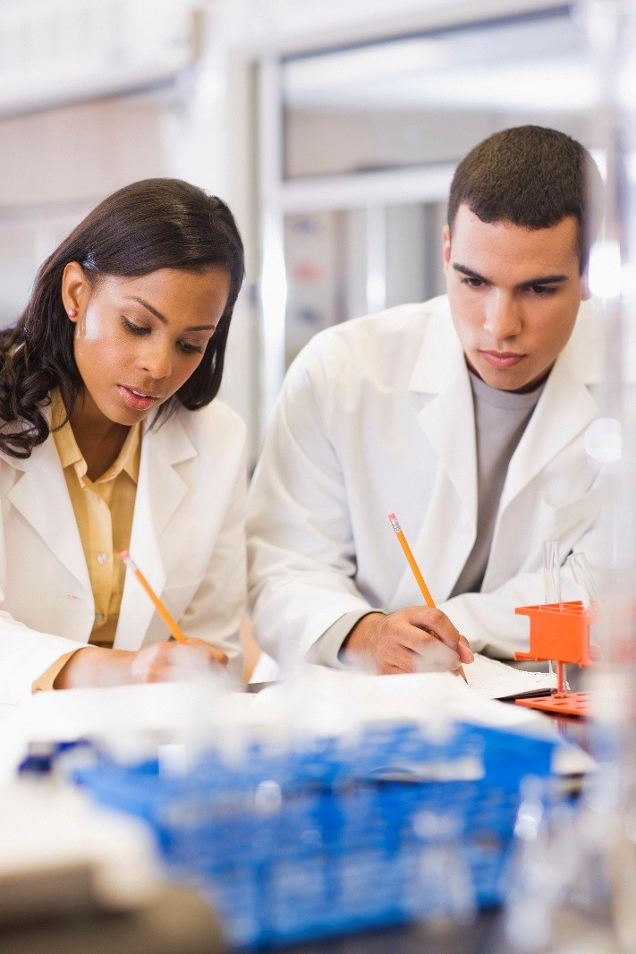
Companies are already exploiting the opportunity in Dorset and the South West region
Click the icons to view each case study
Dorset Cleaner Fish Ltd.
Othniel Oyster Ltd.
Dorset Seaweed Company Ltd.
Houghton Springs Farm Ltd.
Offshore Shellfish Ltd.

Slide 24
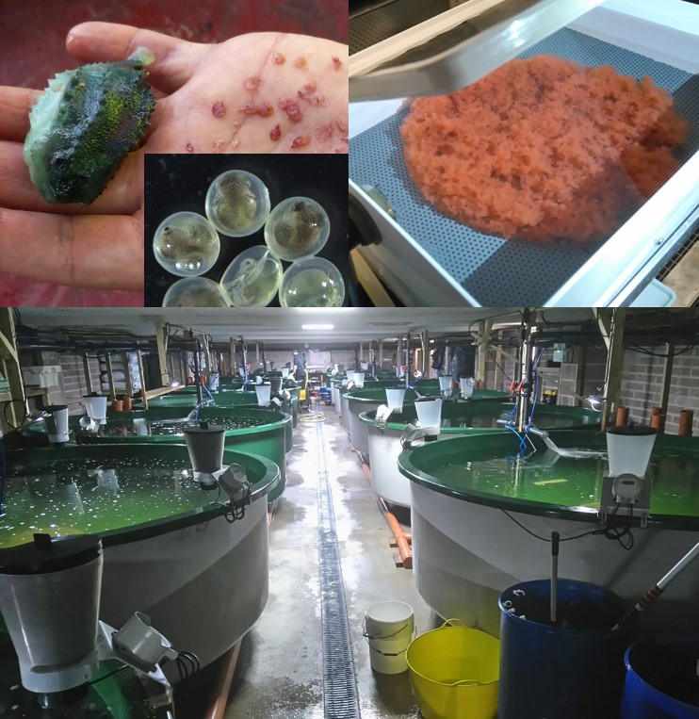
Dorset Cleaner Fish Ltd
The Scottish salmon industry produces 170,000 t/yr of salmon in sea cages along the west coast of Scotland, and in Orkney and Shetland. Sea lice infestations weaken the salmon making them more susceptible to other diseases. The lice have become resistant to various chemical treatments, the residues of which also impact on the environment when released into the sea.
New biological methods of control include ‘cleanerfish’ (ballan wrasse and lumpfish) which co-habit with the salmon and feed on the lice.
Dorset Cleanerfish Ltd. a joint venture with the largest salmon farming company in the world, MOWI and a local company Native Marine Centre Ltd., has been producing lumpfish since 2013. With production units in Portland Port and Castletown, the company produces 750,000 fish per year.
READ MORE CASE STUDIES
Dorset Cleaner Fish
Othniel Oyster
Dorset Seaweed Company
Houghton Springs Farms
Offshore Shellfish

Slide 25
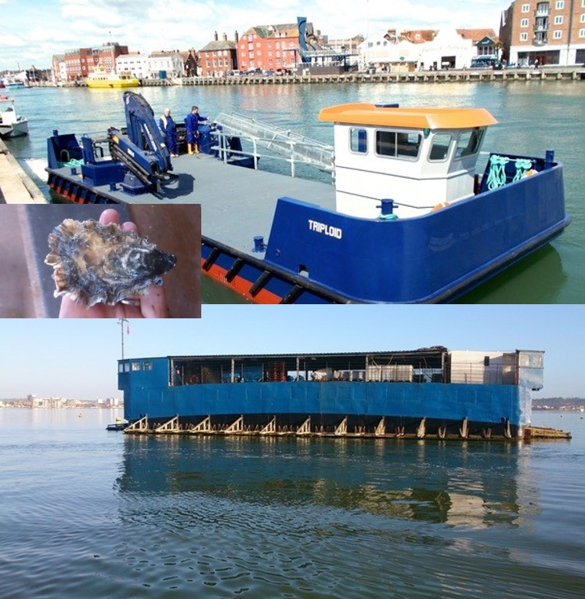
Othniel Oysters Ltd
Othniel Oysters Ltd (OOL) leases 51 hectares of shellfish beds in Poole Harbour to farm Pacific oysters. Small, hatchery produced seed are reared in the floating nursery system to 10 grams and once laid on the sea bed take approximately 9 months to reach harvest size.
OOL operates from a 30 x 15 metre, 400 ton flat-bottomed barge, moored in the shelter of Brownsea Island, providing 300sq metres of covered working space with workshop facilities for repairs and maintenance of boats and gear.
Growers across the world visit to see the innovative harvesting technology using conveyor harvesting barges. Up to 3 million oysters are harvested per year, circa 400 tons, with 30% sold either locally or in the wider UK market. The rest are sold in the Far East, with Hong Kong and China as the main destinations.
READ MORE CASE STUDIES
Dorset Cleaner Fish
Othniel Oyster
Dorset Seaweed Company
Houghton Springs Farms
Offshore Shellfish

Slide 26
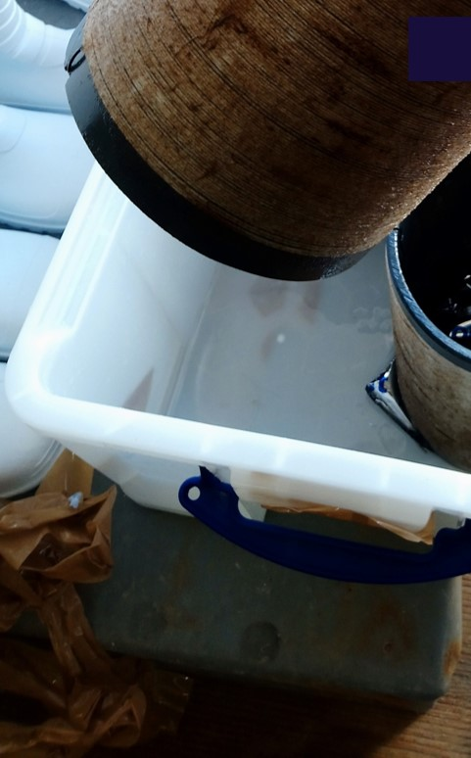
Dorset Seaweed Company Ltd
There has been enormous interest in the culture of seaweeds recently not only in connection with its ‘super food’ reputation, but also its potential use in the cosmetics, health food, pharmaceutical, biofuels and fertiliser industries.
The Dorset Seaweed Company Limited (DSCL) has been recently formed to exploit this exciting opportunity with an initial project in Portland Port which will grow both seaweed and shellfish species such as oysters and scallops. The initial investors include several local partners with relevant expertise to make a success of the operation. Future expansion of the business will either be inside the Port or at a new site in the area.
Cefas will be working with DSCL from November 2019 to analyse the sugar kelp biomass produced in Portland Harbour to investigate the physiology, histology and chemical composition. This will provide baseline data to inform regulation for the emerging seaweed aquaculture industry in the UK; and demonstrate methodologies and knowledge gaps to inform future research.
READ MORE CASE STUDIES
Dorset Cleaner Fish
Othniel Oyster
Dorset Seaweed Company
Houghton Springs Farms
Offshore Shellfish

Slide 27
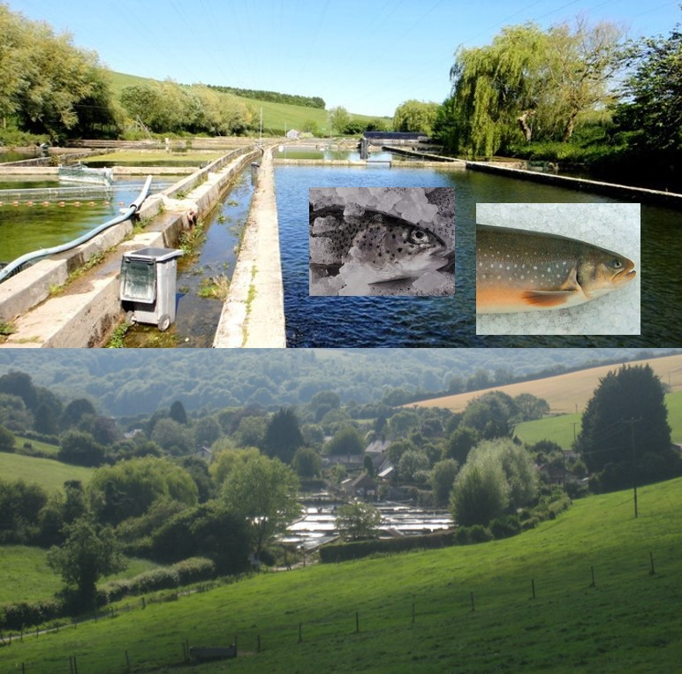
Houghton Springs Fish Farms
Originally established as a mixed farm for restoking both rainbows and brownies, presently, it is geared to facilitate genetic selection of the Houghton, enhanced growth Rainbow strain in tandem with the only Arctic Charr production in England, ultimately destined for either the sporting or table market.
The farm now holds in excess of 22 tons of Charr from eggs to 4 kg in size which in effect converts into the availability of 500 kg a week or +1000 fish at 500 gm.
The hatching and early rearing is carried out on borehole water; in the case of the Charr on water chilled to below 6C for two months.
For faster growth and sustainable water usage, Houghton Springs Fish Farm is a member of British Trout Association and an audited member of Quality Trout UK as well as Global G.A.P.
READ MORE CASE STUDIES
Dorset Cleaner Fish
Othniel Oyster
Dorset Seaweed Company
Houghton Springs Farms
Offshore Shellfish

Slide 28
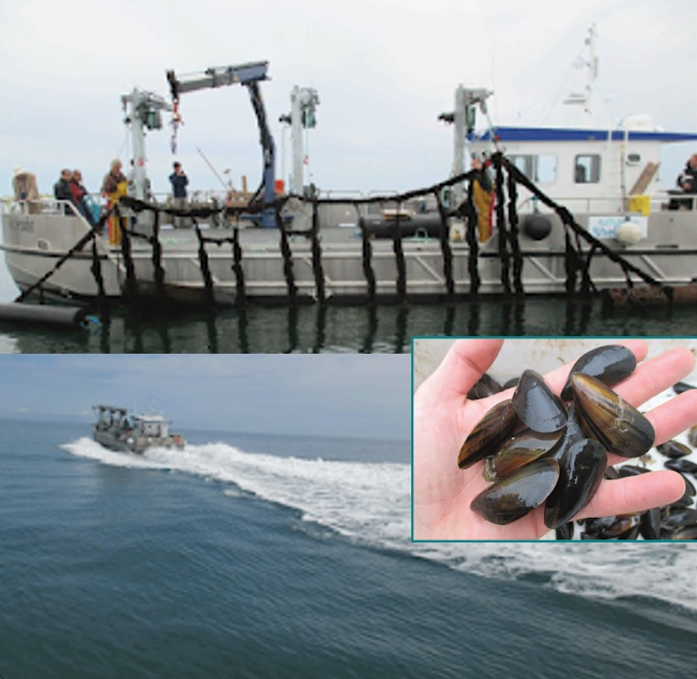
Offshore Shellfish Ltd
Offshore Shellfish Ltd. are developing the UK’s first large-scale offshore rope cultured mussel farm.
Following successful pilot trials in 2014/15 the farm is currently being expanded to its full permitted area. The development will eventually be the largest of its type in European waters and will use specially designed technology to cultivate the native blue mussel, Mytilus edulis, on suspended ropes at three sites between 3 and 6 miles offshore in the fertile waters of Lyme Bay. The three sites will cover a total area of 15.4 square km and produce up to 10,000 tonnes per year once fully developed. Advantages include space and improved water quality. There is also the potential for other shellfish species & seaweed cultivation.
READ MORE CASE STUDIES
Dorset Cleaner Fish
Othniel Oyster
Dorset Seaweed Company
Houghton Springs Farms
Offshore Shellfish

Slide 29
Dedicated support to finding the right fit for your business
The Department for International Trade and local partners are here to support you in navigating the opportunities across the UK – to find the right fit for your business.
Based on our experience of investors like you, this attractive opportunity demonstrates the strength and depth of capability available locally and in central Government to support you, and maximise your investment in the UK.
For investors interested in considering high value options further – we provide a bespoke service tailored to your needs from investment inception, right through to aftercare support.
We pride ourselves in developing long-term relationships with our clients, predicated on a full understanding of their needs.
Contact DIT’s Investment Services Team
W: invest.great.gov.uk/int/contact
E: enquiries@invest-trade.uk
T: +44(0) 207 000 9012
For more information on how to set up a business in the UK, please visit the website

Slide 30
Last updated: May 2019

