Slide 1

Construction sector – overview
Autumn 23 update

Slide 2

Data notes
This sector dashboard uses a combination of data published via the Office of National Statistics (ONS) and also utilises vacancy data via Lightcast
Lightcast is a global leader in labour market analytics. This dashboard primarily uses Lightcast job posting analytics and focuses on the Dorset LSIP area and trends over time
It is important to note that the analysis here only reflects jobs that are posted online. It effectively ‘scrapes’ a range of job websites, alongside candidate profiles
Lightcast uses sophisticated software to try remove duplicates i.e. jobs posted repeatedly, but recognises that this may remain an issue for some postings
Because it captures online job postings only, it cannot capture informal job vacancies and recruitment. It is important to recognise that in some sectors such as construction recruitment tends to be more ‘informal’ and will not be reflected in the data here. This may also be more prevalent in small and micro businesses
It is also important to note that the analysis attempts to differentiate between sectors and ‘occupational pathways’. That is, some of the requirements for certain skills do not necessarily occur in tightly defined sectors. For example, digital skills are important across a whole range of sectors, whilst many people working in construction do not necessarily work in the construction sector per. This utilises the Lightcast Occupation Taxonomy – see later slide around definition
Given there will be some short-term volatility in job posting data, the analysis here covers the period Jan 2022 to Sept 2023. This will serve to ‘smooth’ some of the data and for the use Dorset LSIP analysis – longer-term trends are important
Christchurch is defined within Lightcast as being in the Dorset Council area – this classification does not reflect the post-April 2019 Local Government restructure

Slide 3
Definitions (1)
Standard Industrial Classification (SIC) based approach
– slides 4 and 5
Lightcast occupational taxonomy – slides 10 to 14
Working Futures analysis – slide 6

Slide 4
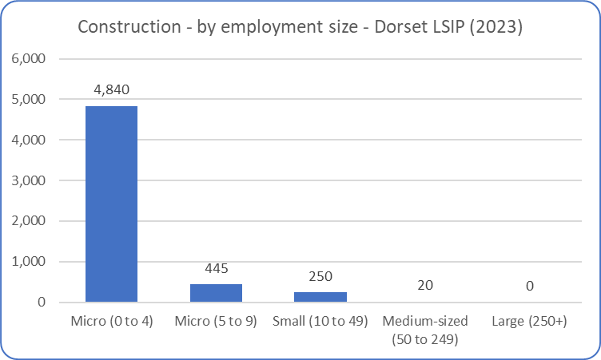
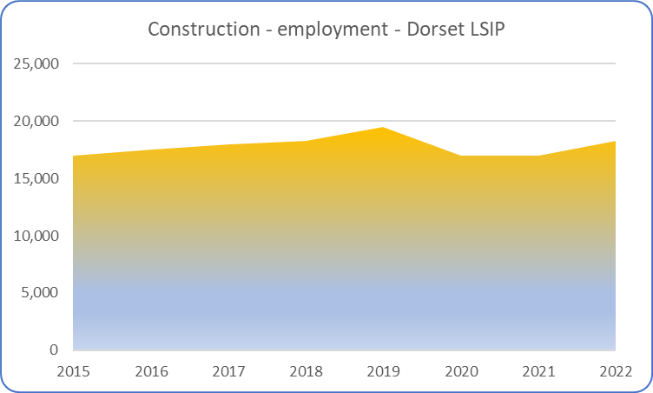
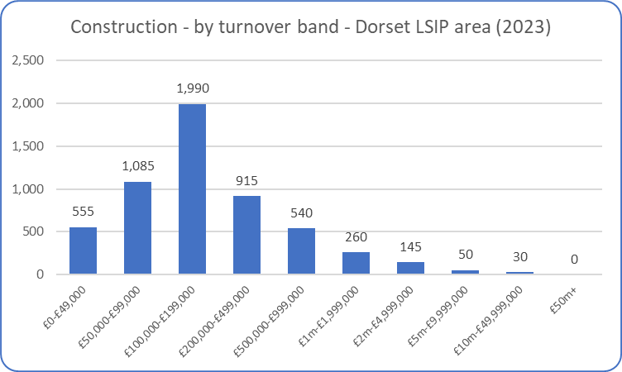
Construction – overview (1)
The construction industry is dominated by micro businesses – either measured by numbers employed and/or annual turnover. The majority construction of businesses (approximately two-thirds) generate an annual turnover <£200,000. Many of these businesses will have an informal approach to training. As would be expected, employment fell during the pandemic as lockdown placed restrictions on construction activity. However, the latest data suggests that it rebounded in 2022 – just below pre-pandemic levels.
Source: ONS (Business Register and Employment Survey and UK Business Counts)

Slide 5
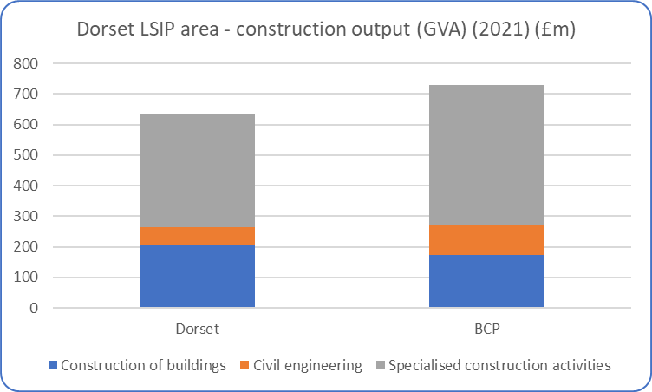
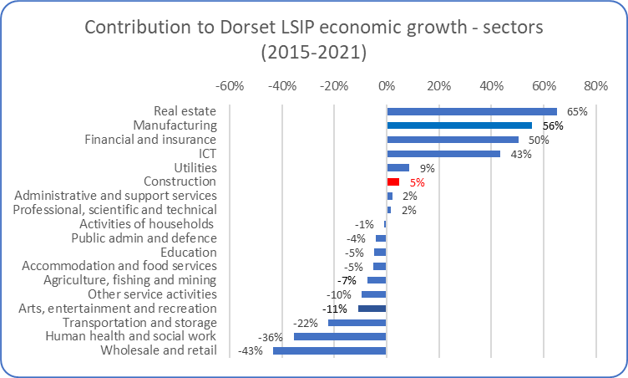
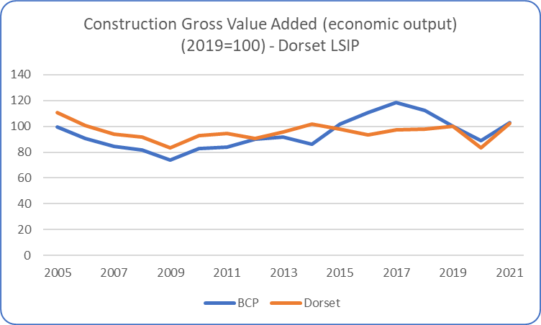
Construction – overview (2)
The (broad) construction sector is slightly larger in BCP than in Dorset County, although – as measured by output – there is a reasonably even distribution across the two local authority areas (top left chart). The sector has not grown significantly over the past 10-15 years, with the impact of the pandemic appearing to have had a particular impact on the industry in BCP (bottom left chart). The latest available data (2021) suggests it only began to recover lost ground. Whilst evidence from the industry (i.e. as shown at national output data) suggests 2022 was a relatively strong growth year, it is now under renewed pressure in sectors such as housebuilding – the result of higher interest rates. Nevertheless, it has a positive contributor to overall economic growth across the Dorset LSIP area.
Source: ONS (Sub-regional (Balanced) Gross Value Added)

Slide 6
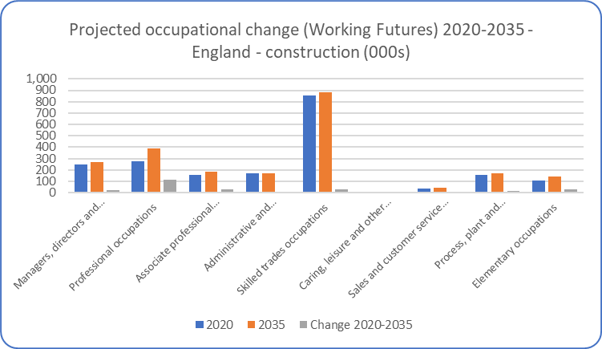
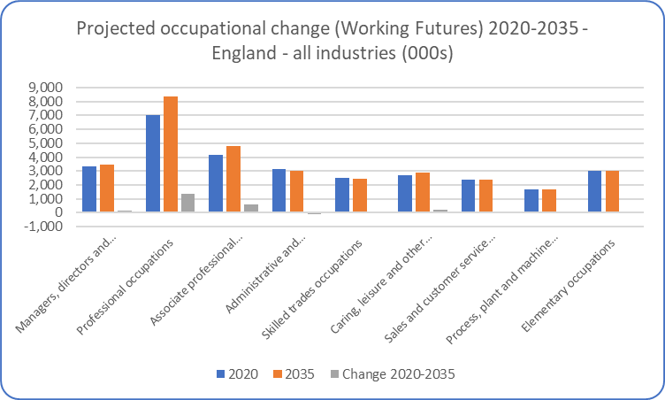
Construction – future projections
The latest Labour Market and Skills projections produced through the Working Futures programme - covering the period 2020-2035 and the first produced in a post-Covid environment – projects that overall employment in construction will increase over the 10-15 years. The data presented here is at a national (England) level.
The projections expect employment to increase in all broad occupational classifications, with particular strong (absolute and proportional) increases in professional occupations. This is expected to reflect the sustained demand for construction activity, and the expectation that elements of the construction process (although certainly not all) will remain dependent on labour input.
The projections are intended to provide a statistical foundation for reflection and debate among all those with an interest in the demand for and supply of skills. They are produced because historical evidence shows that changing patterns of employment by sector and occupation tend to largely dominated by longer-term trends rather than the cyclical position of the economy or short-term impacts. However, it is obvious that these projections are subject to high degrees of uncertainty and therefore we would urge careful interpretation of these projections. They are intended as a starting point for further analysis rather than a projection of what is most likely to happen. They represent one possible future.
Source: Working Futures 2020-2035

Slide 7
Construction – key research findings
Construction vacancies recently hit a 20-year high. CITB estimates that c260,000 extra workers will need to meet UK construction output. Demand remains strong, although industry does historically suffer from volatility
In 2021 over a third (34%) of employers suggested they have skills gaps, compared with 14% in 2018 and 20% in 2016
The strong demand for construction work from the pandemic combined with the end of free movement and lower numbers of self-employed workers, are factors that have contributed to faster wage increases and skilled worker shortages
The trend of fewer EU nationals in the construction workforce and a more constrained migration policy, indicates that that there will be an increasing need for construction companies to:
- Attract skilled workers who have left the industry back into construction. This would be either those who have left to work in other industries or those that have become unemployed or inactive
- Attract new entrants into the workforce from those leaving school, further education, apprenticeships, or higher education
- Improve the retention of workers within the industry
- Look at how productivity can be improved

Slide 8
Construction – key research findings
Three key skills challenges identified by sector:
- Responding to the skills demand - research indicates potential new recruits often have negative perceptions about the working culture
- Developing the capacity & capability of training provision
- Addressing future skills needs - Industry wants to develop the underpinning behavioural skills of construction managers, with employers and employees expressing a strong preference for increasing the availability of nontechnical and behavioural skills training. At the same time, digital skills and net zero ways of working are becoming increasingly important
CITB’s (sector body) work focusing on the employment lifecycle - attracting people to industry and improving retention, routes into industry, promoting core skills (i.e. Health & Safety), upskilling around occupational skills (i.e. digital, net zero skills), upskilling around behavioural skills (i.e. leadership and management)
CITB supporting DfE to further develop Occupational Traineeships in carpentry and joinery, drylining, and painting and decorating (pilot covered bricklaying)
Source: Miscellaneous – including CITB, Migration and Advisory Committee Evidence Call (Construction and Hospitality Shortage Review), Go Construct, Heat Pump Association, Employers Skills Survey 2019

Slide 9
Building and Construction and Manufacturing Technologies (SSA2)
Autumn 23 update
Data covering 2022 – 2023 (to date)

Slide 10
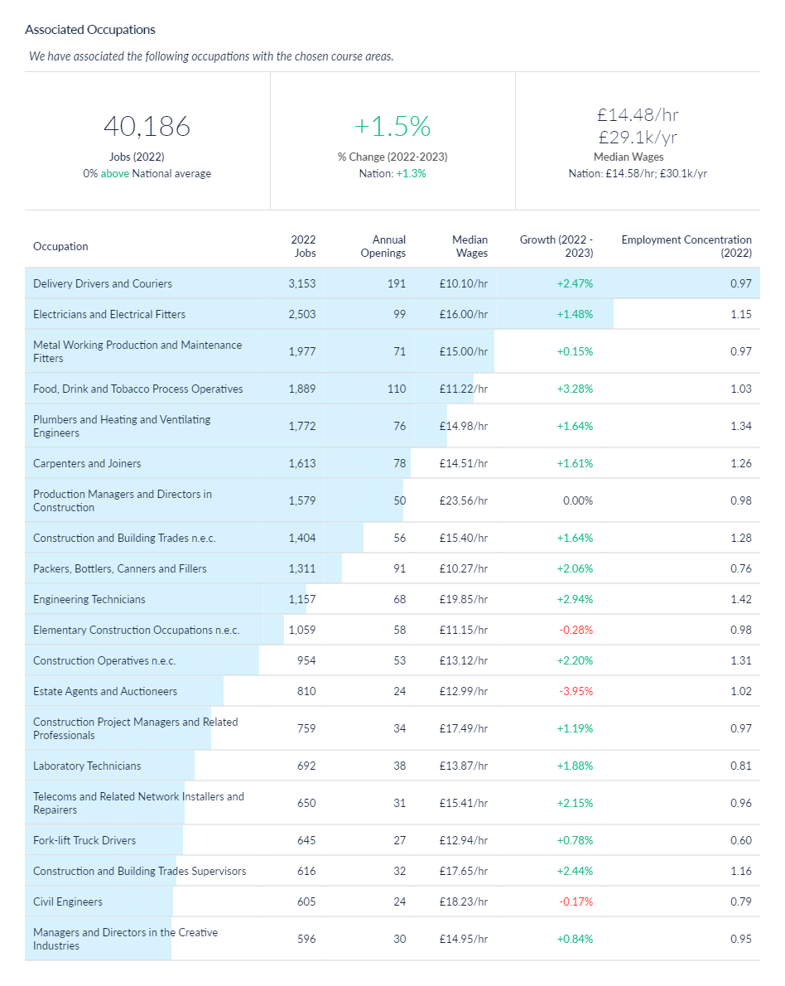
Construction job postings – associated occupations
An alternative method of estimating the scale of manufacturing and engineering jobs/occupations across the Dorset LSIP area is to understand what types of jobs tend to be filled by those individuals who undertook construction training (at SSA 2 level). In effect this represents the ‘occupational pathways’ (as described in the data notes slide). This analysis is available via Lightcast (utilised for this analysis) which have developed the Lightcast Occupation Taxonomy which aims to link skills acquisition to occupations. Based on this methodological approach, it is estimated that there were c40,000 jobs (2022) across the Dorset LSIP area in occupations associated with construction courses (SSA2) – which encapsulates building and construction and manufacturing technologies. The number of jobs in associated occupations has increased by 1.5% between 2022 and 2023 across the Dorset LSIP area.
One of the explanations of the difference between the two job figures shown in this slide pack (slide 4 versus slide 11) is that construction jobs can be found in industries outside of those defined as ‘construction’. This data also includes some elements of manufacturing technologies, given its increasing role in construction. The two cannot be directly compared.
Source: Lightcast, 2023

Slide 11
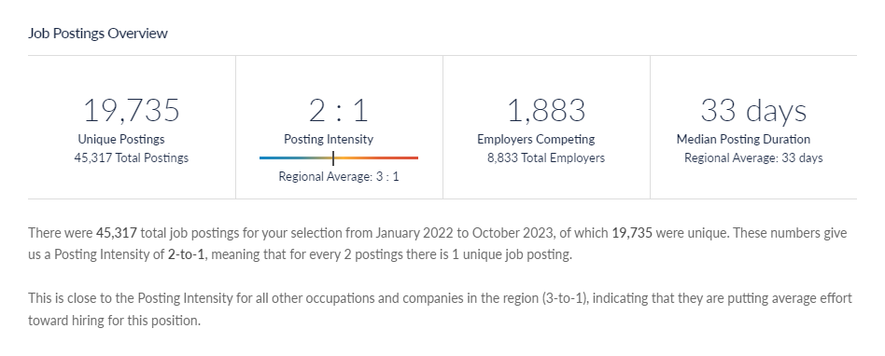
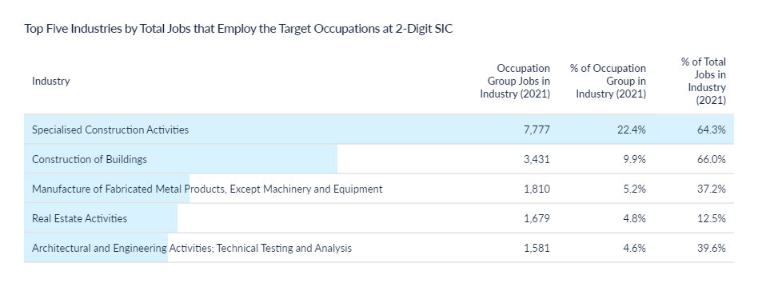
Construction job postings - volume
There c19,800 job postings 2022 and 2023 (to date) relating to the occupations associated with construction (although recognising that recruitment tends to be quite informal in the sector so not reflected in these advertised vacancies – even though vacancies posted by c1,900 businesses in the industry across the Dorset LSIP area are reflected in this data).
Typically, jobs are posted twice before being filled (posting intensity of 2:1), and this has remained broadly stable over time.
Source: Lightcast, 2023

Slide 12
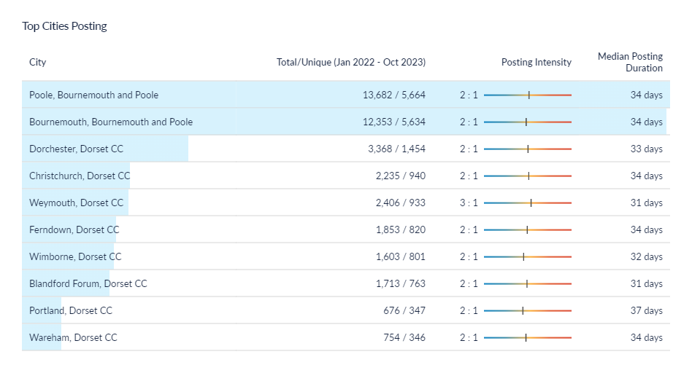
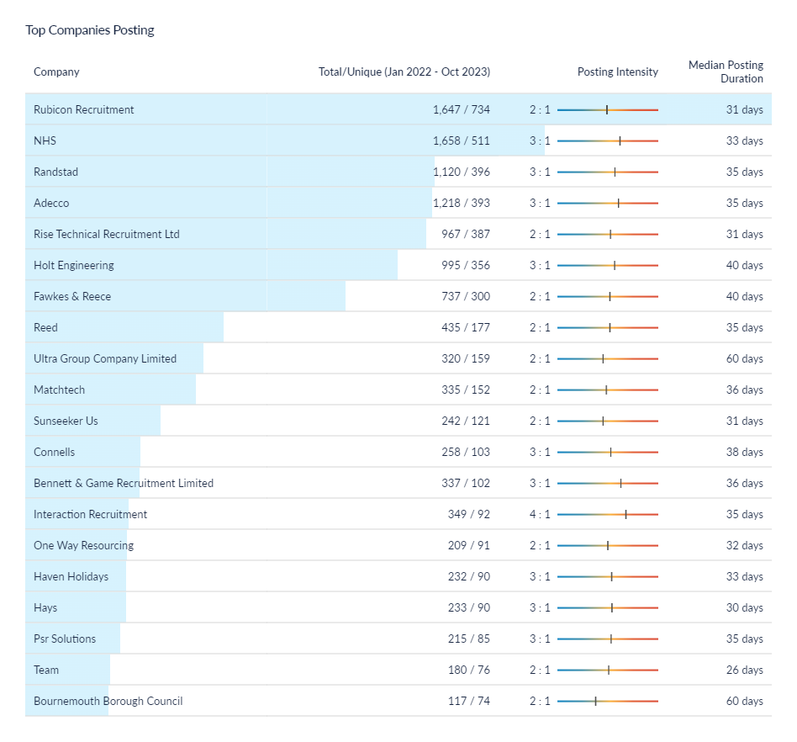
Construction job postings – location and recruiters
* Christchurch is defined within Lightcast as being in the Dorset Council area – this classification does not reflect the post-April 2019 Local Government restructure
What is noticeable from the data on the top companies posting vacancies is the absence of any large construction firms. This may reflect the channels that those construction businesses use to recruit (noting earlier comment about informal recruitment in the industry) but also, but also reflect that the majority of businesses are small/micro (as also noted earlier). The data also illustrates that construction roles are recruited into non-construction organisations. Finally, it also reflects the wider definition used here – also including manufacturing technologies.
Source: Lightcast, 2023

Slide 13
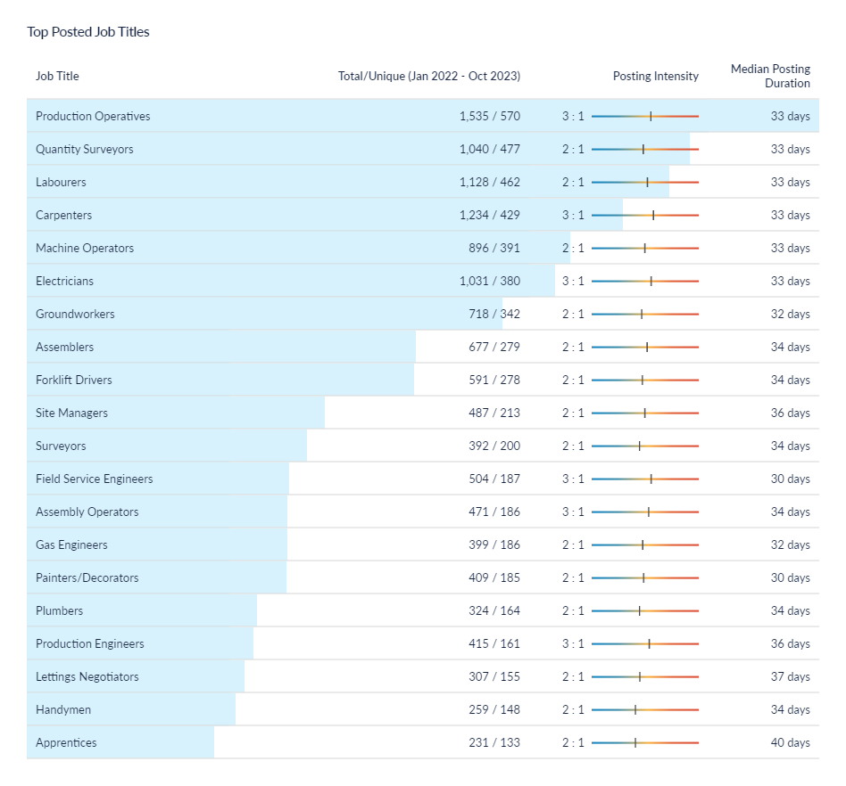
Construction job postings – role demand
The most common job postings across the Dorset LSIP area within the associated occupations are production operatives (reflecting the manufacturing technologies element of the definition) as well as labourers, carpenters, electricians etc – as would be largely expected. There was also significant demand for quantity surveyors, which wasn’t necessarily reflected in the previous sector dashboard.
Again, this data is using a taxonomy that charts the roles/jobs that tend to be filled by individuals that undertook construction and/or manufacturing technologies courses (SSA2 level).
Jobs tended to be posted 2 to 3 times and for an average of c1 month.
It is important to note that this slide details the job vacancy postings i.e. dynamic demand. This compares to some earlier slides (e.g. slide 9) which illustrated the level of job roles across the Dorset LSIP area.
Source: Lightcast, 2023

Slide 14
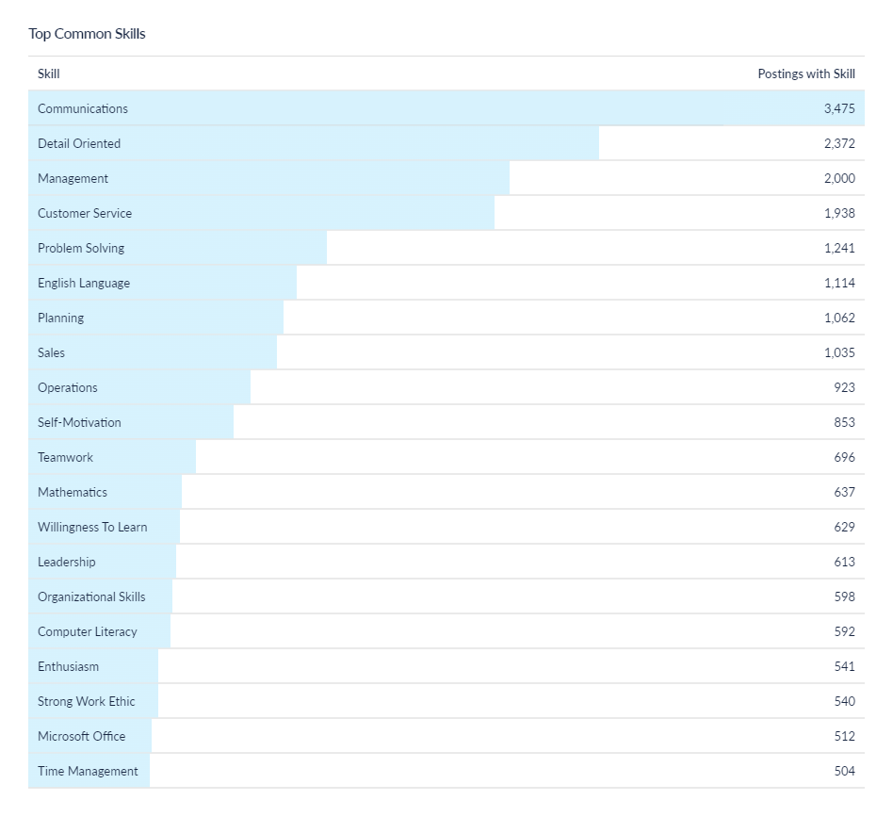
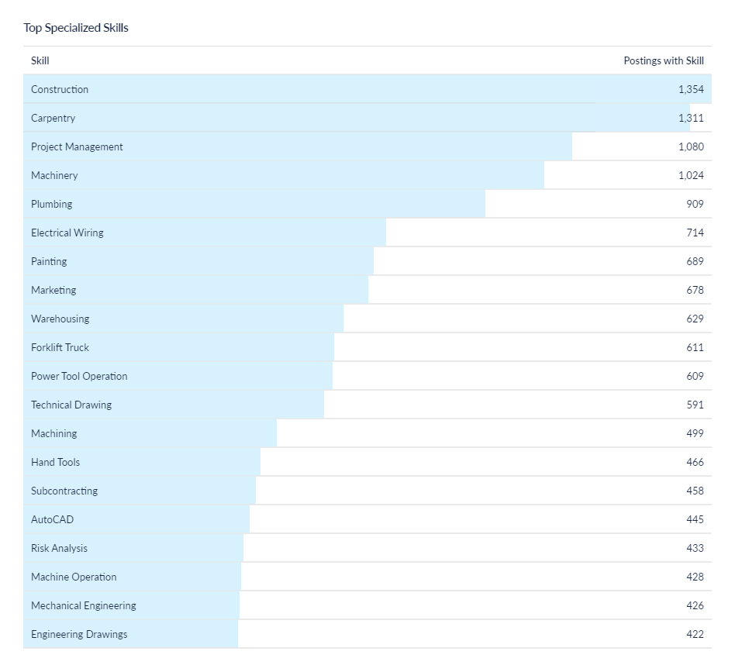
Construction job postings - skills
The most sought after specialised skills include construction (recognising that it a fairly generic description), carpentry, project management and other skills such as electrical wiring.
More common (soft) skills requirements include communication, detail orientation and other aspects such as problem solving etc, self-motivation etc.
Source: Lightcast, 2023

