Slide 1

Digital and Creative – overview
Autumn 23 update

Slide 2

Data notes
This sector dashboard uses a combination of data published via the Office of National Statistics (ONS) and also utilises vacancy data via Lightcast
Lightcast is a global leader in labour market analytics. This dashboard primarily uses Lightcast job posting analytics and focuses on the Dorset LSIP area and trends over time
It is important to note that the analysis here only reflects jobs that are posted online. It effectively ‘scrapes’ a range of job websites, alongside candidate profiles
Lightcast uses sophisticated software to try remove duplicates i.e. jobs posted repeatedly, but recognises that this may remain an issue for some postings
Because it captures online job postings only, it cannot capture informal job vacancies and recruitment. It is important to recognise that in some sectors such as construction recruitment tends to be more ‘informal’ and will not be reflected in the data here. This may also be more prevalent in small and micro businesses
It is also important to note that the analysis attempts to differentiate between sectors and ‘occupational pathways’. That is, some of the requirements for certain skills do not necessarily occur in tightly defined sectors. For example, digital skills are important across a whole range of sectors, whilst many people working in construction do not necessarily work in the construction sector per. This utilises the Lightcast Occupation Taxonomy – see later slide around definition
Given there will be some short-term volatility in job posting data, the analysis here covers the period Jan 2022 to Sept 2023. This will serve to ‘smooth’ some of the data and for the use Dorset LSIP analysis – longer-term trends are important
Christchurch is defined within Lightcast as being in the Dorset Council area – this classification does not reflect the post-April 2019 Local Government restructure

Slide 3
Definitions (1)
Standard Industrial Classification (SIC)
based approach – slides 4 and 5
Working Futures analysis – slide 6
Lightcast occupational taxonomy – slides 10 to 14
2620 : Manufacture of computers and peripheral equipment
6110 : Wired telecommunications activities
6120 : Wireless telecommunications activities
6130 : Satellite telecommunications activities
6190 : Other telecommunications activities
6311 : Data processing, hosting and related activities
6312 : Web portals
9511 : Repair of computers and peripheral equipment
9001 : Performing arts
9002 : Support activities to performing arts
9003 : Artistic creation
9004 : Operation of arts facilities
9101 : Library and archive activities
9102 : Museum activities
9103 : Operation of historical sites and buildings and similar visitor attractions
7410 : Specialised design activities
7420 : Photographic activities
7430 : Translation and interpretation activities
7311 : Advertising agencies
7312 : Media representation
7111 : Architectural activities
7021 : Public relations and communication activities
5811 : Book publishing
5812 : Publishing of directories and mailing lists
5813 : Publishing of newspapers
5814 : Publishing of journals and periodicals
5819 : Other publishing activities
5821 : Publishing of computer games
5829 : Other software publishing
5911 : Motion picture, video and television programme production activities
5912 : Motion picture, video and television programme post-production activities
5913 : Motion picture, video and television programme distribution activities
5914 : Motion picture projection activities
5920 : Sound recording and music publishing activities
3299 : Other manufacturing n.e.c.
6201 : Computer programming activities
6202 : Computer consultancy activities
6203 : Computer facilities management activities
6209 : Other information technology and computer service activities
6010 : Radio broadcasting
6020 : Television programming and broadcasting activities
8552 : Cultural education

Slide 4
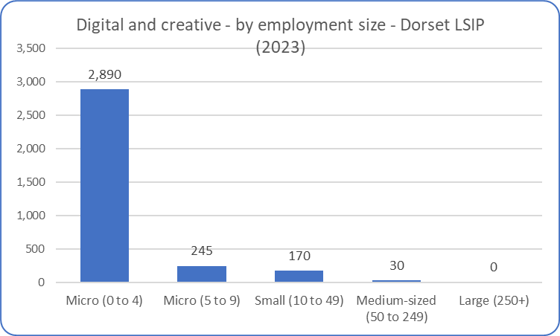
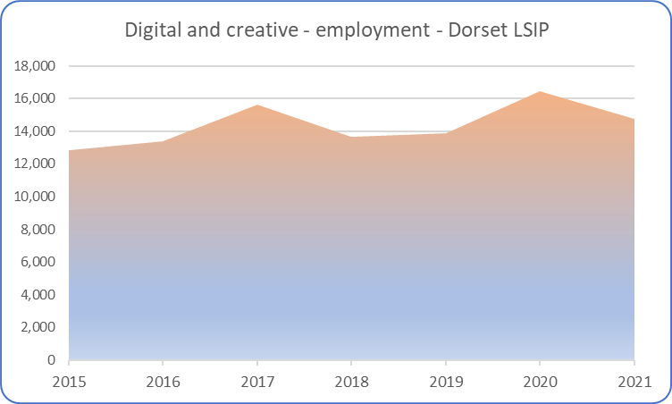
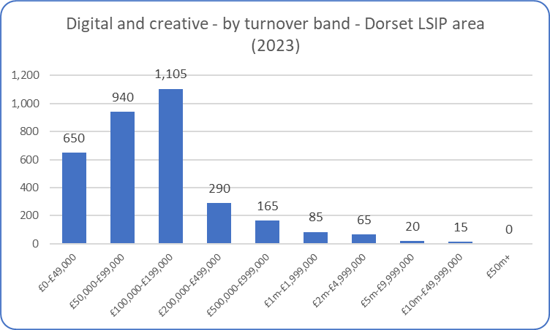
Digital and creative – overview (1)
The digital and creative industry (which in the definition used encapsulates a range of activities) is dominated by micro businesses. Employment has been sustained at a relatively constant level over the past few years, the fall in the numbers employed shown above was undoubtedly a consequence of the impact of the pandemic (the data encapsulates both employees and proprietors) when many in the sector i.e. freelancers were hit hard.
Source: ONS (Business Register and Employment Survey and UK Business Counts)
* All figures are rounded to avoid disclosure. Values may be rounded down to zero and so all zeros are not necessarily true zeros

Slide 5
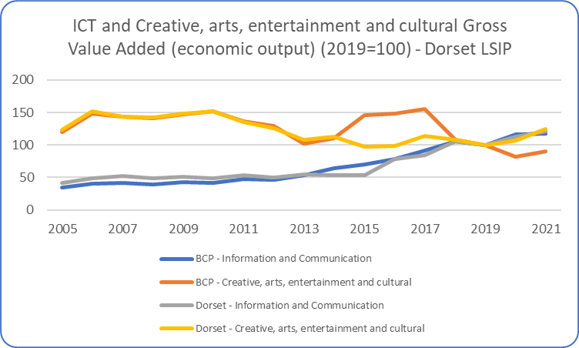
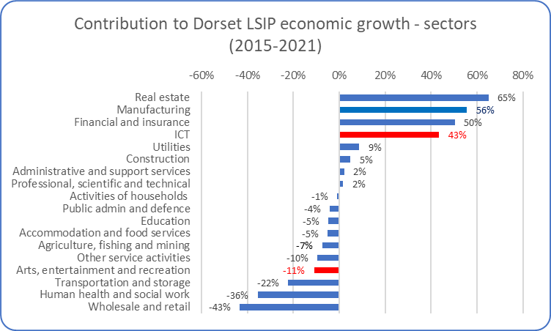
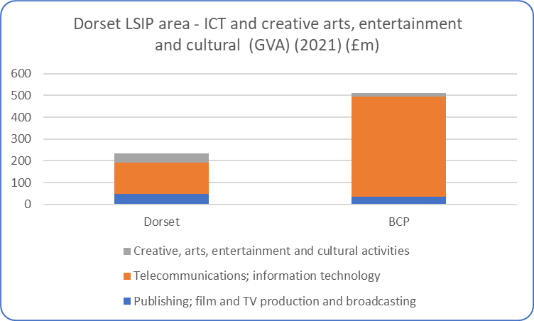
Digital and creative – overview (2)
The ICT (proxy for digital) and the creative arts, entertainment and cultural sector is significantly larger in BCP than in Dorset County – as measured by output (top left chart). The creative arts sector has experienced steady growth over the past 10-15 years across both BCP and Dorset County (bottom left chart).
The ICT sector – which includes publishing, film, TV production as well as telecoms and information technology has been an important contributor to overall economic growth across the Dorset LSIP area. The data (above right chart) indicates that the arts, entertainment and recreation sector played a less significant role in terms of contribution to overall economic growth across the Dorset LSIP area – undoubtedly partly reflecting that much of the sector was shutdown during 2020 and 2021.
Source: ONS (Sub-regional (Balanced) Gross Value Added)

Slide 6
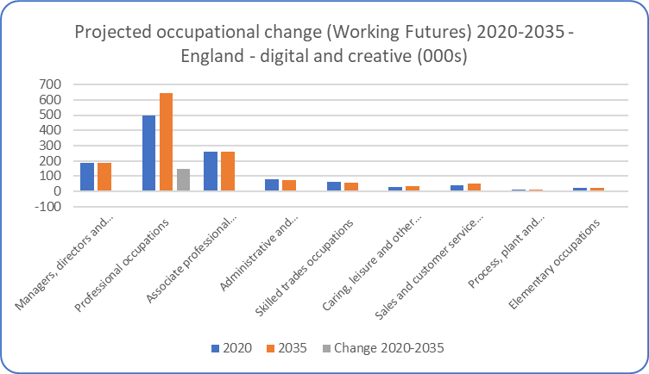
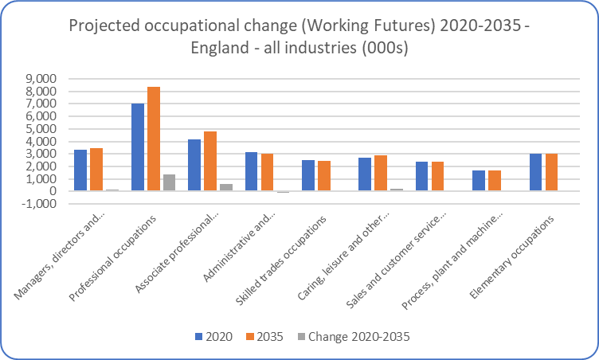
Digital and Creative – future projections
The latest Labour Market and Skills projections produced through the Working Futures programme - covering the period 2020-2035 and the first produced in a post-Covid environment – projects that overall employment in digital and creative will increase over the 10-15 years. The data presented here is at a national (England) level.
The projections expect employment to increase in digital and creative industries over the next 10-15 years, with particular strong increases in professional occupations – which already covers most of the employment in this sector now. The projections suggest a further focusing of employment in that sector.
The projections are intended to provide a statistical foundation for reflection and debate among all those with an interest in the demand for and supply of skills. They are produced because historical evidence shows that changing patterns of employment by sector and occupation tend to largely dominated by longer-term trends rather than the cyclical position of the economy or short-term impacts. However, it is obvious that these projections are subject to high degrees of uncertainty and therefore we would urge careful interpretation of these projections. They are intended as a starting point for further analysis rather than a projection of what is most likely to happen. They represent one possible future.
Source: Working Futures 2020-2035

Slide 7
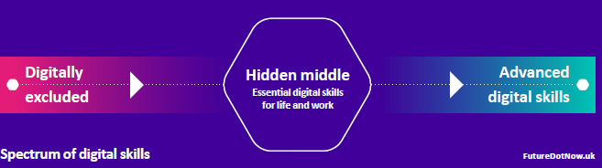
Digital and creative – key research findings
The UK ranks 41st in the world for digital competitiveness rankings for employee training
Digital skills are now essential entry requirements for two-thirds of UK occupations and these occupations account for 82% of online job vacancies. In the manufacturing sector for example, 87% of employers say that basic digital skills are important for their workers.
Employers say that only 48% of people leaving full-time education have the advanced digital skills required, and many companies cite lack of available talent as the single biggest constraining factor to their growth, 30% of skill-shortage vacancies involve a lack of basic digital skills
Covid had a positive impact in terms of increasing the number of people who hold basic digital skills – estimated to be c6mn fewer working adults having zero workplace digital skills. Digital skills in workforce have improved and deepened
However, there remains the ‘hidden middle’ – approx. one-third of workforce still lacking essential digital skills for work. Particularly marked in those aged 55+, those working part-time, those in service sector and those with no formal qualifications

Slide 8
Digital and creative – key research findings
Also appears to be a gender issue – with women not having made the same digital gains (post Covid) as makes – although this also reflects working practices, family commitments, industry of employment etc.
Digital skills of young people have improved markedly - necessity potentially behind big improvements for youngest workers, as they start their working lives and were thrown into the very different working environments due to the pandemic
People working at small or microbusinesses are least likely to have essential workplace digital skills
Range of different motivations for people to digitally upskill – and it is these motivations that tend to drive behaviour rather than the availability of skills training provision. As such digital training should anchor onto outcomes, end goals and ‘hook’ workers with what they will be able to do instead of promoting digital skills as an end result – acting as the incentive for involvement
Jobs in the broader digital tech economy now account for around 14% of the UK workforce at 4.7mn people
More than 2mn tech vacancies were advertised over the last 12 months
Source: Miscellaneous – House of Commons Science and Technology Committee, World Digital Competitiveness Ranking 2023, Department of Digital, Culture Media and Sport, WorldSkillsUK, Employers Skills Survey 2019, 2023 Global Skills Report

Slide 9
Digital and Creative (SSA2)
Autumn 23 update
Data covering 2022 – 2023 (to date)

Slide 10
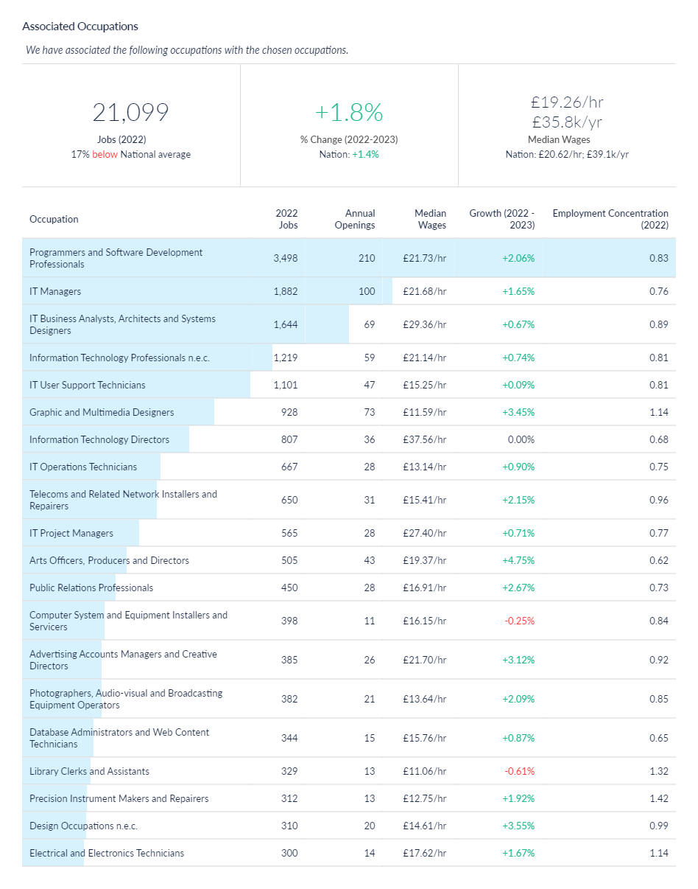
Digital and creative job postings – associated occupations
An alternative method of estimating the scale of digital and creative jobs across the Dorset LSIP area is to understand what types of jobs/occupations tend to be filled by those individuals who undertook related training (at SSA 2 level). In effect this represents the ‘occupational pathways’ (as described in the data notes slide). This analysis is available via Lightcast (utilised for this analysis) which have developed the Lightcast Occupation Taxonomy which aims to link skills acquisition to occupations. Based on this methodological approach, it is estimated that there were c21,100 jobs in 2022 across the Dorset LSIP area in occupations associated with digital and creative courses (SSA2). The number of jobs in associated occupations has increased by 1.8% between 2022 and 2023 across the Dorset LSIP area.
One of the explanations of the difference between the two job figures shown in this slide pack (slide 4 versus slide 11) is that digital and creative occupations can be found across a myriad of sectors (in all likelihood the whole economy). The two cannot be directly compared.
Source: Lightcast, 2023

Slide 11
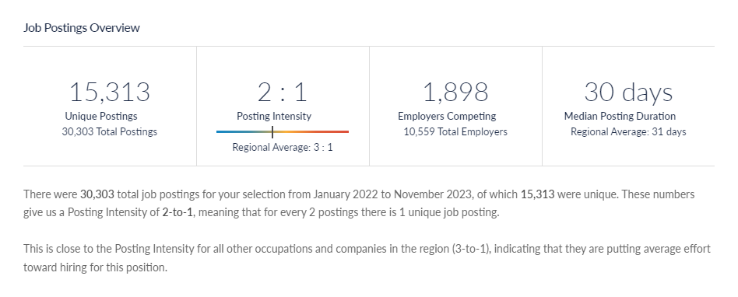
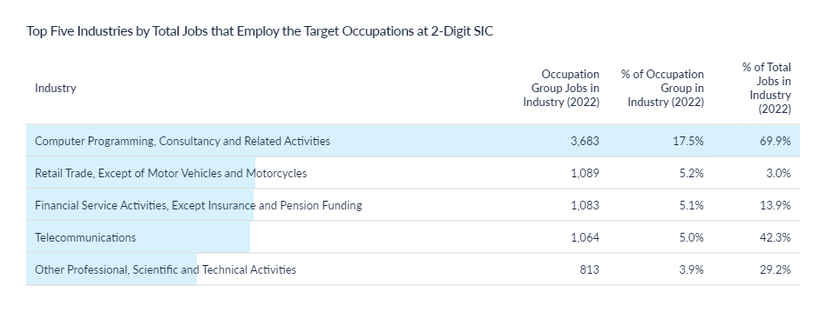
Digital and creative job postings - volume
There c15,000 job postings across 2022 and 2023 (to date) relating to the occupations associated with digital and creative courses (SSA2).
Typically, jobs are posted twice before being filled (posting intensity of 2:1), and this has remained broadly stable over time.
Source: Lightcast, 2023

Slide 12
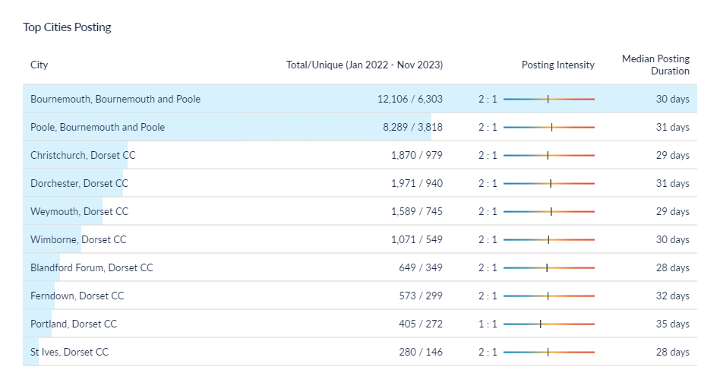
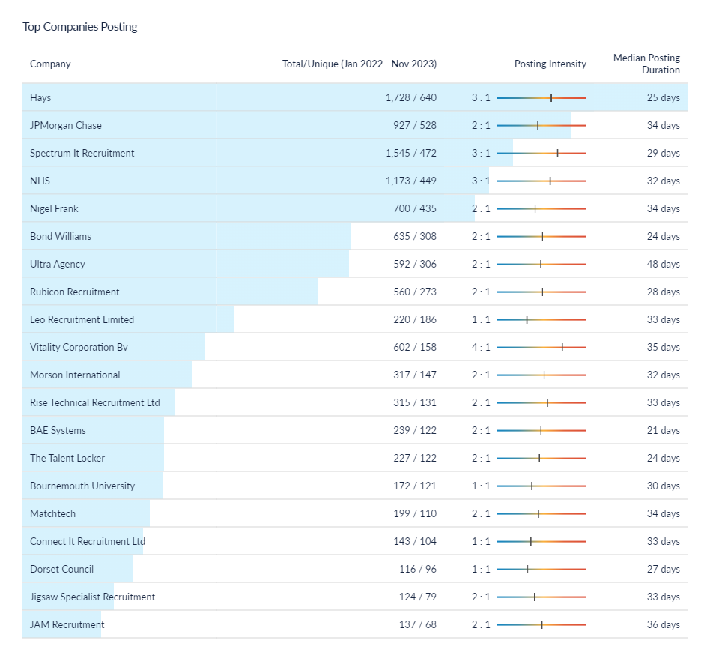
Digital and creative job postings – location and recruiters
* Christchurch is defined within Lightcast as being in the Dorset Council area – this classification does not reflect the post-April 2019 Local Government restructure
One of the aspects to note is that - in terms of top recruiters – this includes recruitment/employment agencies, indicating that some recruitment goes via third parties. The other aspect to note is that some of the largest recruiters are organisations that would not be defined as necessarily digital and/or creative i.e. JP Morgan Chase, NHS, Vitality etc. This mostly reflects digital recruitment.
Source: Lightcast, 2023

Slide 13
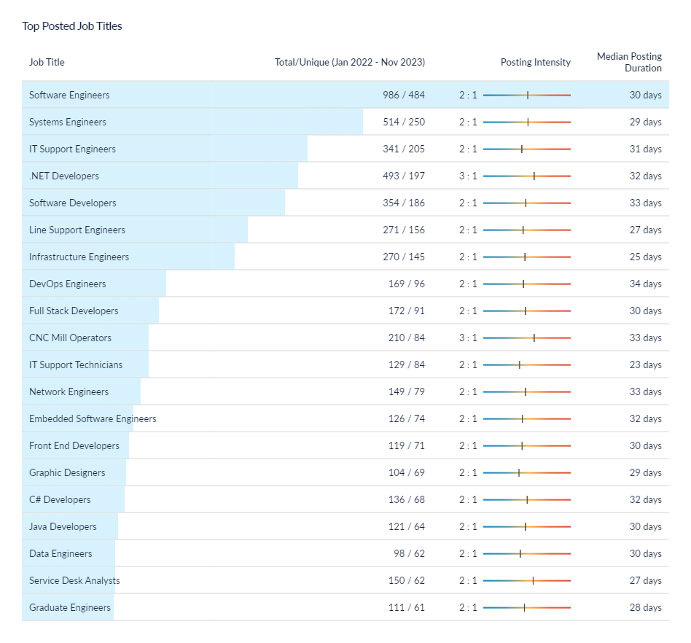
Digital and creative job postings – role demand
The most common job postings within the associated occupations are software engineers, software developers, systems engineers etc. Again, this data is using a taxonomy that charts the roles/jobs that tend to be filled by individuals that undertook digital and/or creative related courses (SSA2 level).
Typically, jobs are posted twice before being filled (posting intensity of 2:1), and this has remained broadly stable over time.
It is important to note that this slide details the job vacancy postings i.e. dynamic demand. This compares to some earlier slides (e.g. slide 9) which illustrated the level of job roles across the Dorset LSIP area.
Source: Lightcast, 2023

Slide 14
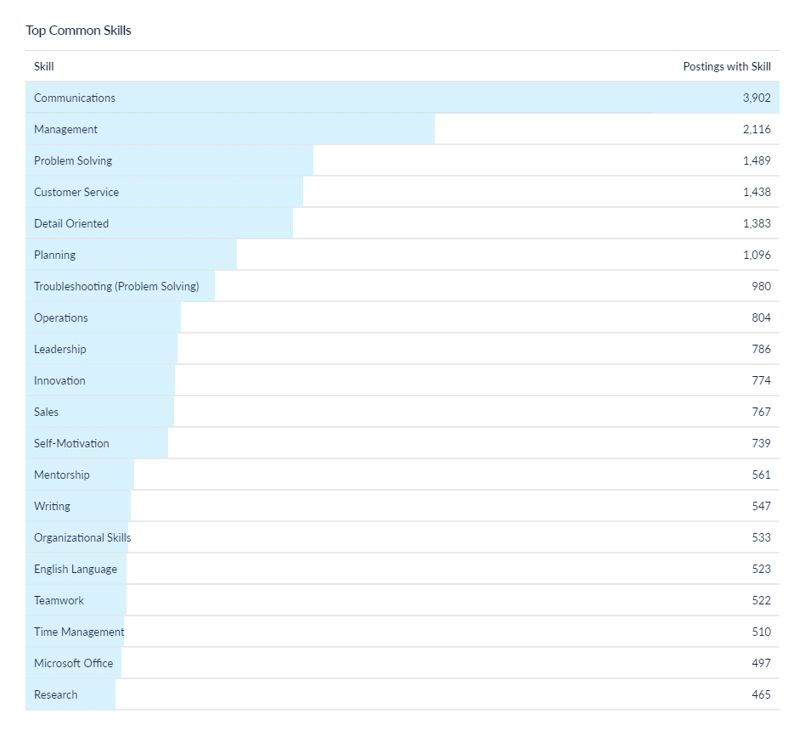
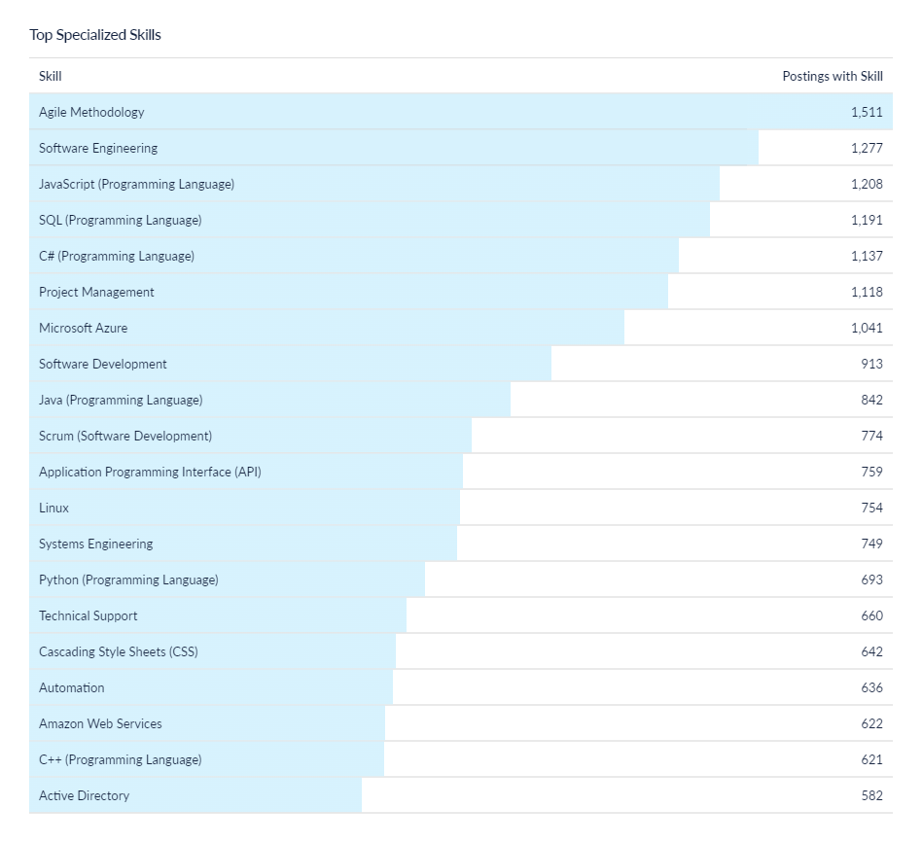
Digital and creative job postings – skills (1)
The most sought after specialised skills predominantly relate to those required in the digital and ICT field. These include software engineering, specific programming and software development such as JavaScript, Azure etc.
In terms of common (soft) skills, communication and management skills tend to highly sought after.
Source: Lightcast, 2023

Slide 15
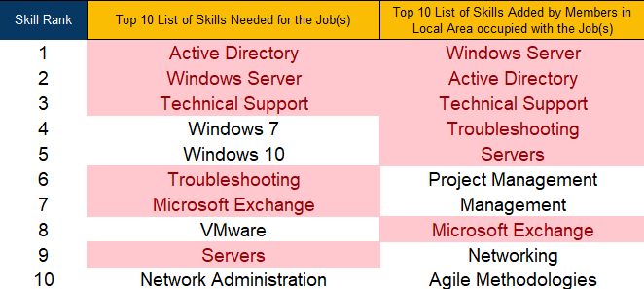
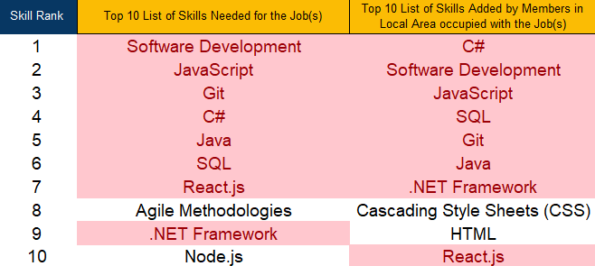
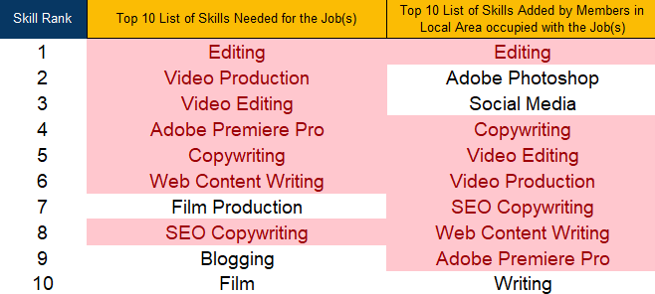
Digital and creative job postings – skills (2)
Information Technology
Software engineer
Media and Communications
Source: LinkedIn – LSIP Programme Team

