Slide 1

Advanced Manufacturing and Engineering – overview
Autumn 23 update

Slide 2

Data notes
This sector dashboard uses a combination of data published via the Office of National Statistics (ONS) and also utilises vacancy data via Lightcast
Lightcast is a global leader in labour market analytics. This dashboard primarily uses Lightcast job posting analytics and focuses on the Dorset LSIP area and trends over time
It is important to note that the analysis here only reflects jobs that are posted online. It effectively ‘scrapes’ a range of job websites, alongside candidate profiles
Lightcast uses sophisticated software to try remove duplicates i.e. jobs posted repeatedly, but recognises that this may remain an issue for some postings
Because it captures online job postings only, it cannot capture informal job vacancies and recruitment. It is important to recognise that in some sectors such as construction recruitment tends to be more ‘informal’ and will not be reflected in the data here. This may also be more prevalent in small and micro businesses
It is also important to note that the analysis attempts to differentiate between sectors and ‘occupational pathways’. That is, some of the requirements for certain skills do not necessarily occur in tightly defined sectors. For example, digital skills are important across a whole range of sectors, whilst many people working in construction do not necessarily work in the construction sector per. This utilises the Lightcast Occupation Taxonomy – see later slide around definition
Given there will be some short-term volatility in job posting data, the analysis here covers the period Jan 2022 to Sept 2023. This will serve to ‘smooth’ some of the data and for the use Dorset LSIP analysis – longer-term trends are important
Christchurch is defined within Lightcast as being in the Dorset Council area – this classification does not reflect the post-April 2019 Local Government restructure

Slide 3
Definitions (1)
Standard Industrial Classification (SIC) based approach
– slides 4 and 5
Lightcast occupational taxonomy – slides 10 to 14
Working Futures analysis – slide 6
2 digit SIC codes 10-33

Slide 4
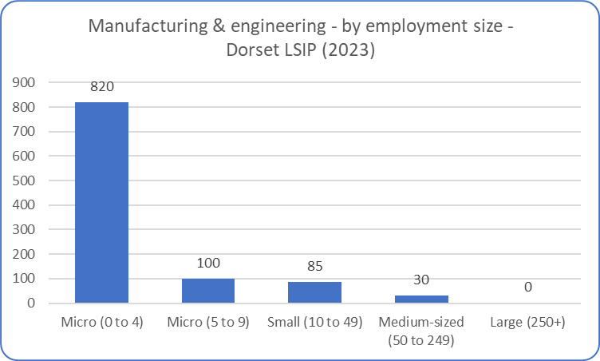
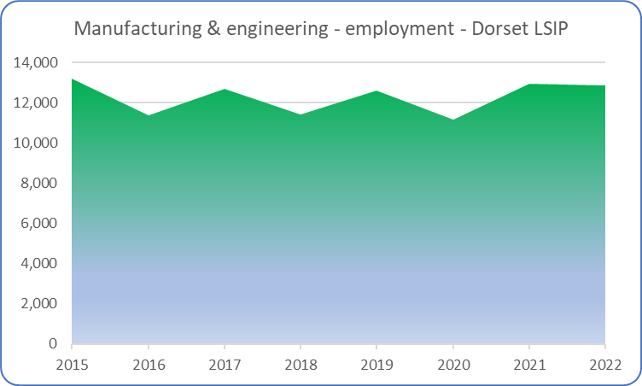
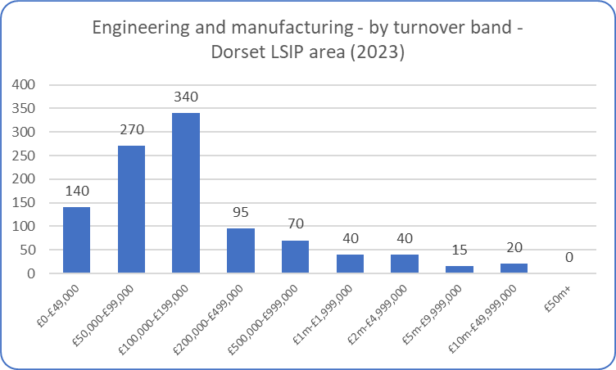
Engineering & manufacturing – overview (1)
It is important to note that this data is based on a definition of ‘advanced manufacturing and engineering’. It does not include all manufacturing activity.
Employment within engineering and manufacturing activities across the Dorset LSIP area have remained broadly constant over the past few years. It has several businesses that have significant turnover (noting this data relates to enterprises, there are also other ‘local units’ which represent the local presence of engineering/manufacturing businesses which may be headquartered elsewhere). However, the majority of businesses involved in manufacturing and engineering (as defined) across the Dorset LSIP area tend to be small – employing fewer than 10 people and generating an annual turnover of <£200,000.
Source: ONS (Business Register and Employment Survey and UK Business Counts)

Slide 5
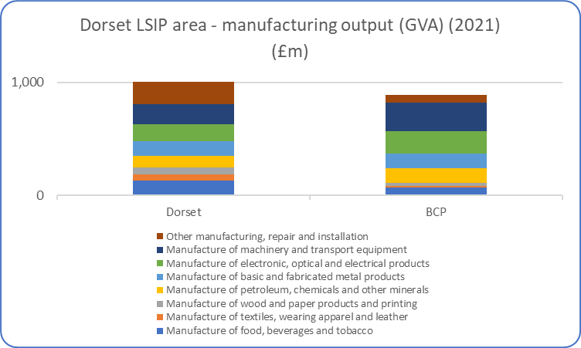
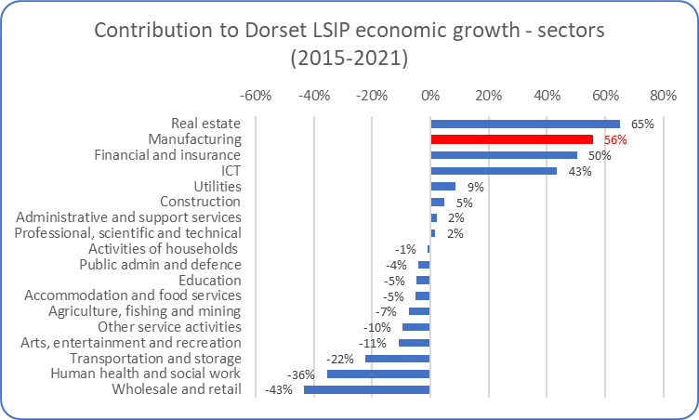
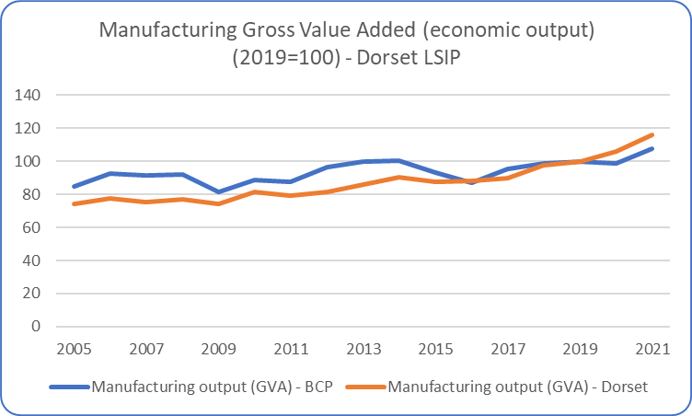
Engineering & manufacturing – overview (2)
The (broad) manufacturing sector is slightly larger in Dorset County than in BCP, although – as measured by output – there is a reasonably even distribution across the two local authority areas (top left chart). The sector has experience steady growth over the past 10-15 years, with indications that it has grown slightly more strongly across Dorset (bottom left chart).
It has been an important contributor to overall economic growth across the Dorset LSIP area. The data (above right chart) indicates that it played a particularly important role during Covid, when other sectors obviously shutdown and experienced negative growth. Several local manufacturing businesses experienced strong growth as consumer demand shifted during that time.
Source: ONS (Sub-regional (Balanced) Gross Value Added)

Slide 6
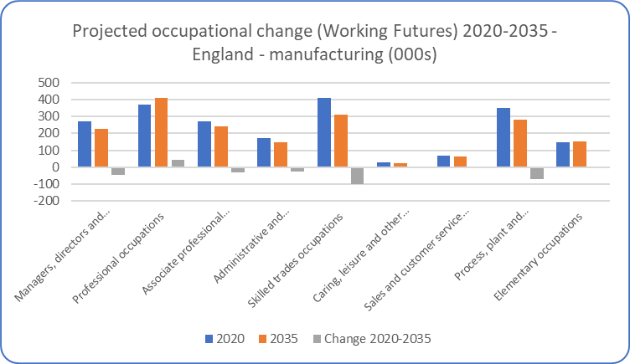
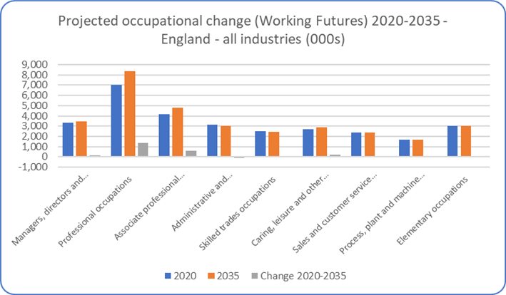
Engineering & manufacturing – future projections
The latest Labour Market and Skills projections produced through the Working Futures programme - covering the period 2020-2035 and the first produced in a post-Covid environment – projects that overall employment in engineering and manufacturing (defined in quite broad terms) will fall over the 10-15 years. The data presented here is at a national (England) level.
The projections expect employment to fall in most of the broad occupational classifications, apart from professional occupations. Some of the largest (absolute and proportional) falls are expected in skilled trade occupations and process, plant and machine operatives. This is expected to reflect the impact of ongoing technological change and how it will shape the future engineering and manufacturing workforce.
The projections are intended to provide a statistical foundation for reflection and debate among all those with an interest in the demand for and supply of skills. They are produced because historical evidence shows that changing patterns of employment by sector and occupation tend to largely dominated by longer-term trends rather than the cyclical position of the economy or short-term impacts. However, it is obvious that these projections are subject to high degrees of uncertainty and therefore we would urge careful interpretation of these projections. They are intended as a starting point for further analysis rather than a projection of what is most likely to happen. They represent one possible future.
Source: Working Futures 2020-2035

Slide 7
Manufacturing and engineering – key research findings
Overriding evidence is that manufacturers and engineering businesses continue to face difficulties in accessing the skilled workforce to drive innovation and growth
Manufacturers now need a workforce with the ability to adapt rapidly and take on new tasks and responsibilities that require different and often higher skillsets
Manufacturing and engineering businesses remain one of the sectors that faces skills shortages – and this has been accentuated by post-pandemic workforce expectations around desire to work remotely, focusing on jobs which offer a more sustainable work-life balance etc.
Current workforce is aging, new recruits with right skills are in short supply and overseas workers now not able to fill gap
Rapid pace of technological change demands more modular and flexible training courses. Because much of the future demand will fall on incumbent workforce, the creation of higher technical qualifications comprised of discrete, credit‑bearing modules could be suitable model for upskilling
In comparison with international competitors, the UK has limited capability and capacity to deliver higher technical skills

Slide 8
Manufacturing and engineering – key research findings
Major themes that will/are influencing the approach to skills in manufacturing and engineering businesses include:
- greater emphasis on future planning – events such as the pandemic has forced many businesses to rethink their efforts to build their workforce, reassessing previous approaches to training, development of talent pipeline and retention
- educating and reaching out to school age – many businesses recognise the need to reach out to young people early and educate them about manufacturing
- the importance of upskilling – the emphasis on current workforce remains a priority for many manufacturers
- importance of company values and culture – becoming increasingly important recruitment tools, particularly for younger workers
Sector still tends to be male-dominated, with 1-in-5 of the workforce female
Digital and green skills still need to be fully embrace, with skills gaps in those areas i.e. moving to Industry 4.0 and producing in a more sustainable way
Source: Miscellaneous – including Make UK, CIPD, The Manufacturer, ONS, SWMAS Barometer

Slide 9
Advanced Manufacturing and Engineering (SSA2)
Autumn 23 update
Data covering 2022 – 2023 (to date)

Slide 10
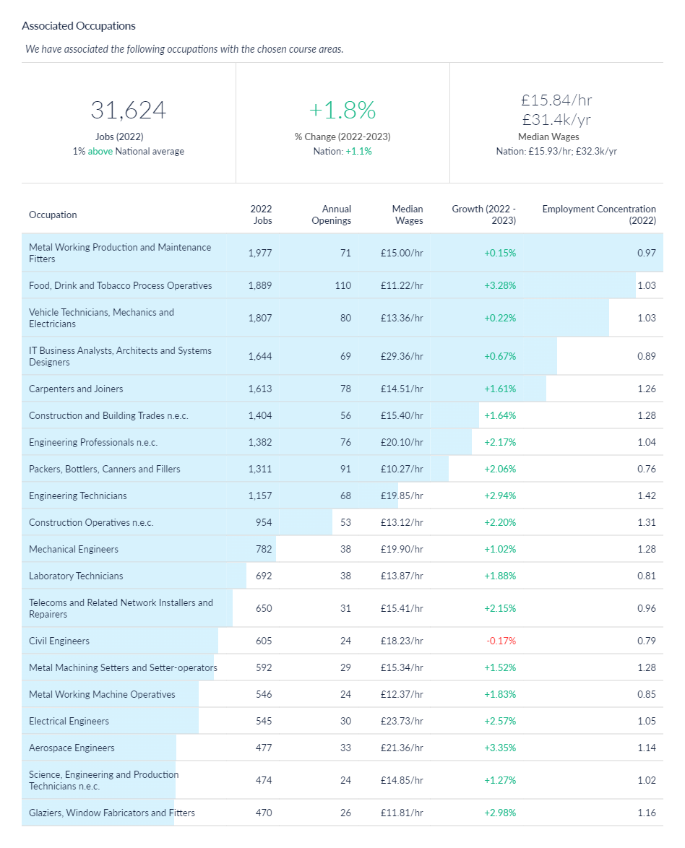
Manufacturing and engineering job postings – associated occupations
An alternative method of estimating the scale of manufacturing and engineering jobs across the Dorset LSIP area is to understand what types of jobs/occupations tend to be filled by those individuals who undertook manufacturing and/or engineering training (at SSA 2 level). In effect this represents the ‘occupational pathways’ (as described in the data notes slide). This analysis is available via Lightcast (utilised for this analysis) which have developed the Lightcast Occupation Taxonomy which aims to link skills acquisition to occupations. Based on this methodological approach, it is estimated that there were c31,500 jobs in 2022 across the Dorset LSIP area in occupations associated with engineering and manufacturing courses (SSA2) – which engineering and manufacturing technologies. The number of jobs in associated occupations has increased by 1.8% between 2022 and 2023 across the Dorset LSIP area.
One of the explanations of the difference between the two job figures shown in this slide pack (slide 4 versus slide 11) is that manufacturing and engineering occupations can be found in industries outside of those defined as ‘advanced manufacturing and engineering’. The other explanation is that the earlier approach was based on a definition of ‘advanced manufacturing’, rather than manufacturing per se. The two cannot be directly compared.
Source: Lightcast, 2023

Slide 11
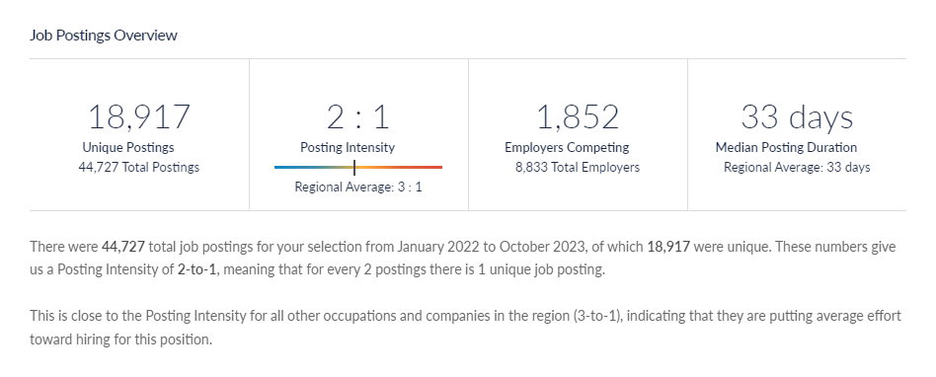
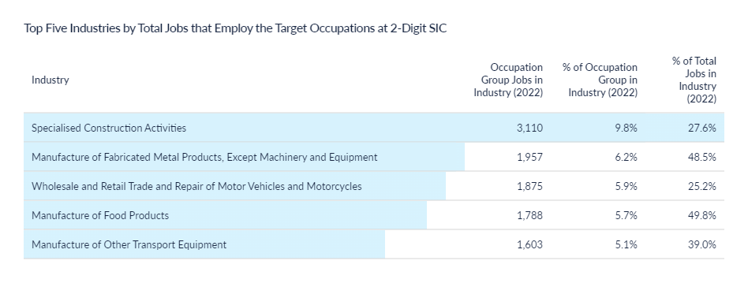
Engineering and manufacturing job postings - volume
There c19,000 job postings across 2022 and 2023 (to date) relating to the occupations associated with manufacturing and engineering courses (SSA2).
Typically, jobs are posted twice before being filled (posting intensity of 2:1), and this has remained broadly stable over time.
Source: Lightcast, 2023

Slide 12
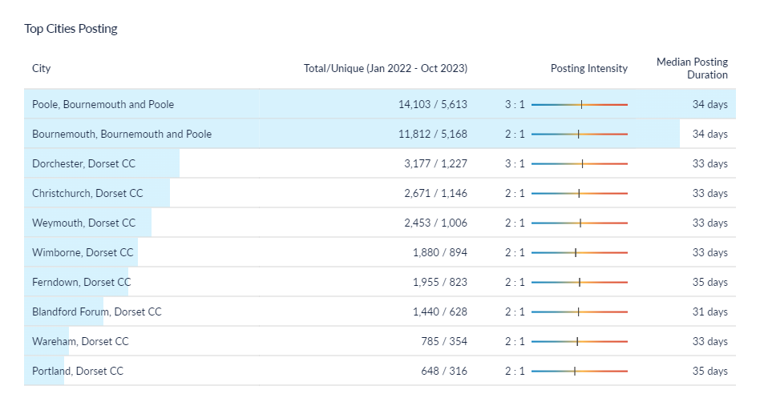
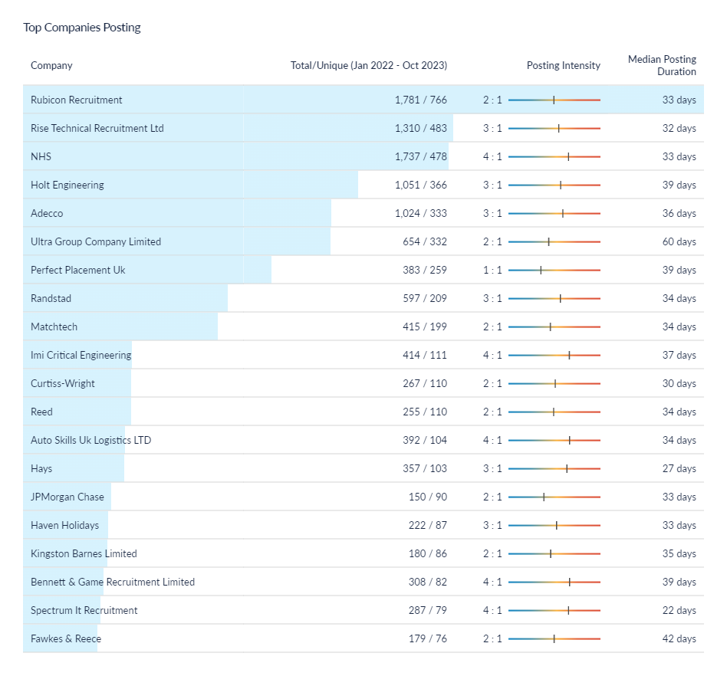
Engineering and manufacturing job postings – location and recruiters
* Christchurch is defined within Lightcast as being in the Dorset Council area – this classification does not reflect the post-April 2019 Local Government restructure
One of the aspects to note is that - in terms of top recruiters – this includes recruitment/employment agencies, indicating that some recruitment goes via third parties. The other aspect to note is that some of the largest recruiters are organisations that would not be defined as ‘manufacturers’ i.e. the NHS.
Source: Lightcast, 2023

Slide 13
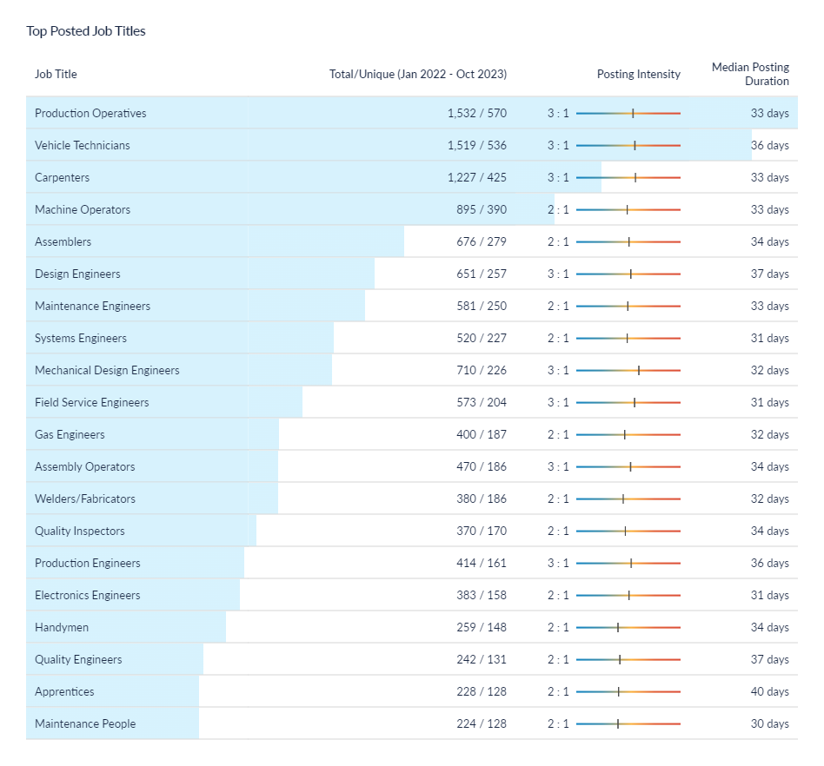
Engineering and manufacturing job postings – role demand
The most common job postings within the associated occupations are production operatives, vehicle technicians, machine operators etc. Again, this data is using a taxonomy that charts the roles/jobs that tend to be filled by individuals that undertook manufacturing and/or engineering courses (SSA2 level).
The data indicated that those roles that are most in demand (as measured by online job postings) tend to be low-to-medium skill levels. However, there has also been a reasonable level of demand for roles such as design, system and electronic engineers across recruiting organisations.
It is important to note that this slide details the job vacancy postings i.e. dynamic demand. This compares to some earlier slides (e.g. slide 9) which illustrated the level of job roles across the Dorset LSIP area.
Source: Lightcast, 2023

Slide 14
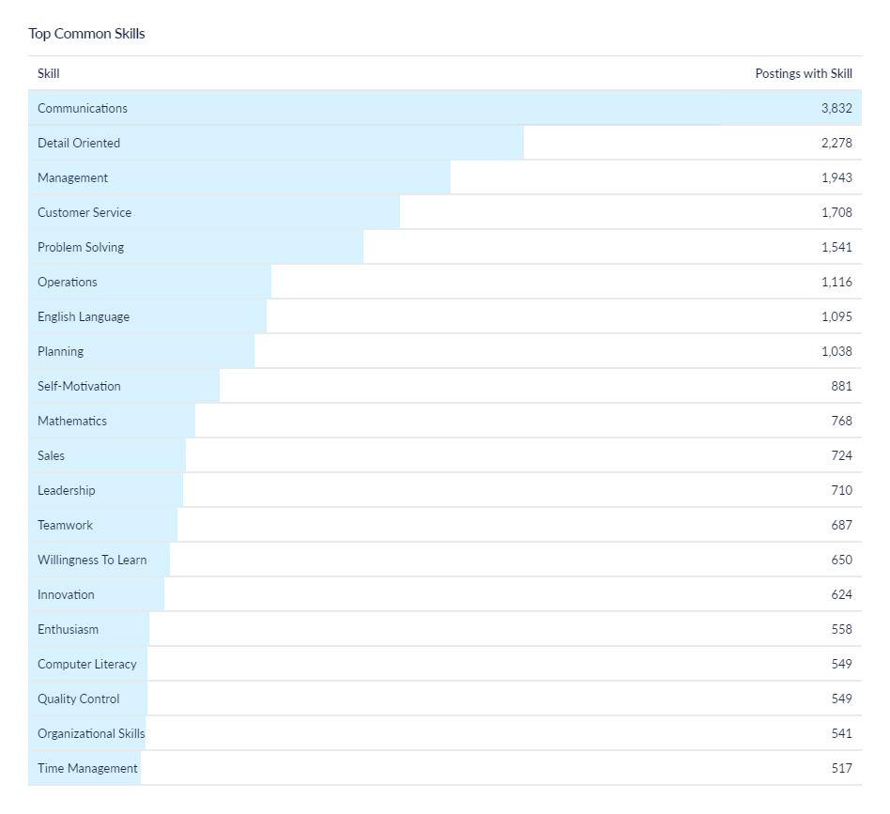
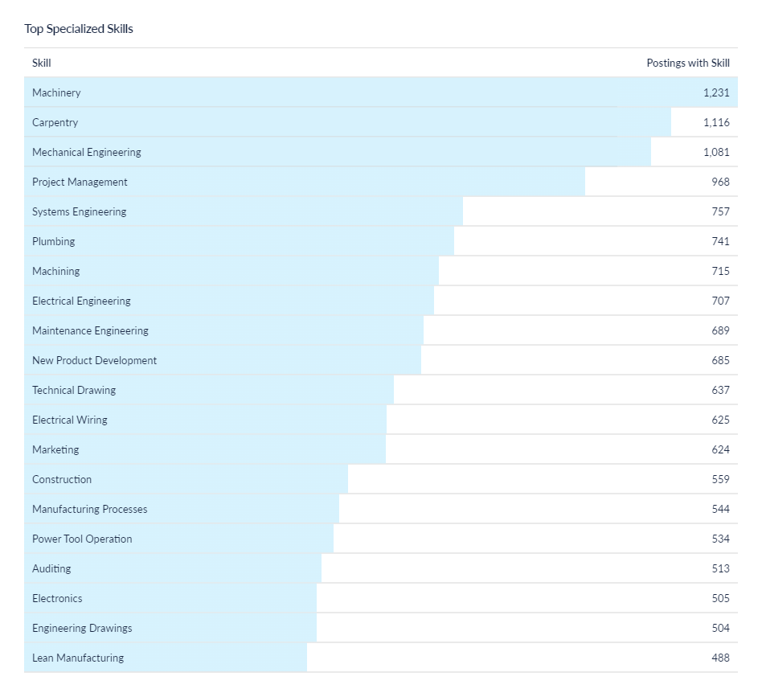
Engineering and manufacturing job postings - skills
Source: Lightcast, 2023

