Slide 1

Health and Social Care – overview
Autumn 23 update

Slide 2

Data notes
This sector dashboard uses a combination of data published via the Office of National Statistics (ONS) and also utilises vacancy data via Lightcast
Lightcast is a global leader in labour market analytics. This dashboard primarily uses Lightcast job posting analytics and focuses on the Dorset LSIP area and trends over time
It is important to note that the analysis here only reflects jobs that are posted online. It effectively ‘scrapes’ a range of job websites, alongside candidate profiles
Lightcast uses sophisticated software to try remove duplicates i.e. jobs posted repeatedly, but recognises that this may remain an issue for some postings
Because it captures online job postings only, it cannot capture informal job vacancies and recruitment. It is important to recognise that in some sectors such as construction recruitment tends to be more ‘informal’ and will not be reflected in the data here. This may also be more prevalent in small and micro businesses
It is also important to note that the analysis attempts to differentiate between sectors and ‘occupational pathways’. That is, some of the requirements for certain skills do not necessarily occur in tightly defined sectors. For example, digital skills are important across a whole range of sectors, whilst many people working in construction do not necessarily work in the construction sector per. This utilises the Lightcast Occupation Taxonomy – see later slide around definition
Given there will be some short-term volatility in job posting data, the analysis here covers the period Jan 2022 to Sept 2023. This will serve to ‘smooth’ some of the data and for the use Dorset LSIP analysis – longer-term trends are important
Christchurch is defined within Lightcast as being in the Dorset Council area – this classification does not reflect the post-April 2019 Local Government restructure

Slide 3
Definitions (1)
Standard Industrial Classification (SIC) based approach
– slides 4 and 5
Lightcast occupational taxonomy – slides 10 to 14
Working Futures analysis – slide 6

Slide 4
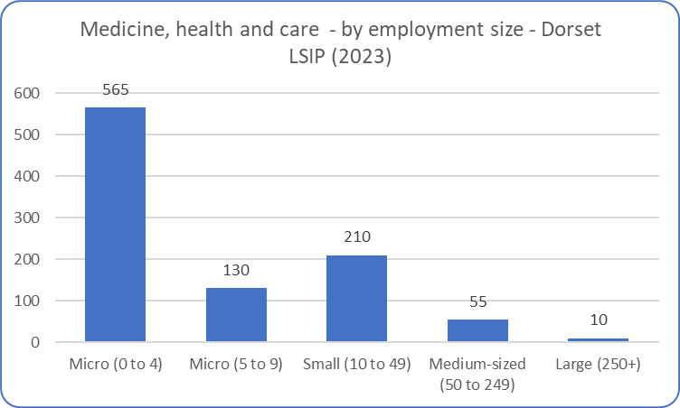
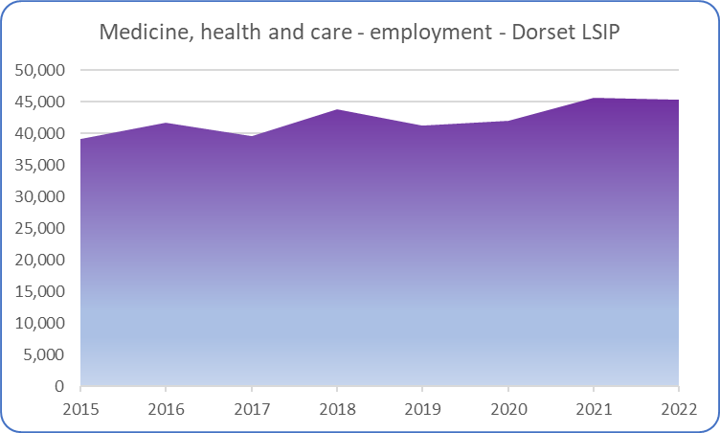
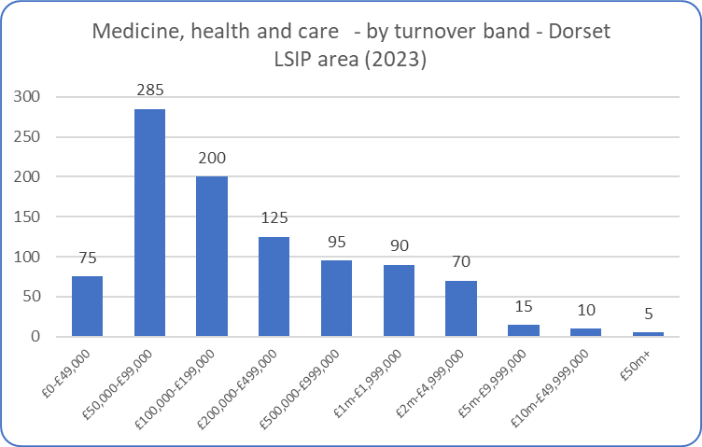
Health and social care – overview (1)
Given that the health and care sector includes several public sector organisations (NHS etc.) then the business profile does differ from the other sectors – with more medium-sized and large organisations. Employment levels have grown over time and illustrate that the sector (here defined in quite wide terms and including medical technologies) is a significant employer across the Dorset LSIP area.
Source: ONS (Business Register and Employment Survey and UK Business Counts)

Slide 5
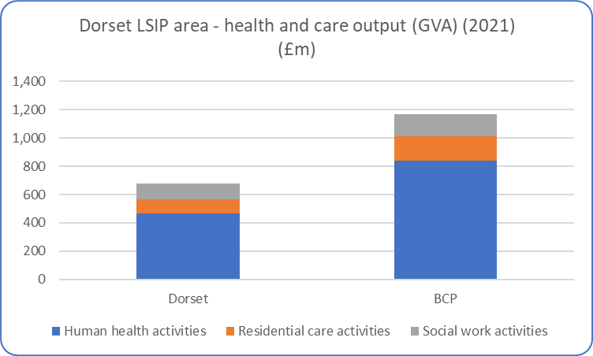
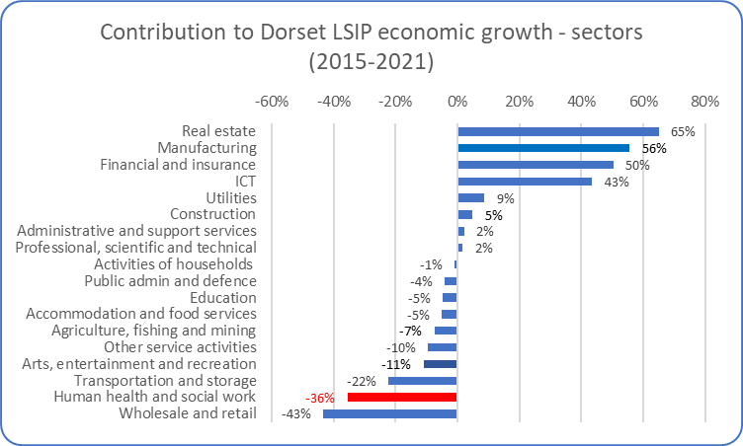
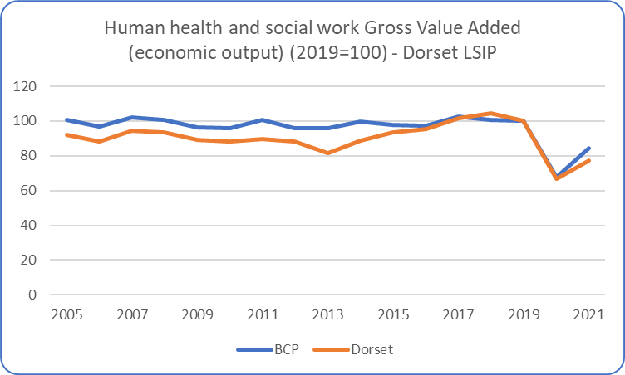
Health and social care – overview (2)
It is important to recognise that measuring the scale and importance of the health and care sector by its ‘output’ is fraught with difficulties. Output is a difficult concept within the sector, which obviously plays a wider societal role. With this caveat in mind, the (broad) health and care sector as measured is slightly larger in BCP than in Dorset County (reflecting the presence of larger hospitals etc.) The sector has not grown significantly over the past 10-15 years, and suffered a large contraction during the pandemic as non-routine activity largely stopped. As such, over the medium-term it provided a negative contribution (in output terms – noting the above comment) to the wider Dorset economy. However, this data (top right-hand chart) will largely reflect the considerable impact of the pandemic on output/activity (particularly through the 2020 and 2021 data).
Source: ONS (Sub-regional (Balanced) Gross Value Added)

Slide 6
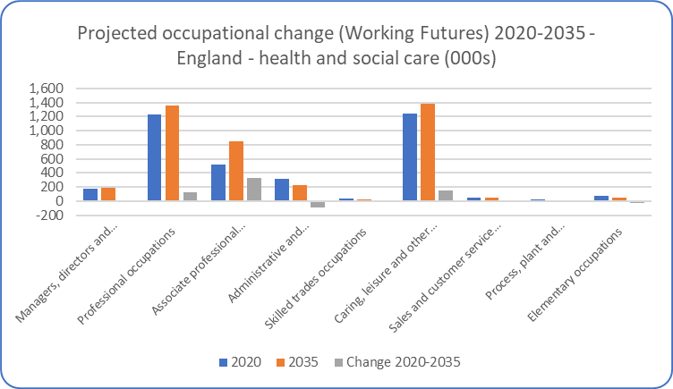
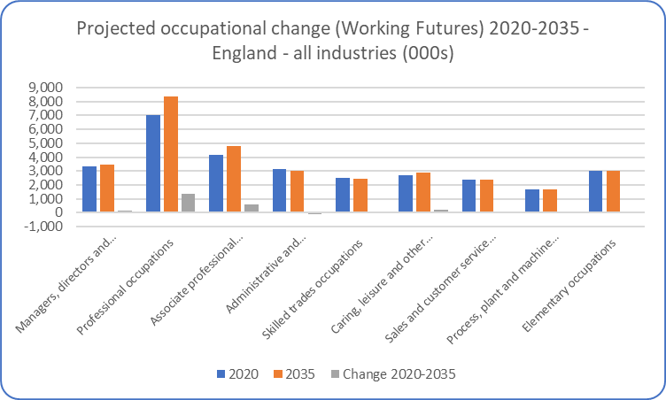
Health and Care – future projections
The latest Labour Market and Skills projections produced through the Working Futures programme - covering the period 2020-2035 and the first produced in a post-Covid environment – projects that overall employment in construction will increase over the 10-15 years. The data presented here is at a national (England) level.
The projections expect employment to increase significantly in health and social care over the next 10-15 years, with particular strong increases in associate professional occupations and (as expected) caring etc. These projections are obviously driven by demographic trends.
The projections are intended to provide a statistical foundation for reflection and debate among all those with an interest in the demand for and supply of skills. They are produced because historical evidence shows that changing patterns of employment by sector and occupation tend to largely dominated by longer-term trends rather than the cyclical position of the economy or short-term impacts. However, it is obvious that these projections are subject to high degrees of uncertainty and therefore we would urge careful interpretation of these projections. They are intended as a starting point for further analysis rather than a projection of what is most likely to happen. They represent one possible future.
Source: Working Futures 2020-2035

Slide 7
Health and care – key research findings
Healthcare sector in the UK facing a significant challenge with both employee recruitment and retention. According to the NHS, the turnover rate for nurses is c12% and roughly 1-in-5 doctors considering leaving the profession, with nearly half experiencing burnout. In addition, 4-in-5 nurses experience high levels of stress at work
The sector is characterised by a mismatch between supply-demand of skills. Most supply is determined by education/formal training pathways. Increased focus on workforce skills i.e. evolution of health professional’s skills mix which may help with retention/motivation etc.
There is a need to prepare health professionals for meeting the dual challenges of technically and emotionally complex workplace. Evidence suggests that education and training is not keeping pace with the pace of change in the workplace, particularly post-Covid
Digital skills also becoming important with growth in eHealth and mHealth and increased use of AI. However, this needs to be complemented by core soft skills such as patient-centred communication skills. Covid has pushed towards digitalisation to provide services remotely
To meet the current demand for digital up­skilling more systematic support needs to be created through channels such as more flexible learning opportunities. The prevailing problems of CPD, such as a lack of dedicated time, need to be addressed

Slide 8
Health and care – key research findings
Trends that will influence fur future skills needs within healthcare include:
- the shift from care in hospitals to provision of care closer to home
- the growth of new technologies, new medical appliances and diagnostic techniques which require technical skills in addition to clinical knowledge
- the expansion of e-health, which is also resulting in different ways of working
Skills requirements seem to be broken down into three broad categories:
1) skills for managing people-centred care
2) skills for managing complex tasks – such as collaborative problem solving in multi-disciplinary settings
3) skills for creating a positive work culture
Most health professionals perform dual roles as care providers as well as mentors/teachers – given much of healthcare needs to be learned through face-to-face patient interaction and hands-on experience. Therefore, there is a focus on how those that work in the sector can most effectively transfer their knowledge and skills
Source: Miscellaneous – including British Medical Association, Royal College of Nursing, Care England, Skills for Care, House of Commons Health and Social Care Committee, Cavendish Report, Kings Fund

Slide 9
Health and Social Care (SSA2)
Autumn 23 update
Data covering 2022 – 2023 (to date)

Slide 10
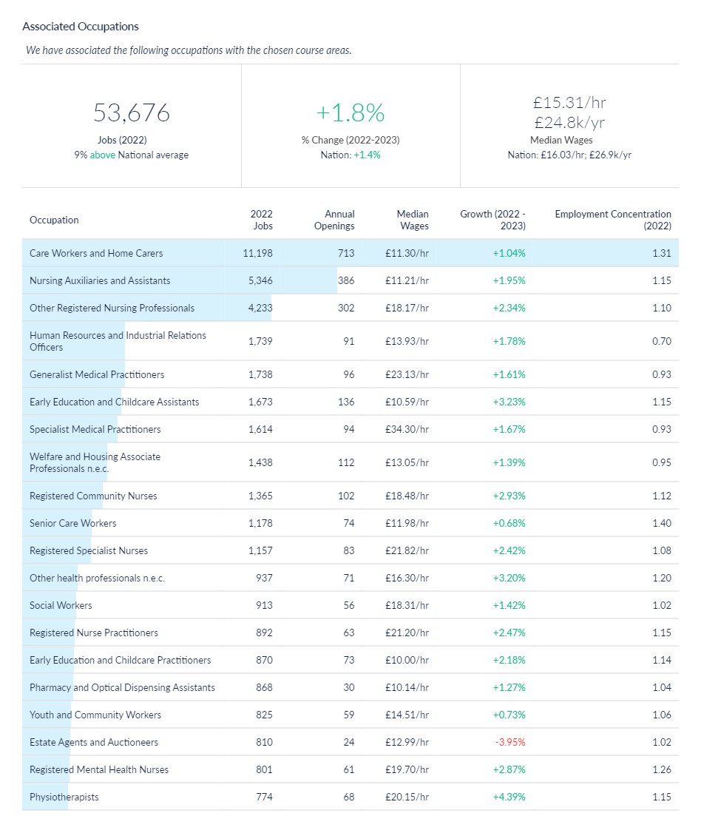
Health and social care job postings – associated occupations
An alternative method of estimating the scale of manufacturing and engineering jobs across the Dorset LSIP area is to understand what types of jobs/occupations tend to be filled by those individuals who undertook health and/or care related training (at SSA 2 level). In effect this represents the ‘occupational pathways’ (as described in the data notes slide). This analysis is available via Lightcast (utilised for this analysis) which have developed the Lightcast Occupation Taxonomy which aims to link skills acquisition to occupations.
Based on this methodological approach, it is estimated that there were c54,500 jobs in 2022 across the Dorset LSIP area in occupations health and/or care courses (SSA2) –medicine, dentistry, nursing, care provision etc. The number of jobs in associated occupations has increased by 1.8% between 2022 and 2023 across the Dorset LSIP area.
Source: Lightcast, 2023

Slide 11
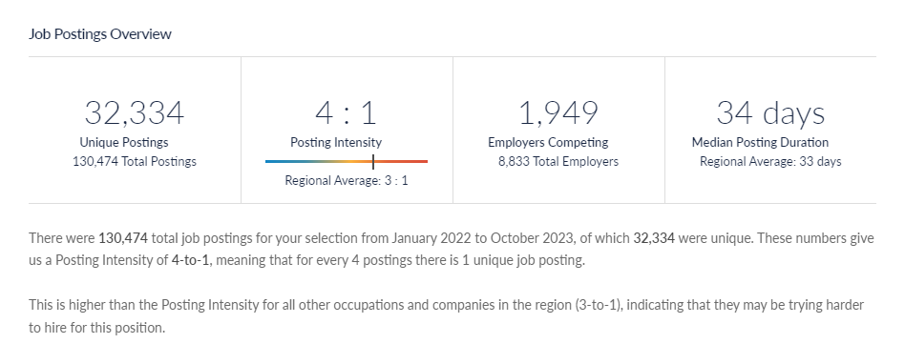
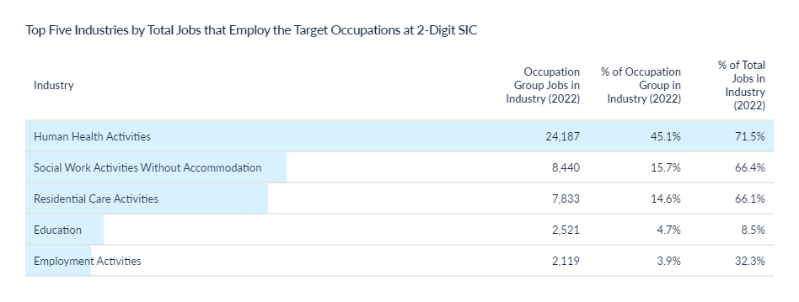
Health and social care job postings - volume
There c33,000 job postings across 2022 and 2023 (to date) relating to the associated health and care occupations. The health and care sector remains the sector with the most significant labour demand as illustrated by advertised vacancies.
Typically, jobs are posted 4x before being filled (posting intensity of 4:1), although (as shown on the following slides) this does vary across roles.
Source: Lightcast, 2023

Slide 12
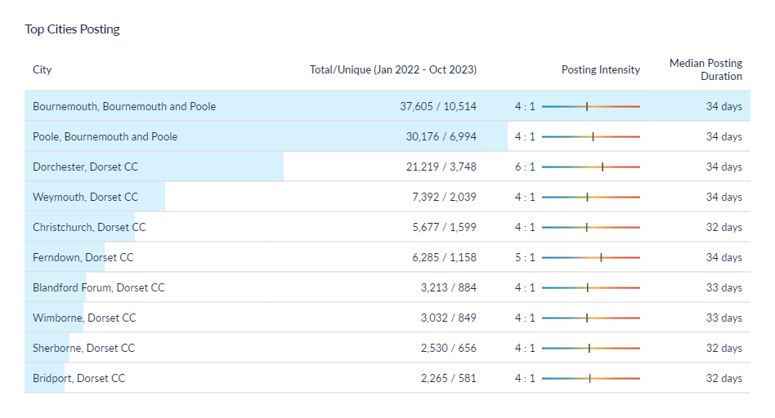
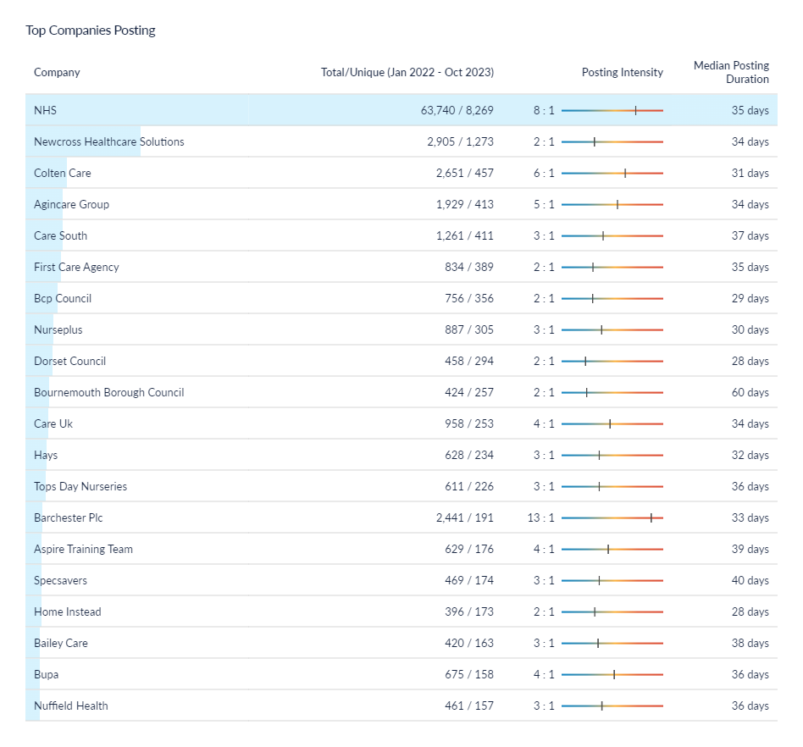
Health and social care job postings – location and recruiters
* Christchurch is defined within Lightcast as being in the Dorset Council area – this classification does not reflect the post-April 2019 Local Government restructure
As would be expected, the NHS is by far the largest recruiter, and the largest recruiter across the Dorset LSIP as a whole. However, some of the care providers (public and private) are also significant recruiters.
Source: Lightcast, 2023

Slide 13
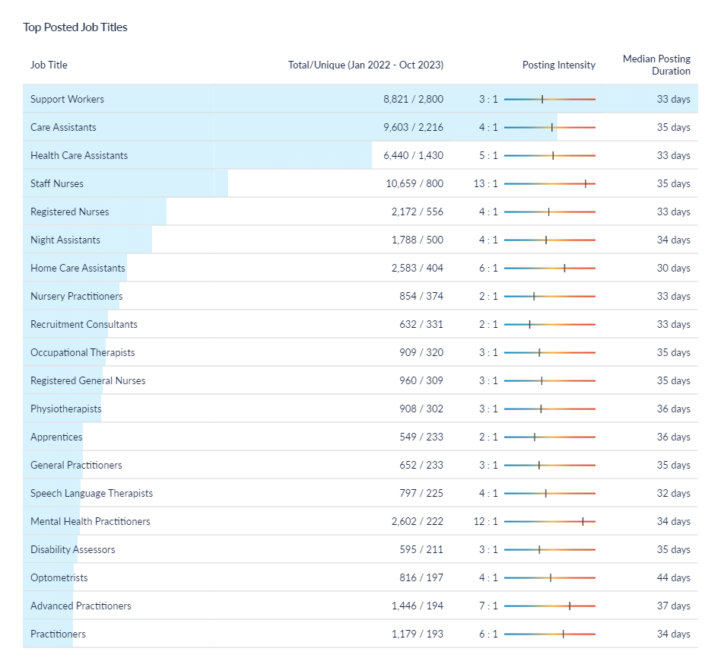
Health and social care job postings – role demand
The most common job postings within the associated occupations are support workers, care assistants, health care assistants and staff nurses. Again, this data is using a taxonomy that charts the roles/jobs that tend to be filled by individuals that undertook health and/or care courses (SSA2 level).
The data indicated that those roles that are most in demand (as measured by online job postings) tend to be low-to-medium skill levels – particularly in the care sector. The data also illustrates that there are particular roles which are obviously difficult to recruit into – most notably staff nurses and mental health practitioners (with a relative posting intensity of 13:1 and 12:1). This, markedly highlights the recruitment difficulties and skills shortages in those positions.
It is important to note that this slide details the job vacancy postings i.e. dynamic demand. This compares to some earlier slides (e.g. slide 9) which illustrated the level of job roles across the Dorset LSIP area.
Source: Lightcast, 2023

Slide 14
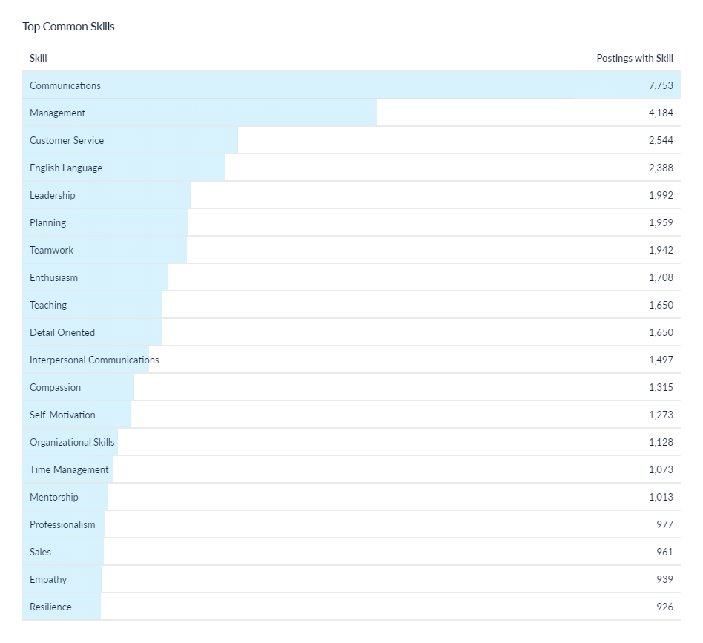
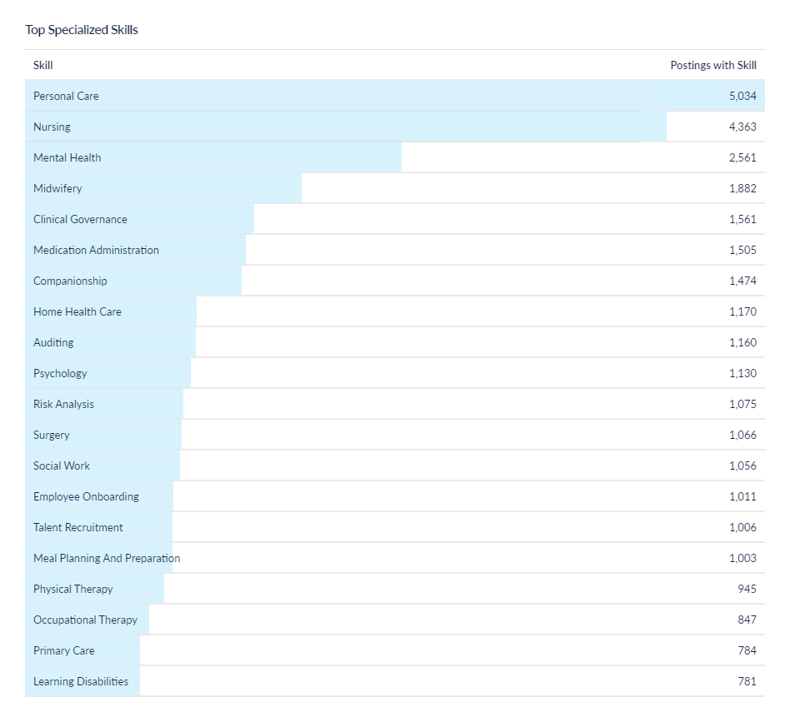
Health and social care job postings – skills (1)
Source: Lightcast, 2023

Slide 15
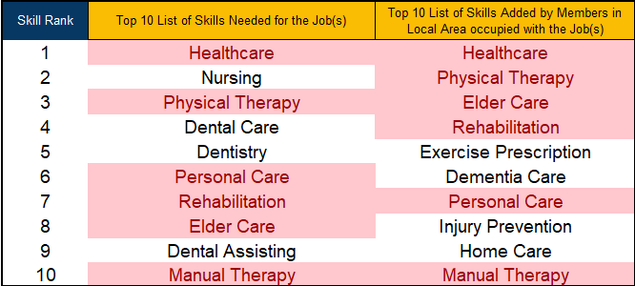
Health and social care job postings – skills (2)
Source: LinkedIn – LSIP Programme Team

