Slide 1

Agritech/Land Based – overview
Autumn 23 update

Slide 2

Data notes
This sector dashboard uses a combination of data published via the Office of National Statistics (ONS) and also utilises vacancy data via Lightcast
Lightcast is a global leader in labour market analytics. This dashboard primarily uses Lightcast job posting analytics and focuses on the Dorset LSIP area and trends over time
It is important to note that the analysis here only reflects jobs that are posted online. It effectively ‘scrapes’ a range of job websites, alongside candidate profiles
Lightcast uses sophisticated software to try remove duplicates i.e. jobs posted repeatedly, but recognises that this may remain an issue for some postings
Because it captures online job postings only, it cannot capture informal job vacancies and recruitment. It is important to recognise that in some sectors such as construction recruitment tends to be more ‘informal’ and will not be reflected in the data here. This may also be more prevalent in small and micro businesses
It is also important to note that the analysis attempts to differentiate between sectors and ‘occupational pathways’. That is, some of the requirements for certain skills do not necessarily occur in tightly defined sectors. For example, digital skills are important across a whole range of sectors, whilst many people working in construction do not necessarily work in the construction sector per. This utilises the Lightcast Occupation Taxonomy – see later slide around definition
Given there will be some short-term volatility in job posting data, the analysis here covers the period Jan 2022 to Sept 2023. This will serve to ‘smooth’ some of the data and for the use Dorset LSIP analysis – longer-term trends are important
Christchurch is defined within Lightcast as being in the Dorset Council area – this classification does not reflect the post-April 2019 Local Government restructure

Slide 3
Definitions (1)
Standard Industrial Classification (SIC) based approach
– slides 4 and 5
Lightcast occupational taxonomy – slides 10 to 14
Working Futures analysis – slide 6

Slide 4
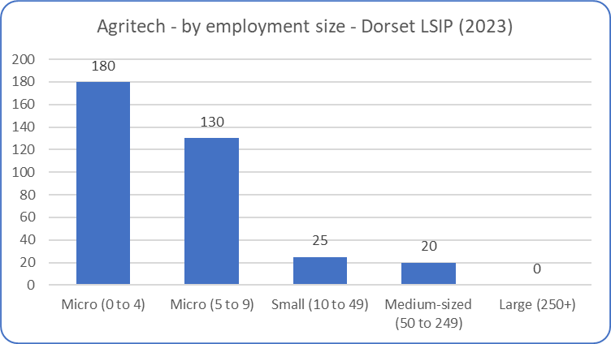
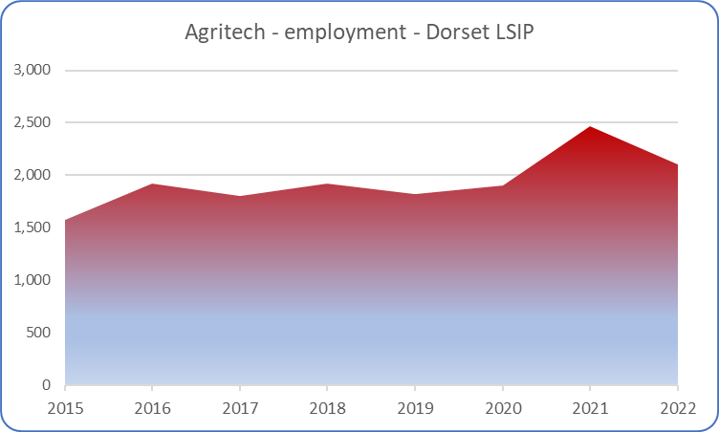
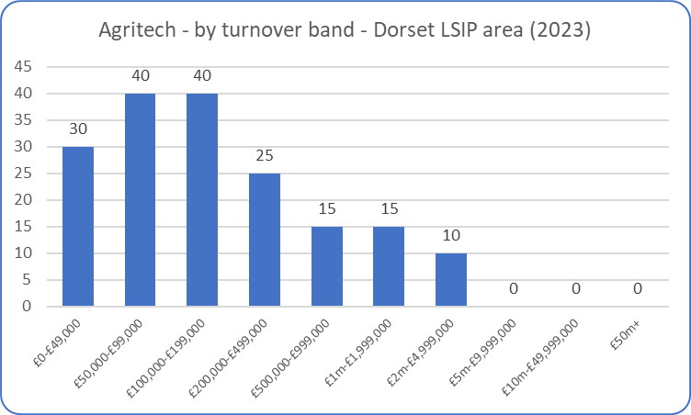
Agritech - overview
Agritech is a difficult sector to define (effectively it means the use of technology within agriculture), and more difficult in building a picture with regards to data. However, based on a definition that encapsulates innovation-heavy activities such as agrochemicals, R&D in biotechnology, alongside more ‘traditional’ agricultural activities – the data suggests that after rising steadily employment may have dipped between 2021 and 2022. The sector is dominated by small and micro businesses, with the majority of businesses employing fewer than 10 people.
Source: ONS (Business Register and Employment Survey and UK Business Counts)
* All figures are rounded to avoid disclosure. Values may be rounded down to zero and so all zeros are not necessarily true zeros

Slide 5
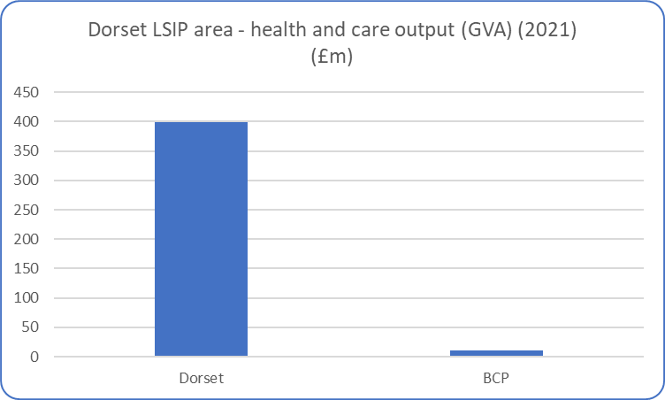
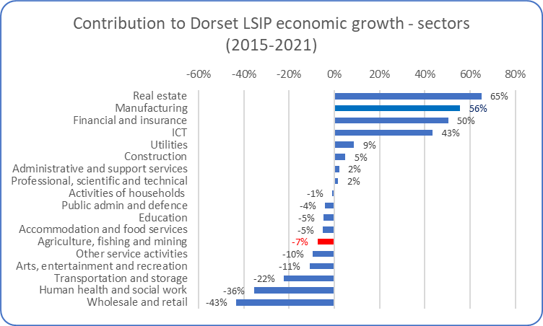
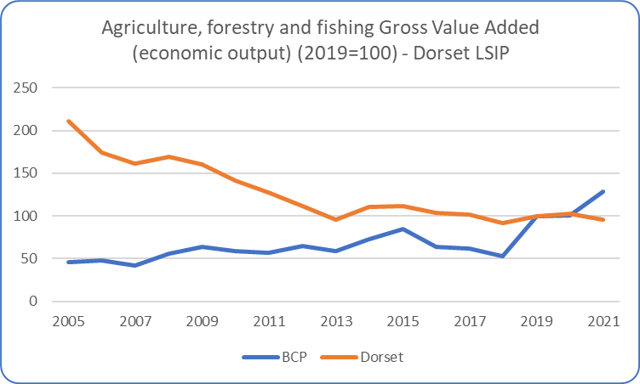
Agritech – overview (2)
As would be expected, the (broad) agricultural sector (which includes forestry and fishing) is much larger in Dorset County than in BCP – reflecting the rural/urban characteristics of both areas (top left chart). What is marked is that the sector has experience a steady decline over the past 10-15 years in terms of output. In terms of output (as measured by Gross Value Added) it is a smaller sector than 10-15 years ago. This decline in output is relatively marked.
Consequently, it has not played a significant part in overall economic growth across the Dorset LSIP area (above right chart), although obviously it plays a fundamental wider societal role i.e. food production, environmental protection and enhancement etc.
Source: ONS (Sub-regional (Balanced) Gross Value Added)

Slide 6
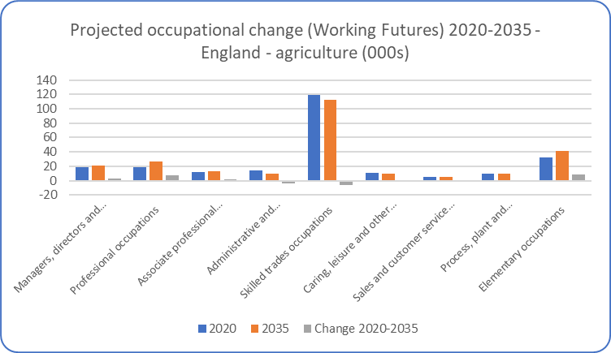
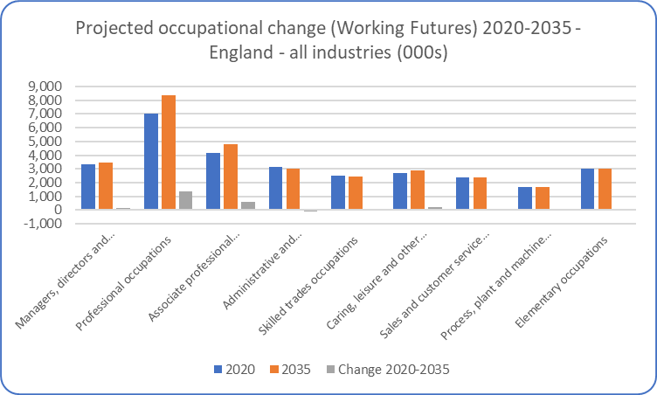
Agritech – future projections
The latest Labour Market and Skills projections produced through the Working Futures programme - covering the period 2020-2035 and the first produced in a post-Covid environment – projects that overall employment in agriculture will marginally increase over the 10-15 years. The data presented here is at a national (England) level.
The projections expect employment to slightly increase in agriculture and land-based industries over the next 10-15 years, this reverses the historical reduction in jobs over the longer term. The projections are that most jobs will remain in skilled trade occupations (in terms of broad occupational groups).
The projections are intended to provide a statistical foundation for reflection and debate among all those with an interest in the demand for and supply of skills. They are produced because historical evidence shows that changing patterns of employment by sector and occupation tend to largely dominated by longer-term trends rather than the cyclical position of the economy or short-term impacts. However, it is obvious that these projections are subject to high degrees of uncertainty and therefore we would urge careful interpretation of these projections. They are intended as a starting point for further analysis rather than a projection of what is most likely to happen. They represent one possible future.
Source: Working Futures 2020-2035

Slide 7
Agritech – key research findings
The top issues for skills development in sector have been grouped into:
1) Labour substitution through automation:
    skills for engineering, soft robotics, AI and data are growing in importance and more supply will be needed to meet industry needs
    An agile workforce with higher levels of technical skills
    Applied research and skills in new disciplines
Meeting existing skills shortages in industry:
- The industry has had a historical reliance on inward migration. There remains a continued challenge for employers in meeting basic skills. Employers report problems with a lack of ‘practical’ focus in new recruits and would like to see short technical courses for the existing workforce in the winter
Meeting the demand for research and development staff:
- Shortages in these areas and the ability to attract talent been accentuated post-Brexit

Slide 8
Agritech – key research findings
4) Young people and progression:
  Recognised challenges in equipping young people for entry level jobs in the industry, given the problems created by the rapid increase in ‘tickets’ needed. Industry struggling with developing appropriate models into industry, particularly within HE. Employers feel industry needs to work with training providers to link into schools, develop internships and other innovative models to develop experience
  Attracting talent to the industry:
  - The image of the industry remains an issue in terms of attracting new staff, either as young people or career changers later in life. Employers also recognise industry needs to address working conditions and improve rewards
  Meeting the demand for trainers:
  - Important to ensure that the industry can ensure that it has a supply of committed and highly qualified trainers. Recruitment into ‘teaching roles’ is challenging, with many later in their working life. There are recruitment difficulties, with training roles in areas such as engineering competing with higher paid opportunities within the wider economy
Source: Miscellaneous – including University of Exeter Centre for Rural Policy Research, South West Agritech, Agriculture in the UK Evidence Pack (Defra), Agritech East. The South West Farm Survey, Automation in horticulture review (Defra) etc.

Slide 9
Land Based* (SSA2)
- noting this is wider than Agritech
Autumn 23 update
Data covering 2022 – 2023 (to date)

Slide 10
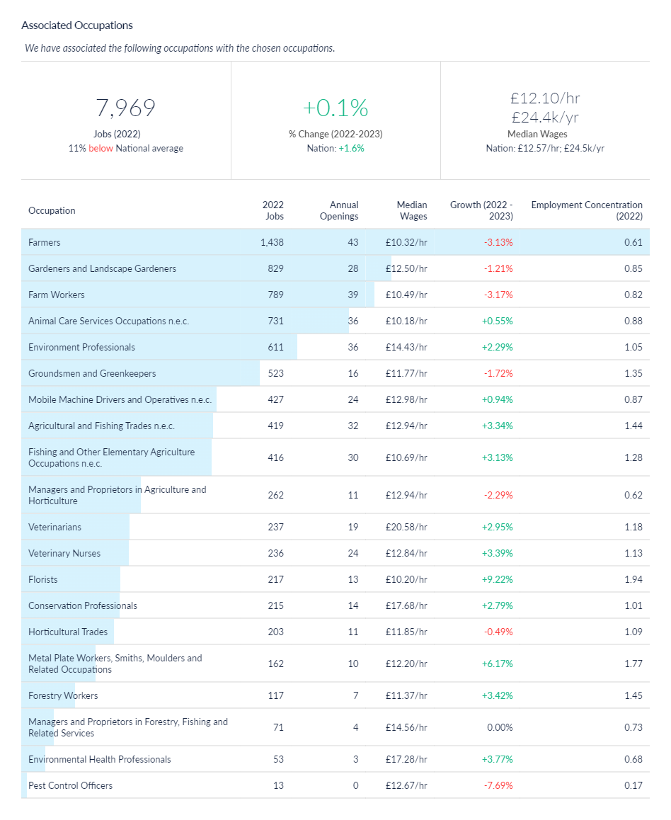
Land Based, agriculture job postings – associated occupations
An alternative method of estimating the scale of agricultural related jobs/occupations across the Dorset LSIP area is to understand what types of jobs tend to be filled by those individuals who undertook agricultural-related training (at SSA 2 level). In effect this represents the ‘occupational pathways’ (as described in the data notes slide). This analysis is available via Lightcast (utilised for this analysis) which have developed the Lightcast Occupation Taxonomy which aims to link skills acquisition to occupations.
Based on this methodological approach, it is estimated that there were c8,000 jobs in 2022 across the Dorset LSIP area in occupations associated with agriculture (SSA2). This includes land based courses (SSA2) – which include agriculture, horticulture and forestry, animal care and veterinary science and environmental conservation. The number of jobs in associated occupations has increased by 0.1% between 2022 and 2023 across the Dorset LSIP area.
Source: Lightcast, 2023

Slide 11
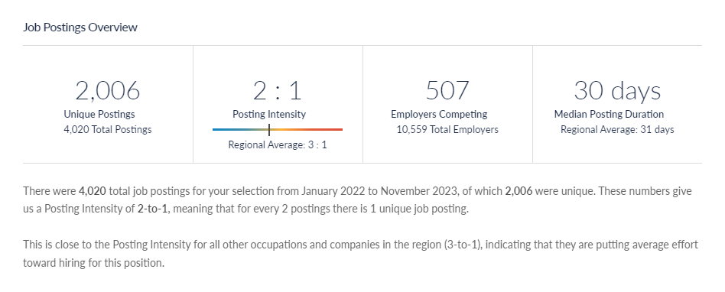
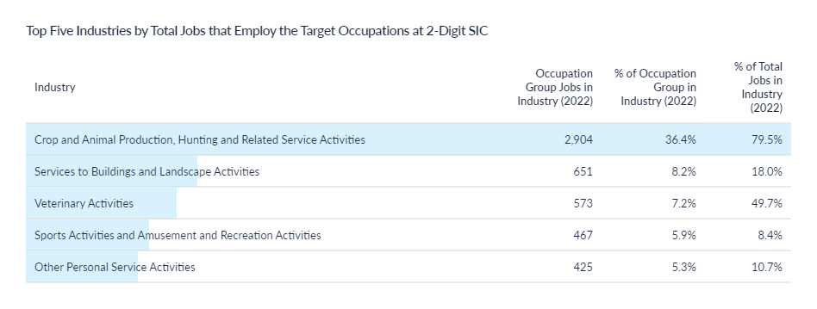
Land Based, agriculture job postings - volume
There c2,000 job postings across 2022 and 2023 (to date) relating to the occupations associated with agriculture and land-based activities courses (SSA2).
Typically, jobs are posted twice before being filled (posting intensity of 2:1), and this has remained broadly stable over time. There were c480 organisations recruiting into such positions across the Dorset LSIP area.
Source: Lightcast, 2023

Slide 12
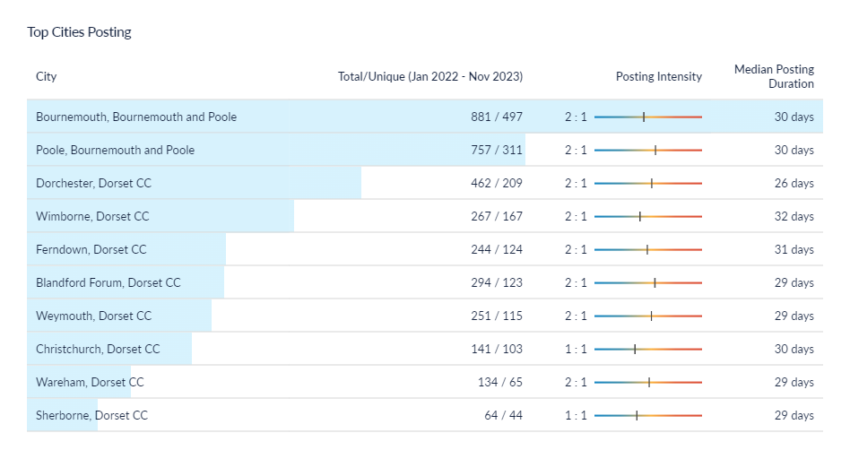
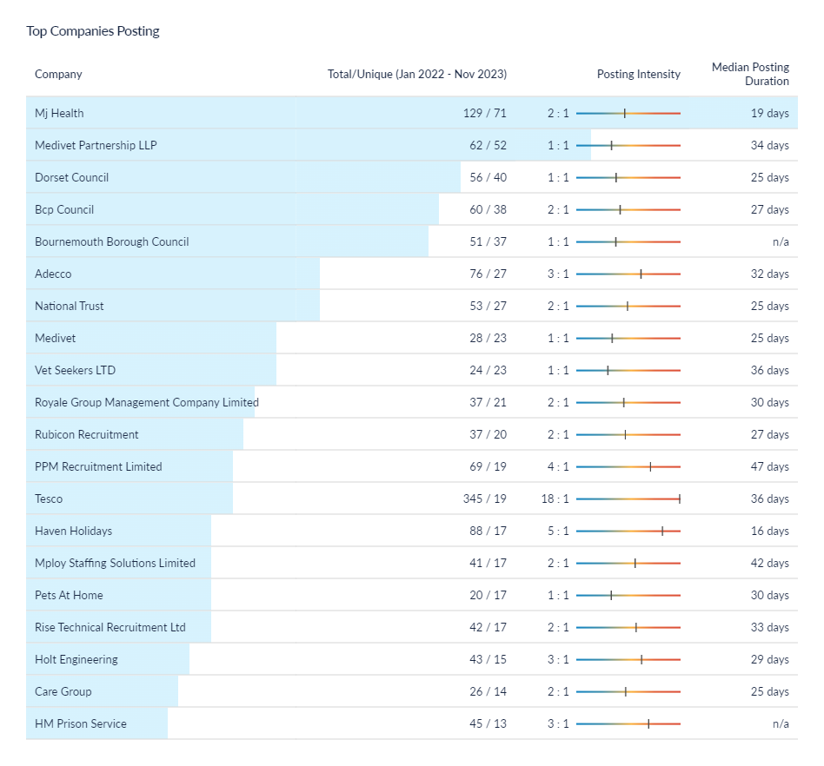
Land Based, agriculture job postings – location and recruiters
* Christchurch is defined within Lightcast as being in the Dorset Council area – this classification does not reflect the post-April 2019 Local Government restructure
One of the aspects to note is that - in terms of top recruiters – is the inclusion of veterinary practices. The other aspect to note is that the scale of advertised vacancies – when compared to the other identified Dorset LSIP priorities – is much lower. The volume of advertised vacancies across the top recruiters is relatively defined.
Source: Lightcast, 2023

Slide 13
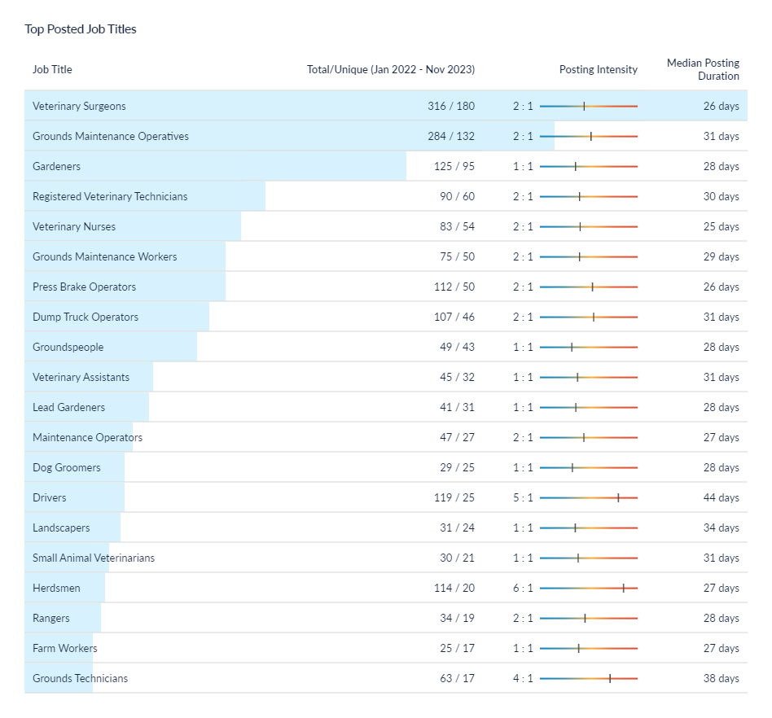
Land Based, agriculture job postings – role demand
The most common job postings within the associated occupations are veterinary surgeons, ground maintenance operatives etc. Again, this data is using a taxonomy that charts the roles/jobs that tend to be filled by individuals that undertook agricultural and/or land-based courses (SSA2 level).
The data indicated that those roles that are most in demand (as measured by online job postings) are a mixture of high skills (i.e. veterinary surgeons) and low-to-medium skill levels (ground maintenance, gardeners etc.)
It is important to note that this slide details the job vacancy postings i.e. dynamic demand. This compares to some earlier slides (e.g. slide 9) which illustrated the level of job roles across the Dorset LSIP area.
Source: Lightcast, 2023

Slide 14
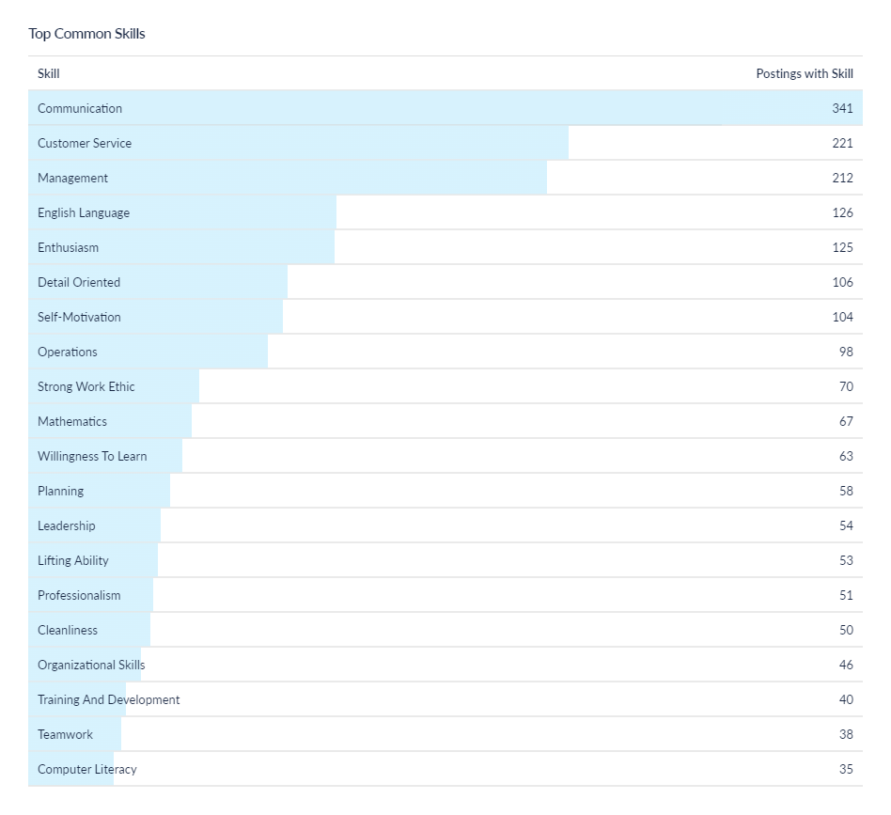
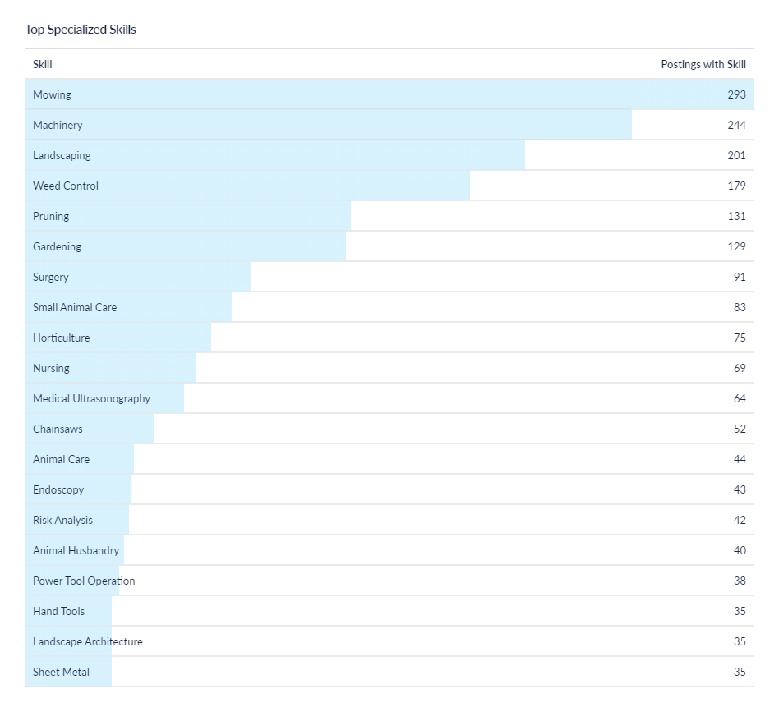
Land Based, agriculture job postings - skills
The most sought after specialised skills appear to predominantly relate to land-based activities. They do not appear to specifically relate to farming – probably illustrating that much of the recruitment in agricultural remains ‘informal’ i.e. roles not advertised through online channels. In terms of common (soft) skills, these broadly aligned with those seen in other priority sectors i.e. communication, management skills etc.
Source: Lightcast, 2023

